Slide 1
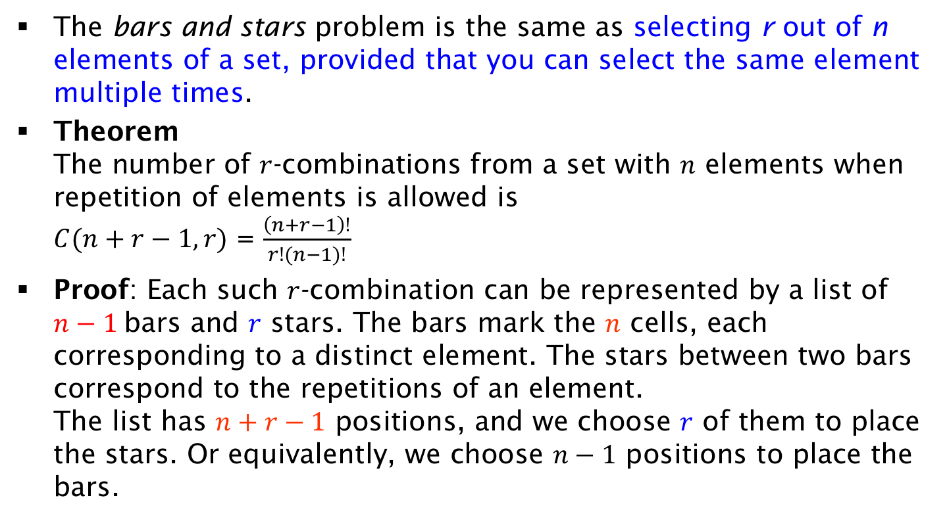
Combinations with Repetition (bars and stars)
The bars and stars problem is the same as selecting r out of n elements of a set, provided that you can select the same element multiple times.
Theorem
The number of $r$-combinations from a set with $n$ elements when repetition of elements is allowed is
$C(n+r−1,r)$ = $\frac{\left(n+r−1\right)!}{r!(n−1)!}$
Proof: Each such $r$-combination can be represented by a list of $n−1$ bars and $r$ stars. The bars mark the $n$ cells, each corresponding to a distinct element. The stars between two bars correspond to the repetitions of an element.
The list has $n+r−1$ positions, and we choose $r$ of them to place the stars. Or equivalently, we choose $n−1$ positions to place the bars.

