Slide 1
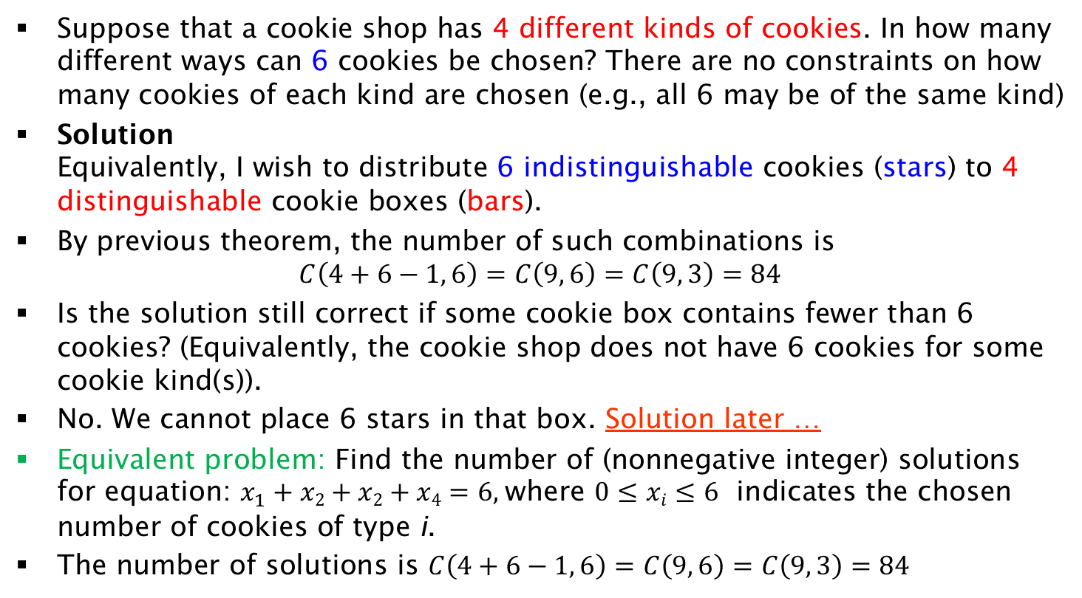
Example of Combinations with Repetition
Suppose that a cookie shop has 4 different kinds of cookies. In how many different ways can 6 cookies be chosen? There are no constraints on how many cookies of each kind are chosen (e.g., all 6 may be of the same kind)
Solution
Equivalently, I wish to distribute 6 indistinguishable cookies (stars) to 4 distinguishable cookie boxes (bars).
By previous theorem, the number of such combinations is
$C\left(4+6−1, 6\right)=C\left(9, 6\right)=C\left(9, 3\right)=84$
Is the solution still correct if some cookie box contains fewer than 6 cookies? (Equivalently, the cookie shop does not have 6 cookies for some cookie kind(s)).
No. We cannot place 6 stars in that box. Solution later …
Equivalent problem: Find the number of (nonnegative integer) solutions for equation: $x_{1}+x2+x2+x4=6$, where $0≤xi≤6$ indicates the chosen number of cookies of type i.
The number of solutions is $C\left(4+6−1, 6\right)=C\left(9, 6\right)=C\left(9, 3\right)=84$

