Slide 1
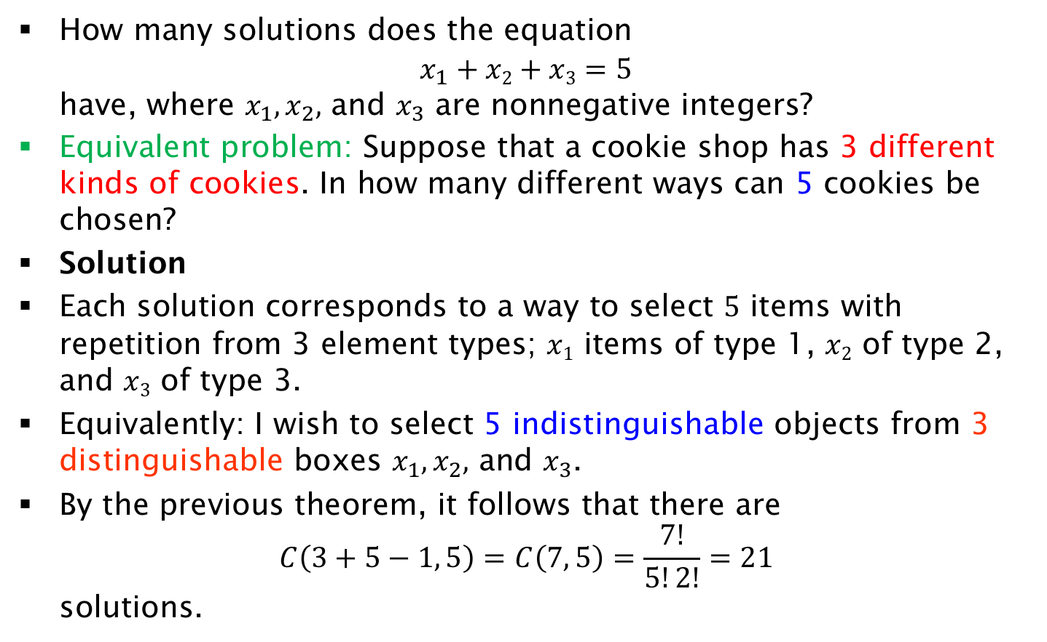
Exercise on Equation Solutions
How many solutions does the equation
$x_{1}+x2+x3=5$
have, where $x_{1},x_{2},$ and $x_{3}$ are nonnegative integers?
Equivalent problem: Suppose that a cookie shop has 3 different kinds of cookies. In how many different ways can 5 cookies be chosen?
Solution
Each solution corresponds to a way to select 5 items with repetition from 3 element types; $x1$ items of type 1, $x2$ of type 2, and $x3$ of type 3.
Equivalently: I wish to select 5 indistinguishable objects from 3 distinguishable boxes $x_{1},x_{2},$ and $x_{3}$.
By the previous theorem, it follows that there are
$C\left(3+5−1, 5\right)=C\left(7, 5\right)=\frac{7!}{5!2!}=21$
solutions.

