Slide 1
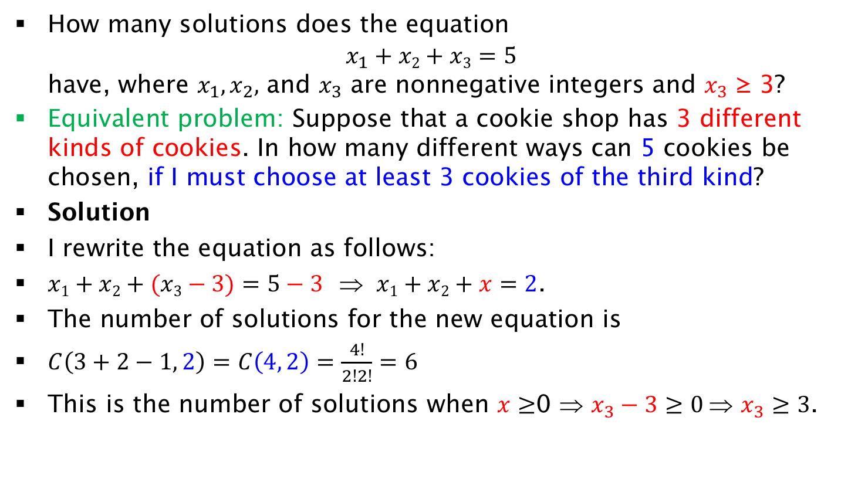
Exercise on Equation Solutions with minimum constraint
How many solutions does the equation
$x_{1}+x2+x3=5$
have, where $x_{1},x_{2},$ and $x_{3}$ are nonnegative integers and $x_{3}$ ≥ 3?
Equivalent problem: Suppose that a cookie shop has 3 different kinds of cookies. In how many different ways can 5 cookies be chosen, if I must choose at least 3 cookies of the third kind?
Solution
I rewrite the equation as follows:
$x1+x2+(x3−3)=5−3$ ⇒ $x1+x2+x=2$.
The number of solutions for the new equation is
$C\left(3+2−1, 2\right)=C\left(4, 2\right)=\frac{4!}{2!2!}=6$
This is the number of solutions when $x≥$0 ⇒ $x_{3}−3≥0 \text{⇒} x_{3}≥3$.

