Slide 1
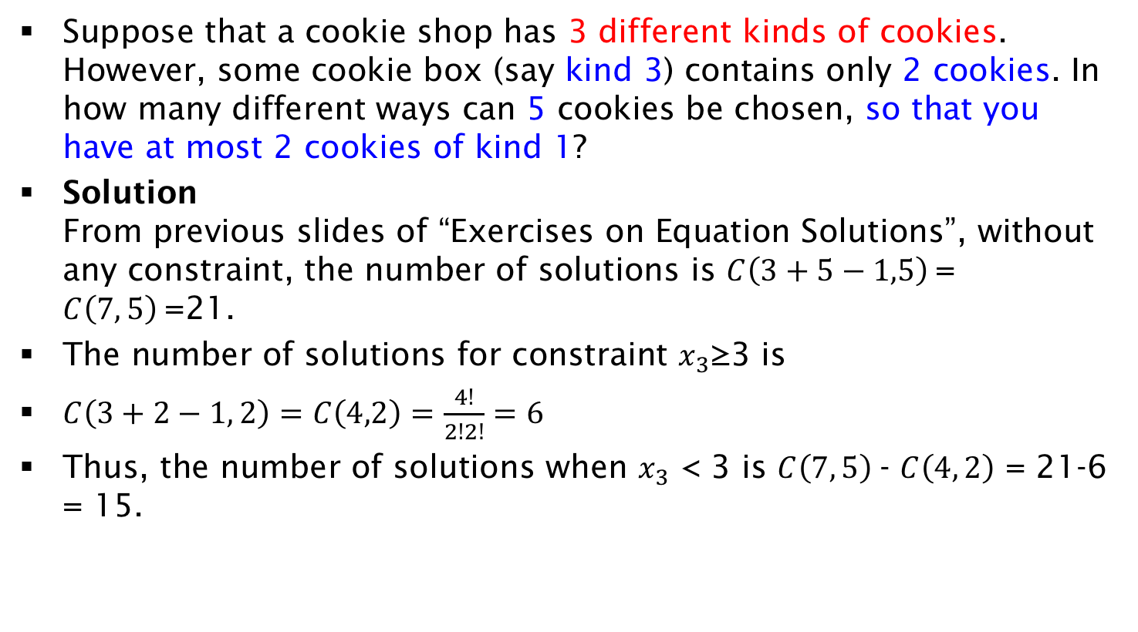
Exercise on Equation Solutions with maximum constraint
Suppose that a cookie shop has 3 different kinds of cookies. However, some cookie box (say kind 3) contains only 2 cookies. In how many different ways can 5 cookies be chosen, so that you have at most 2 cookies of kind 1?
Solution
From previous slides of “Exercises on Equation Solutions”, without any constraint, the number of solutions is $C\left(3+5−1,5\right)$= $C\left(7, 5\right)$=21.
The number of solutions for constraint $x_{3}$≥3 is
$C\left(3+2−1, 2\right)=C\left(4,2\right)=\frac{4!}{2!2!}=6$
Thus, the number of solutions when $x_{3}$ < 3 is $C\left(7, 5\right)$- $C\left(4, 2\right)$ = 21-6 = 15.

