Slide 1
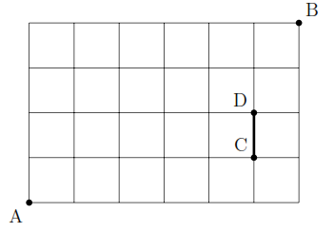
Exercise on Paths 1
In the following picture, starting from A we wish to reach B, by taking edges Up or Right. How many different paths (two paths are different if they differ in at least one edge) exist from A to B such that.
(i)There are no restrictions. Hint: Any path from A to B is a combination of Up and Right moves for a total of 10.
  Each path from A to B contains 10 edges, 4 of which must go up. Finding a specific path is just a matter of deciding when to take the up moves out of the 10 total available moves: C(10, 4) ways. The rest must go right.
(ii) You have to pass from CD edge.
  6 (ways from A to C) x 3 (ways from D to B) = 18
(iii) You can not pass from CD edge.
  C(10, 4) - 18

