Slide 1
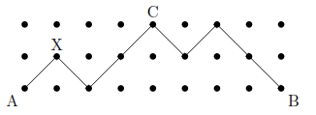
Exercise on Paths 2
Consider the following picture. You are only allowed to move ↗ (one to the right and up) and ↘ (one to the right and down) only. In how many ways you can get from A to B such that:
(i) There are no restrictions. Hint: Note that in order to get from A to B you have to pass from some certain points like X.
The path has to pass from the middle point (e.g., X) of every other column. There are 4 such points (in red). The path between any two successive red points has only two options (top or bottom row). Total number of paths 2³.
(ii) You want to pass from C.
2 (ways from A to C) x 2 (ways from C to B) = 4

