Slide 1
Binomial Coefficients
Binomial Theorem
Pascal’s Identity and Triangle
Some Other Identities
Reading: Rosen 6.4

Slide 2



Binomial Expression
Coefficient of
  = number of length-3 lists having y in 2 places.

Slide 3
Binomial Expression Expansion
Coefficient of
  = number of length-3 lists having y in 2 places.

Slide 4
Binomial Expression Expansion
Coefficient of
  = number of length-3 lists having y in 2 places.

Slide 5
Binomial Expression Expansion
Coefficient of
  = number of length-3 lists having y in 2 places.

Slide 6
Binomial Expression Expansion
Coefficient of
  = number of length-3 lists having y in 2 places.
You can think of x as 0 and y as 1 in a bitstring
  The equivalent question is how many bit strings have exactly 2 1's: C(3,2).

Slide 7
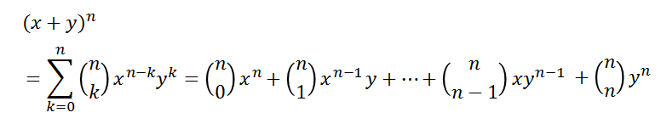
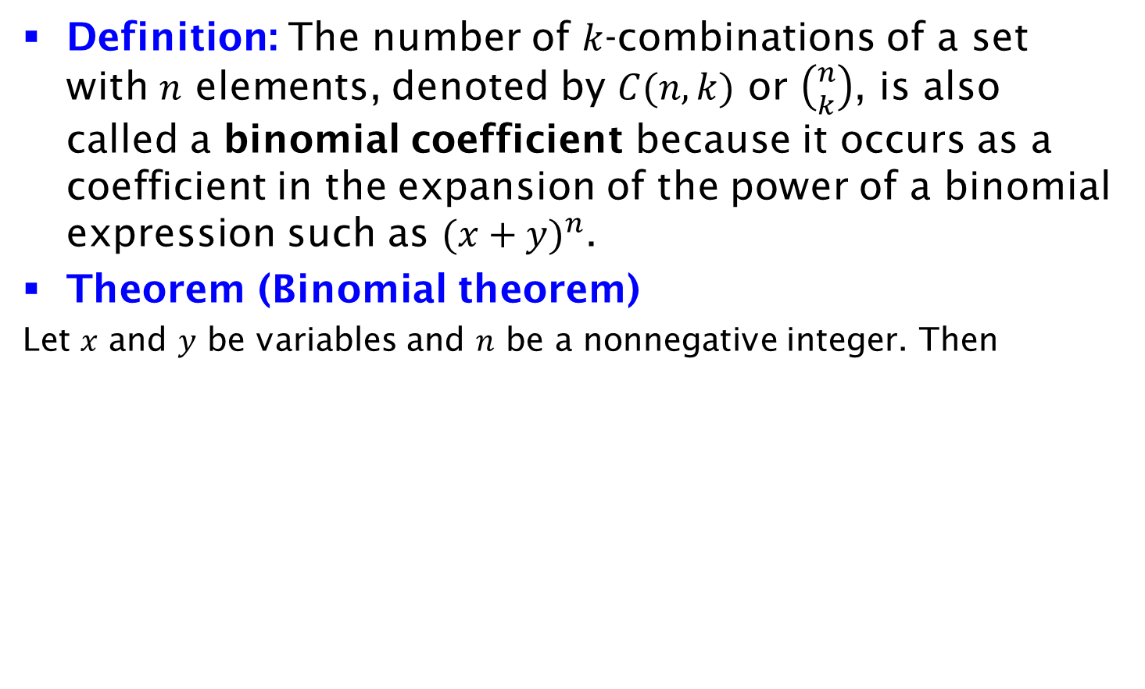
Binomial Theorem
Definition: The number of $k$-combinations of a set with $n$ elements, denoted by $C(n, k)$ or $\left({n \atop k}\right)$, is also called a binomial coefficient because it occurs as a coefficient in the expansion of the power of a binomial expression such as ${(x+y)}^{n}$.
Theorem (Binomial theorem)
Let $x$ and $y$ be variables and $n$ be a nonnegative integer. Then

Slide 8
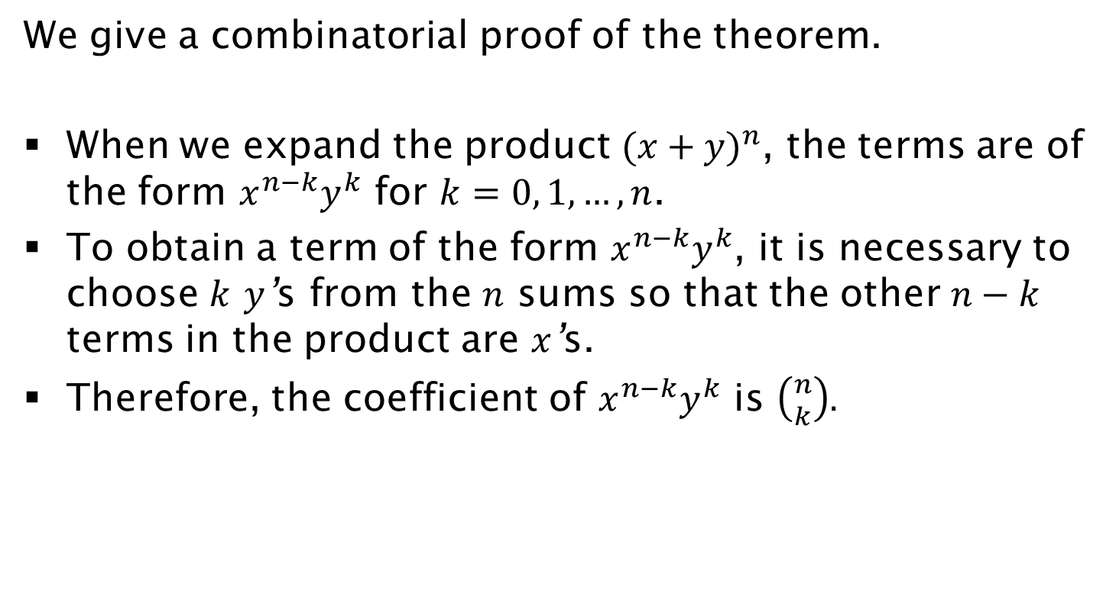
Proof
We give a combinatorial proof of the theorem.
When we expand the product ${(x+y)}^{n}$, the terms are of the form $x^{n−k}y^{k}$ for $k=0, 1, …, n$.
To obtain a term of the form $x^{n−k}y^{k}$, it is necessary to choose $k$ $y$’s from the $n$ sums so that the other $n−k$ terms in the product are $x$’s.
Therefore, the coefficient of $x^{n−k}y^{k}$ is $\left({n \atop k}\right).$

Slide 9
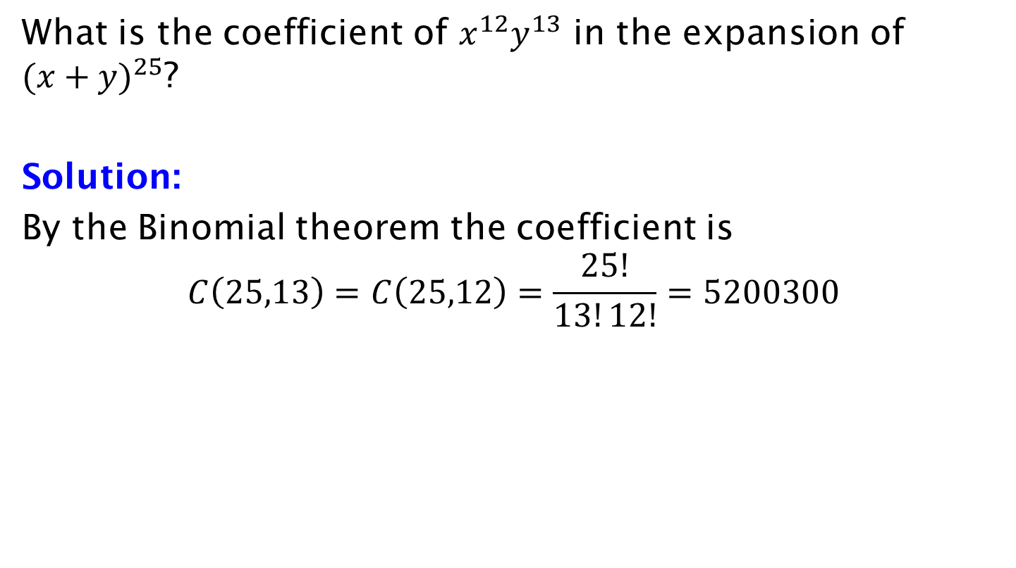
Example
What is the coefficient of $x^{12}y^{13}$ in the expansion of ${(x+y)}^{25}$?
Solution:
By the Binomial theorem the coefficient is
$$C\left(25,13\right)=C\left(25,12\right)=\frac{25!}{13!12!}=5200300$$

Slide 10
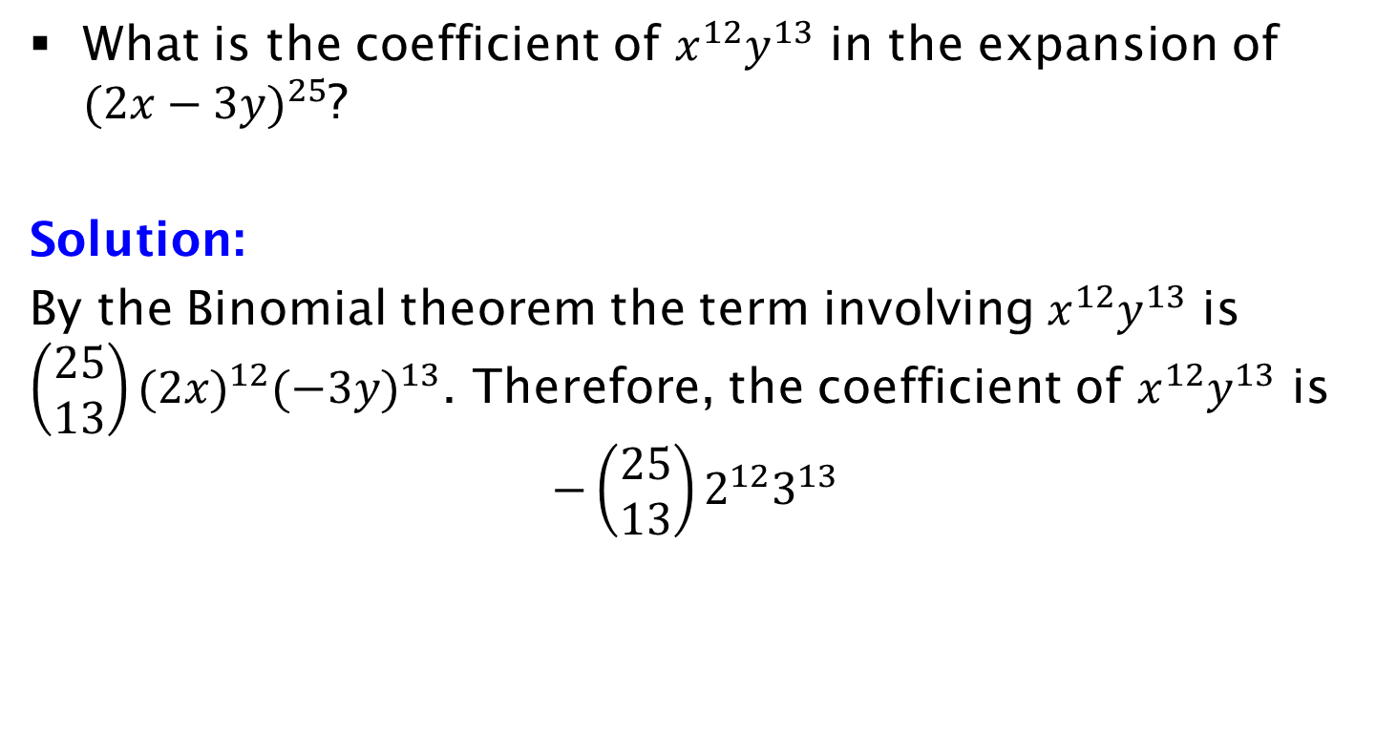
Example
What is the coefficient of $x^{12}y^{13}$ in the expansion of ${(2x−3y)}^{25}$?
Solution:
By the Binomial theorem the term involving $x^{12}y^{13}$ is $\left(\begin{aligned}25 \\ 13\end{aligned}\right){(2x)}^{12}{(−3y)}^{13}$. Therefore, the coefficient of $x^{12}y^{13}$ is
$$−\left(\begin{aligned}25 \\ 13\end{aligned}\right)2^{12}3^{13}$$

Slide 11
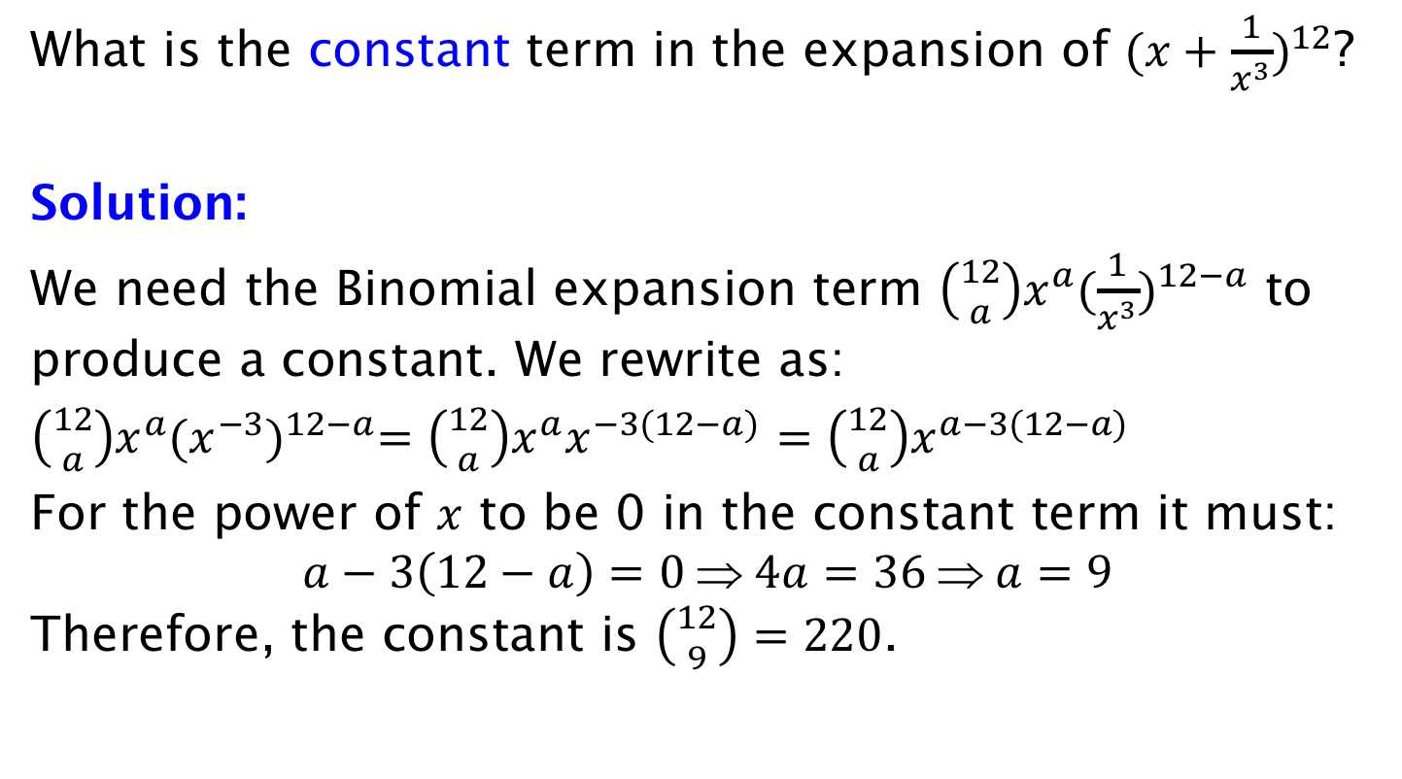
Example
What is the constant term in the expansion of ${(x+\frac{1}{x^{3}})}^{12}$?
Solution:
We need the Binomial expansion term $\left({12 \atop a}\right)x^{a}{(\frac{1}{x^{3}})}^{12−a}$ to produce a constant. We rewrite as:
$\left({12 \atop a}\right)x^{a}{(x^{−3})}^{12−a}=\left({12 \atop a}\right)x^{a}x^{−3(12−a)}$ $=\left({12 \atop a}\right)x^{a−3(12−a)}$
For the power of $x$ to be 0 in the constant term it must:
$$a−3\left(12−a\right)=0 ⇒ 4a=36 ⇒ a=9$$
Therefore, the constant is $\left({12 \atop 9}\right)=220$.

Slide 12
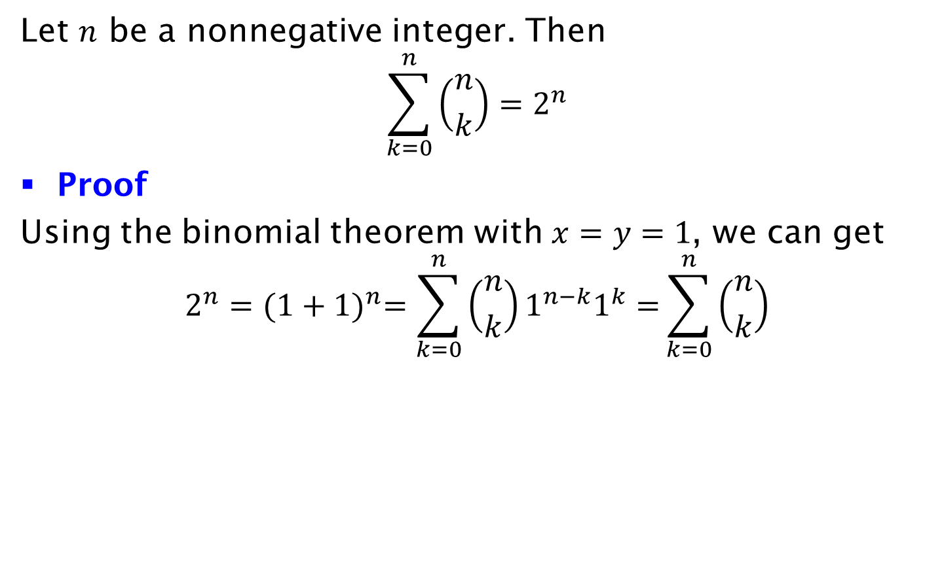
Corollary
Let $n$ be a nonnegative integer. Then
$$\sum_{k=0}^{n}{\left({n \atop k}\right)=2^{n}}$$
Proof
Using the binomial theorem with $x=y=1$, we can get
$$2^{n}={(1+1)}^{n}=\sum_{k=0}^{n}{\left({n \atop k}\right)1^{n−k}1^{k}=}\sum_{k=0}^{n}{\left({n \atop k}\right)}$$

Slide 13
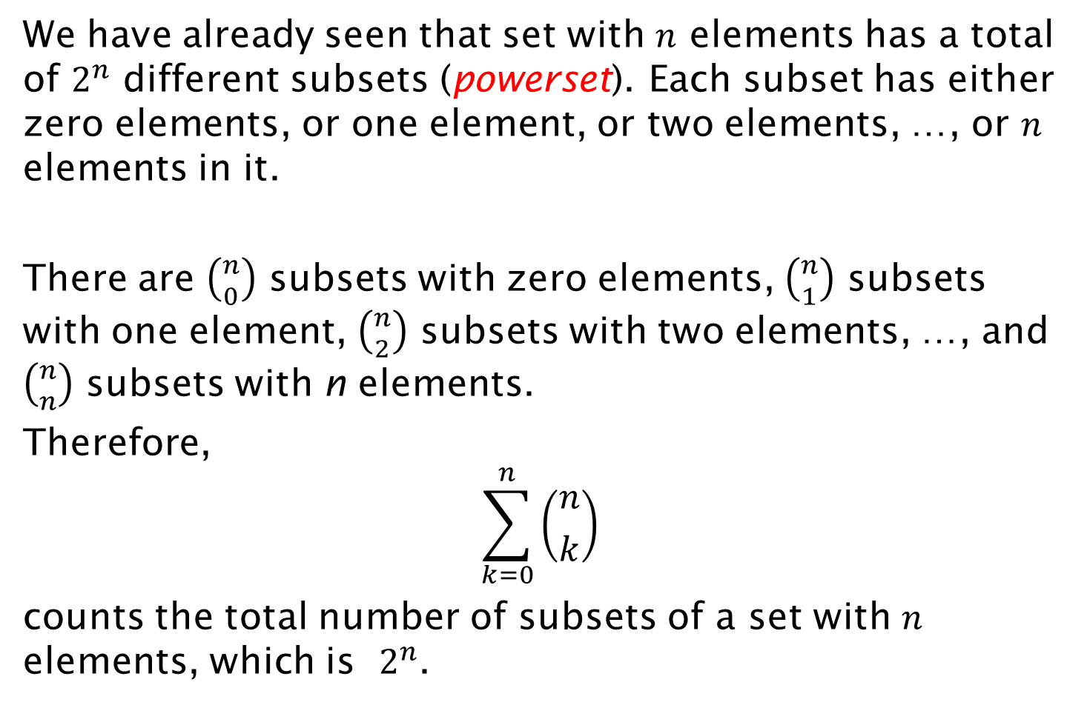
Alternative: Combinatorial Proof
We have already seen that set with $n$ elements has a total of $2^{n}$ different subsets (powerset). Each subset has either zero elements, or one element, or two elements, …, or $n$ elements in it.
There are $\left({n \atop 0}\right)$ subsets with zero elements, $\left({n \atop 1}\right)$ subsets with one element, $\left({n \atop 2}\right)$ subsets with two elements, …, and $\left({n \atop n}\right)$ subsets with n elements.
Therefore,
$$\sum_{k=0}^{n}{\left({n \atop k}\right)}$$
counts the total number of subsets of a set with $n$ elements, which is $2^{n}$.

Slide 14
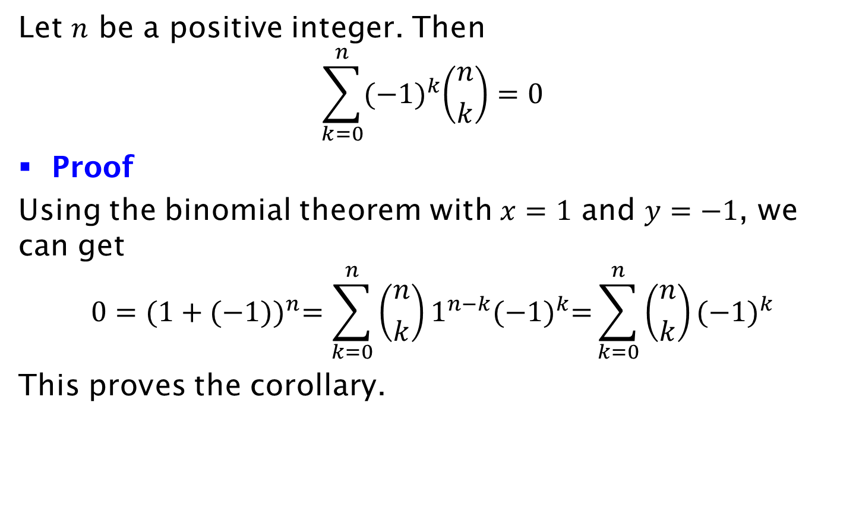
Corollary
Let $n$ be a positive integer. Then
$$\sum_{k=0}^{n}{{(−1)}^{k}\left({n \atop k}\right)=0}$$
Proof
Using the binomial theorem with $x=1$ and $y=−1$, we can get
$$0={(1+(−1))}^{n}=\sum_{k=0}^{n}{\left({n \atop k}\right)1^{n−k}{(−1)}^{k}=}\sum_{k=0}^{n}{\left({n \atop k}\right){(−1)}^{k}}$$
This proves the corollary.

Slide 15
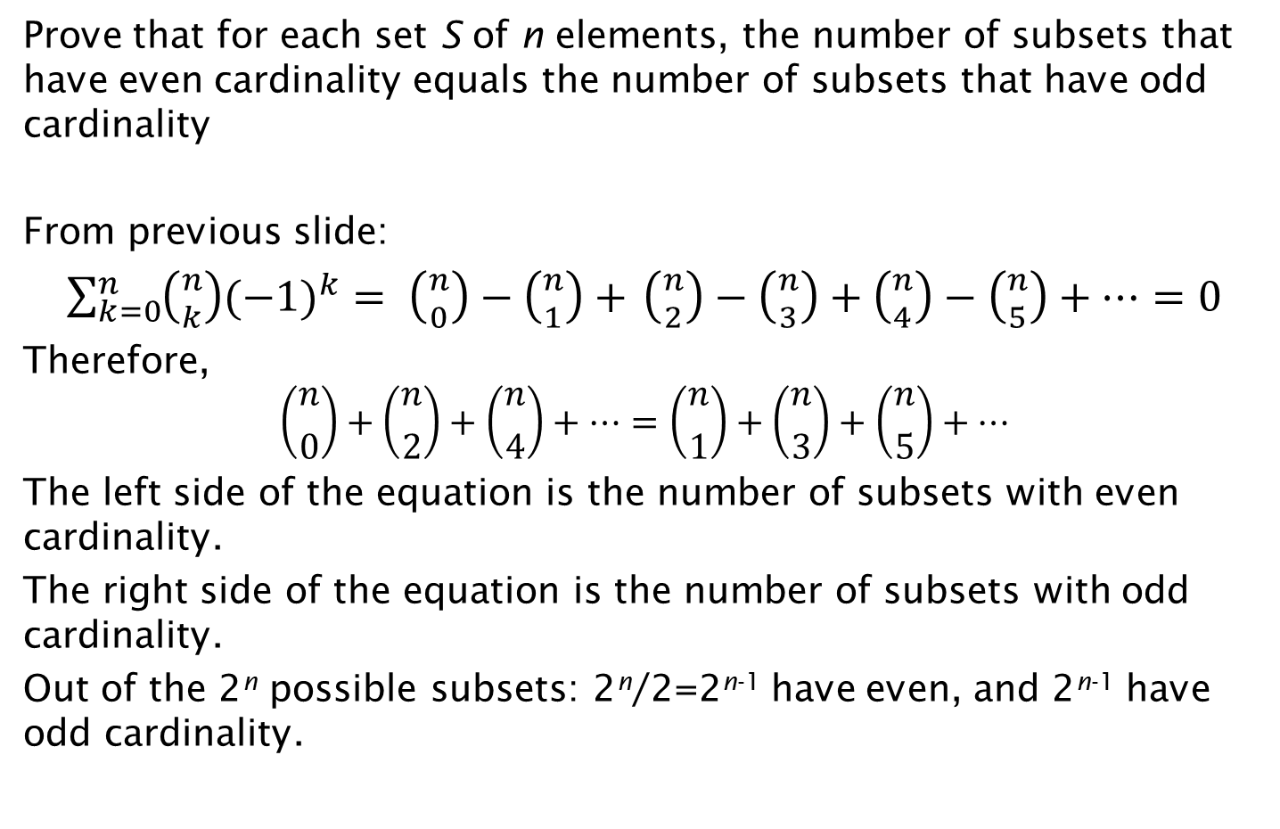
Exercise on Number of Subsets
Prove that for each set S of n elements, the number of subsets that have even cardinality equals the number of subsets that have odd cardinality
From previous slide:
$\sum_{k=0}^{n}{\left({n \atop k}\right){(−1)}^{k}}= \left({n \atop 0}\right)−\left({n \atop 1}\right)+$ $\left({n \atop 2}\right)−\left({n \atop 3}\right)+\left({n \atop 4}\right)−\left({n \atop 5}\right)+…=0$
Therefore,
$$\left({n \atop 0}\right)+\left({n \atop 2}\right)+\left({n \atop 4}\right)+…=\left({n \atop 1}\right)+\left({n \atop 3}\right)+\left({n \atop 5}\right)+…$$
The left side of the equation is the number of subsets with even cardinality.
The right side of the equation is the number of subsets with odd cardinality.
Out of the 2^{n} possible subsets: 2^{n}/2=2^{n-1} have even, and 2^{n-1} have odd cardinality.

Slide 16
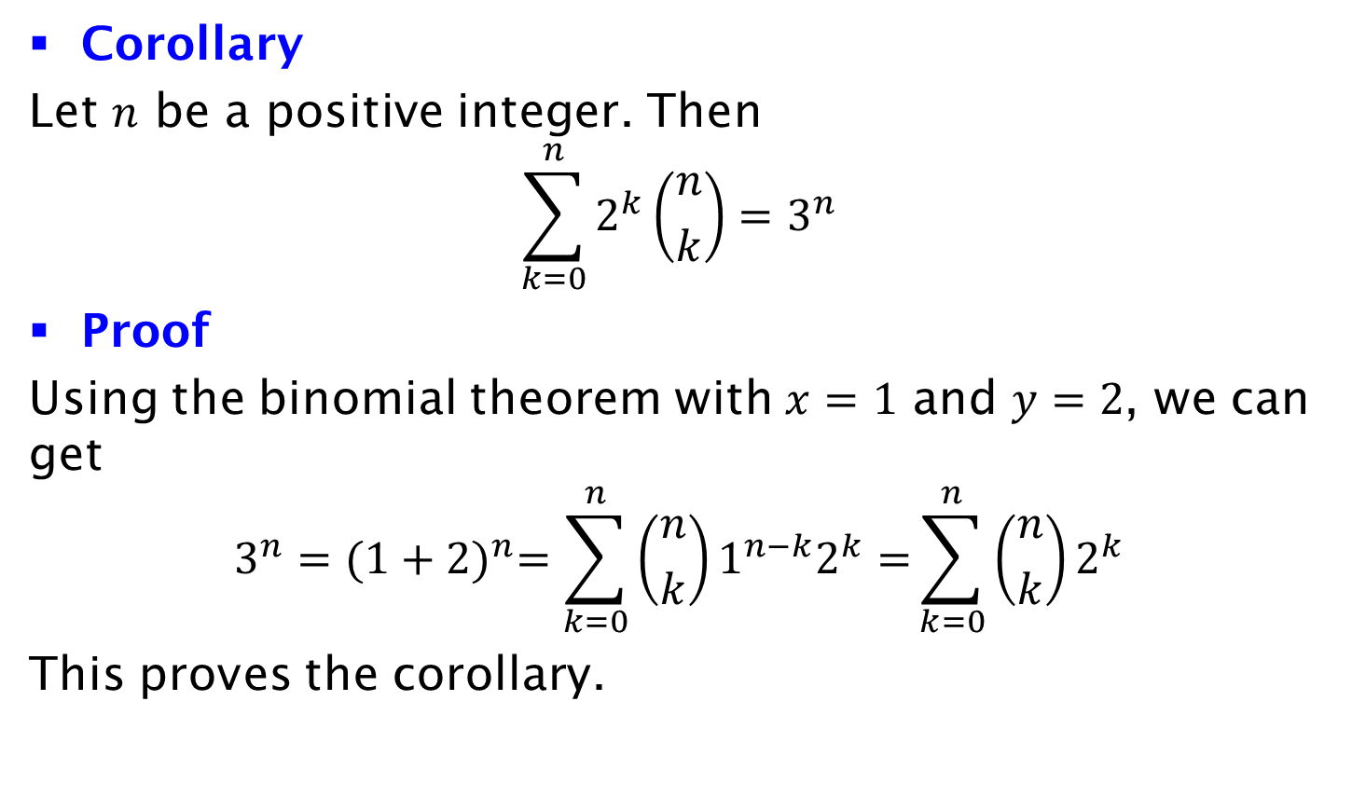
Corollary
Corollary
Let $n$ be a positive integer. Then
$$\sum_{k=0}^{n}{2^{k}\left({n \atop k}\right)=3^{n}}$$
Proof
Using the binomial theorem with $x=1$ and $y=2$, we can get
$$3^{n}={(1+2)}^{n}=\sum_{k=0}^{n}{\left({n \atop k}\right)1^{n−k}2^{k}=}\sum_{k=0}^{n}{\left({n \atop k}\right)2^{k}}$$
This proves the corollary.

Slide 17
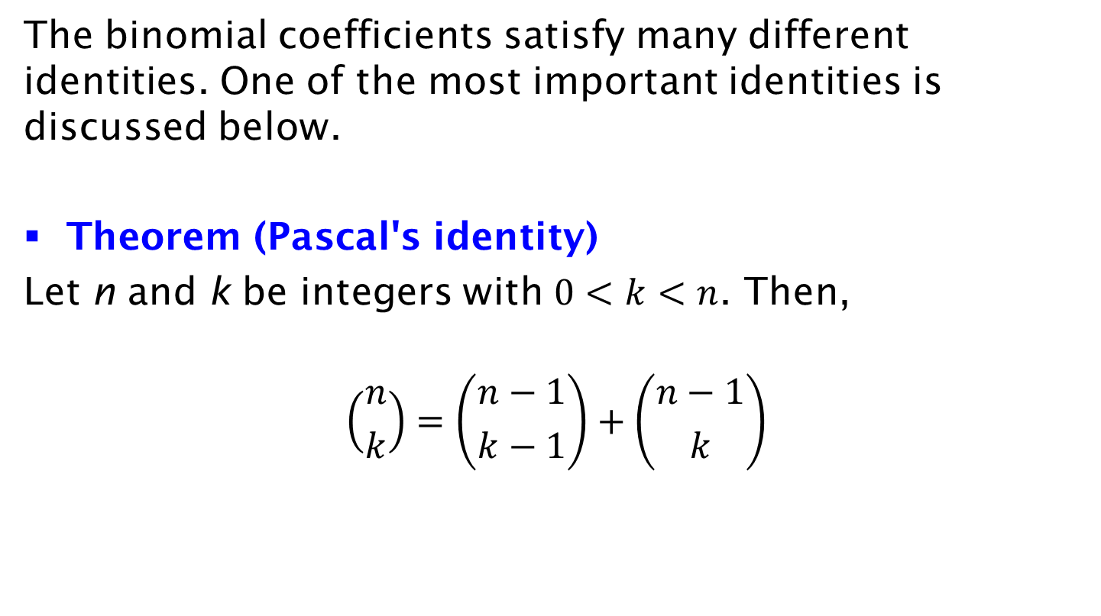
Pascal's Identity
The binomial coefficients satisfy many different identities. One of the most important identities is discussed below.
Theorem (Pascal's identity)
Let n and k be integers with $0<k<n$. Then,
$$\left({n \atop k}\right)=\left({n−1 \atop k−1}\right)+\left({n−1 \atop k}\right)$$

Slide 18




Example of Pascal's Identity for n=5, k=2
Let X = {A, B, C, D, E}
S = 2-combinations of X
= {those containing E} U {those without E}
= S₁ U S₂
S₁ = { {A,E}, {B,E}, {C,E}, {D,E} }
i.e., 1-combinations from {A,B,C,D}
|S₁| =
S₂ = {{A,B}, {A,C}, {A,D}, {B,C}, {B,D}, {C,D}}
i.e., 2-combinations from {A, B, C, D}
|S₂| =

Slide 19
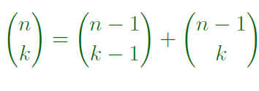
Proof
#k-combinations of {1,2,3,…,n}
#k-combinations of {1,2,3,…, n-1} not containing last element
#(k-1)-combinations of {1,2,3, …, n-1} containing last element
Use the Sum Rule for the total number of combinations

Slide 20
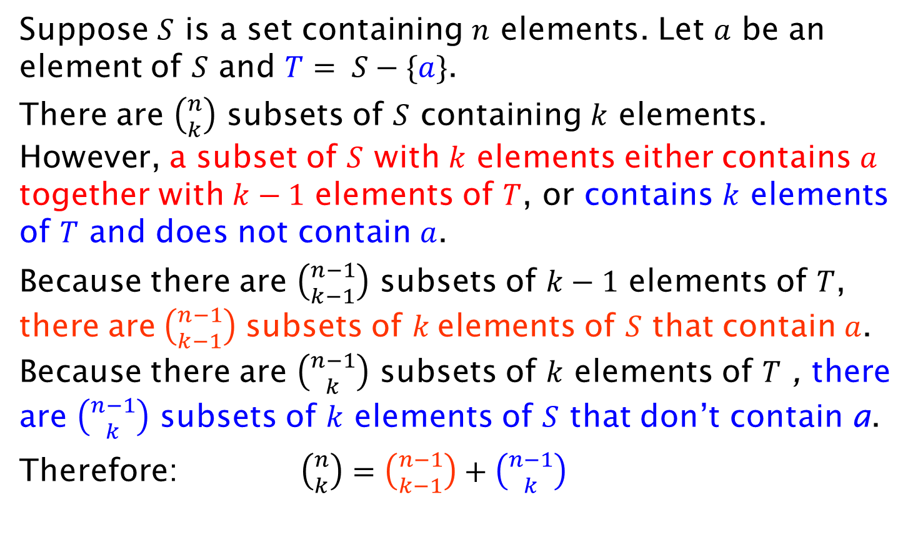
Combinatorial proof of Pascal’s identity
Suppose $S$ is a set containing $n$ elements. Let $a$ be an element of $S$ and $T= S−\{a\}$.
There are $\left({n \atop k}\right)$ subsets of $S$ containing $k$ elements. However, a subset of $S$ with $k$ elements either contains $a$ together with $k−1$ elements of $T$, or contains $k$ elements of $T$ and does not contain $a$.
Because there are $\left({n−1 \atop k−1}\right)$ subsets of $k−1$ elements of $T$, there are$\left({n−1 \atop k−1}\right)$ subsets of $k$elements of $S$ that contain $a$. Because there are $\left({n−1 \atop k}\right)$ subsets of $k$ elements of $T$ , there are $\left({n−1 \atop k}\right)$ subsets of $k$ elements of $S$ that don’t contain a.
Therefore: $\left({n \atop k}\right)=\left({n−1 \atop k−1}\right)+\left({n−1 \atop k}\right)$

Slide 21



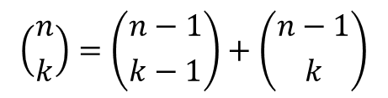
Pascal’s Triangle (1641)
$$\left({n \atop k}\right)=\left({n−1 \atop k−1}\right)+\left({n−1 \atop k}\right)$$
Corollary
Pascal's identity, together with the initial conditions $\left({n \atop 0}\right)=\left({n \atop n}\right)=1$ for all integers n, can be used to give a geometric arrangement of the binomial coefficients in a triangle, called Pascal's triangle, as follows:

Slide 22
Pascal’s Triangle (1641)
$$\left({n \atop k}\right)=\left({n−1 \atop k−1}\right)+\left({n−1 \atop k}\right)$$
Corollary
Pascal's identity, together with the initial conditions $\left({n \atop 0}\right)=\left({n \atop n}\right)=1$ for all integers n, can be used to give a geometric arrangement of the binomial coefficients in a triangle, called Pascal's triangle, as follows:

Slide 23
Pascal’s Triangle (1641)
$$\left({n \atop k}\right)=\left({n−1 \atop k−1}\right)+\left({n−1 \atop k}\right)$$
Corollary
Pascal's identity, together with the initial conditions $\left({n \atop 0}\right)=\left({n \atop n}\right)=1$ for all integers n, can be used to give a geometric arrangement of the binomial coefficients in a triangle, called Pascal's triangle, as follows:

Slide 24
Pascal’s Triangle (1641)
$$\left({n \atop k}\right)=\left({n−1 \atop k−1}\right)+\left({n−1 \atop k}\right)$$
Corollary
Pascal's identity, together with the initial conditions $\left({n \atop 0}\right)=\left({n \atop n}\right)=1$ for all integers n, can be used to give a geometric arrangement of the binomial coefficients in a triangle, called Pascal's triangle, as follows:

Slide 25
Pascal’s Triangle (1641)
$$\left({n \atop k}\right)=\left({n−1 \atop k−1}\right)+\left({n−1 \atop k}\right)$$
Corollary
Pascal's identity, together with the initial conditions $\left({n \atop 0}\right)=\left({n \atop n}\right)=1$ for all integers n, can be used to give a geometric arrangement of the binomial coefficients in a triangle, called Pascal's triangle, as follows:

Slide 26
Pascal’s Triangle (1641)
$$\left({n \atop k}\right)=\left({n−1 \atop k−1}\right)+\left({n−1 \atop k}\right)$$
Corollary
Pascal's identity, together with the initial conditions $\left({n \atop 0}\right)=\left({n \atop n}\right)=1$ for all integers n, can be used to give a geometric arrangement of the binomial coefficients in a triangle, called Pascal's triangle, as follows:

Slide 27
Pascal’s Triangle (1641)
$$\left({n \atop k}\right)=\left({n−1 \atop k−1}\right)+\left({n−1 \atop k}\right)$$
Corollary
Pascal's identity, together with the initial conditions $\left({n \atop 0}\right)=\left({n \atop n}\right)=1$ for all integers n, can be used to give a geometric arrangement of the binomial coefficients in a triangle, called Pascal's triangle, as follows:

Slide 28


Pascal’s Triangle
X
The numbers of distinct paths to each square by a rook, when only rightward and downward movements are considered.
Yang Hui triangle (12??)

Slide 29
Pascal’s Triangle
X
The numbers of distinct paths to each square by a rook, when only rightward and downward movements are considered.
Yang Hui triangle (12??)

Slide 30
Pascal’s Triangle
X
The numbers of distinct paths to each square by a rook, when only rightward and downward movements are considered.
Yang Hui triangle (12??)

Slide 31
Pascal’s Triangle
X
The numbers of distinct paths to each square by a rook, when only rightward and downward movements are considered.
Yang Hui triangle (12??)

Slide 32
Pascal’s Triangle
X
The numbers of distinct paths to each square by a rook, when only rightward and downward movements are considered.
Yang Hui triangle (12??)

Slide 33
Pascal’s Triangle
X
The numbers of distinct paths to each square by a rook, when only rightward and downward movements are considered.
Yang Hui triangle (12??)

Slide 34
Pascal’s Triangle
20=C(6,3) – There is a total of 6 moves down/right. If we select the 3 moves down (or right), we fix the entire path.
Yang Hui triangle (12??)

Slide 35
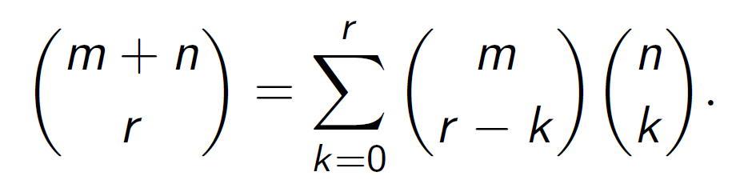
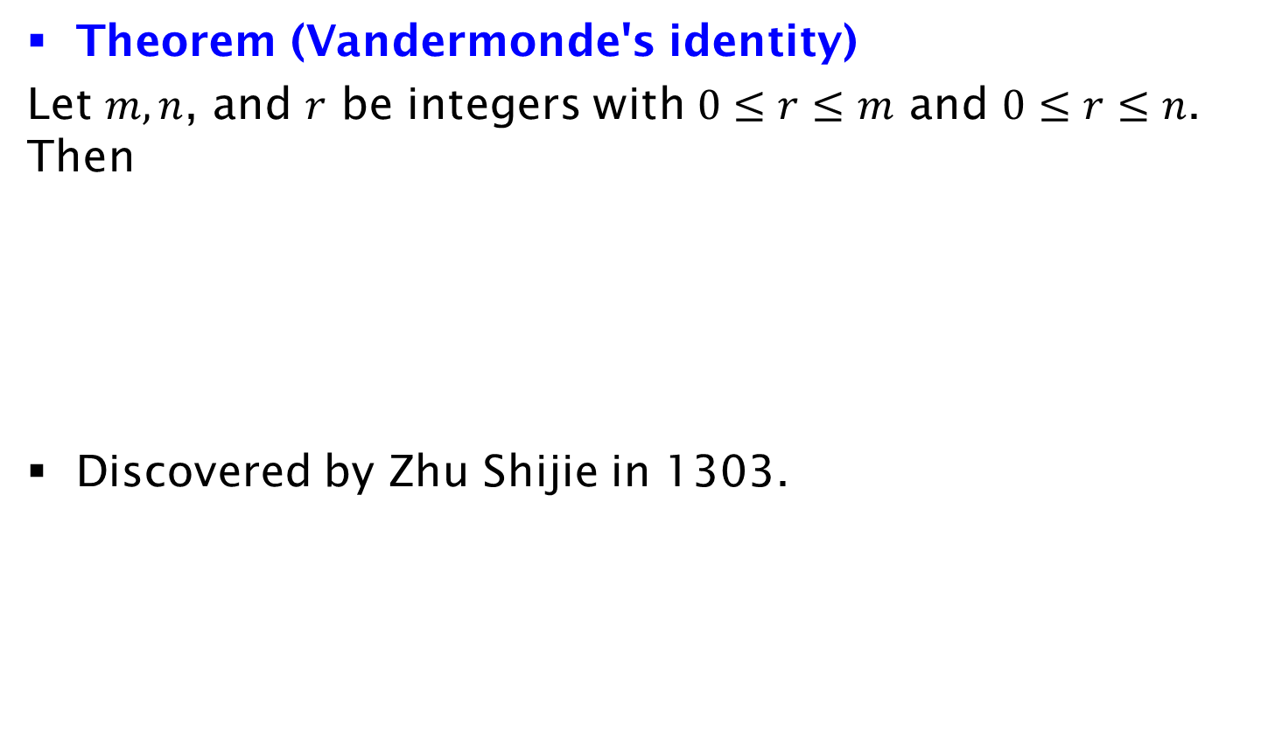
Vandermonde's Identity
Theorem (Vandermonde's identity)
Let $m, n$, and $r$ be integers with $0≤r≤m$ and $0≤r≤n$. Then
Discovered by Zhu Shijie in 1303.

Slide 36
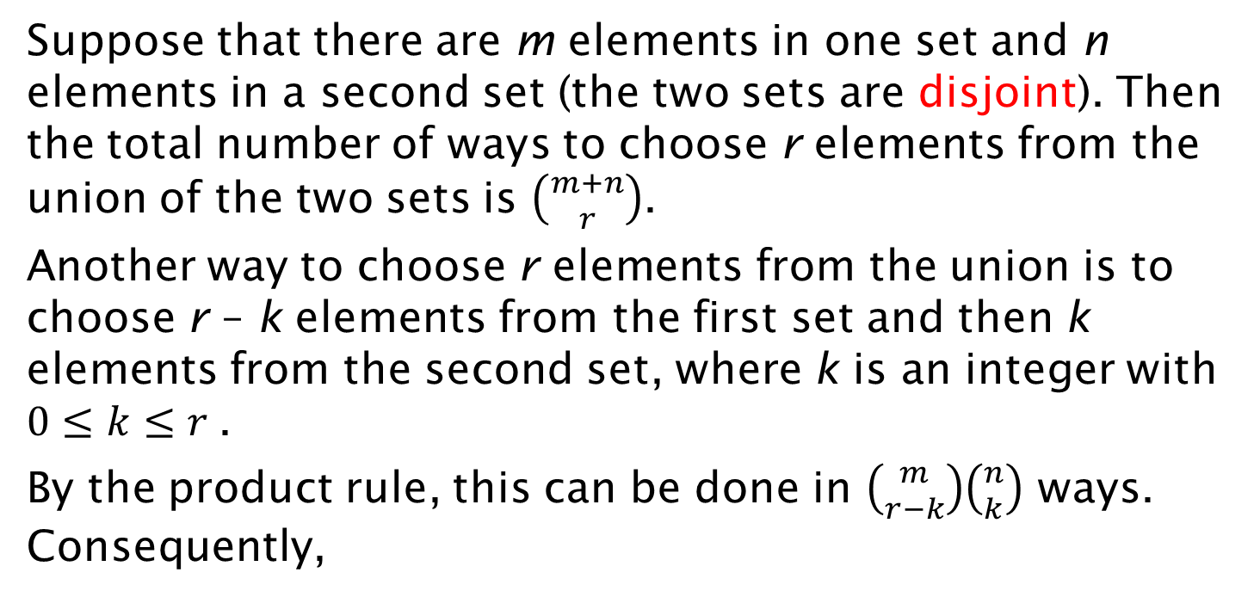
Combinatorial Proof
Suppose that there are m elements in one set and n elements in a second set (the two sets are disjoint). Then the total number of ways to choose r elements from the union of the two sets is $\left({m+n \atop r}\right)$.
Another way to choose r elements from the union is to choose r – k elements from the first set and then k elements from the second set, where k is an integer with $0≤k≤r$.
By the product rule, this can be done in $\left({m \atop r−k}\right)\left({n \atop k}\right)$ ways. Consequently,

Slide 37
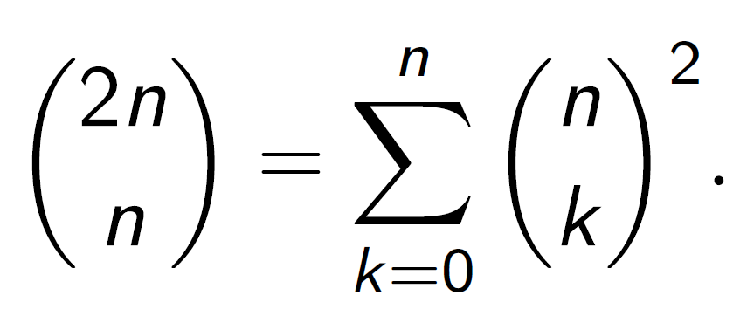
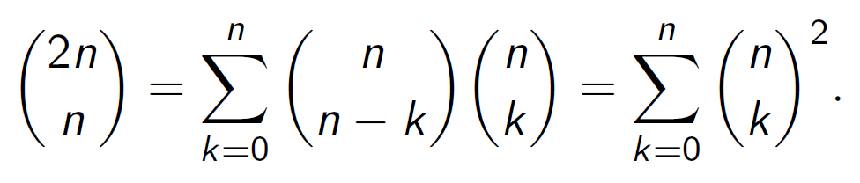
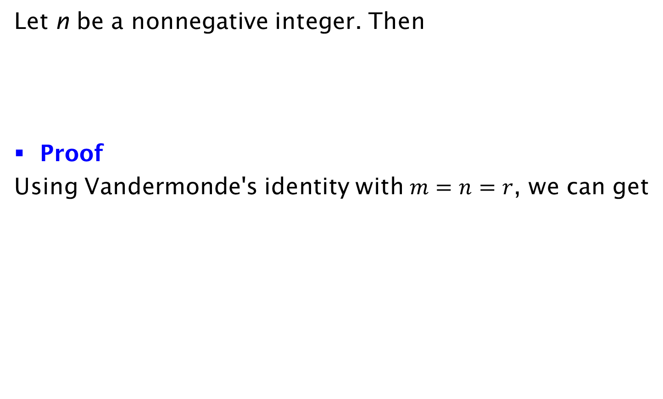
Corollary
Let n be a nonnegative integer. Then
Proof
Using Vandermonde's identity with $m=n=r$, we can get

Slide 38
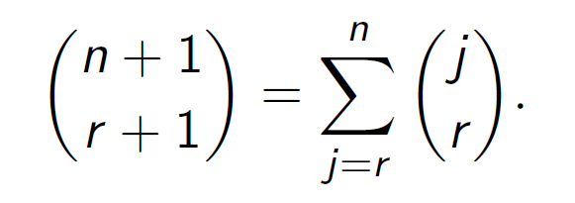
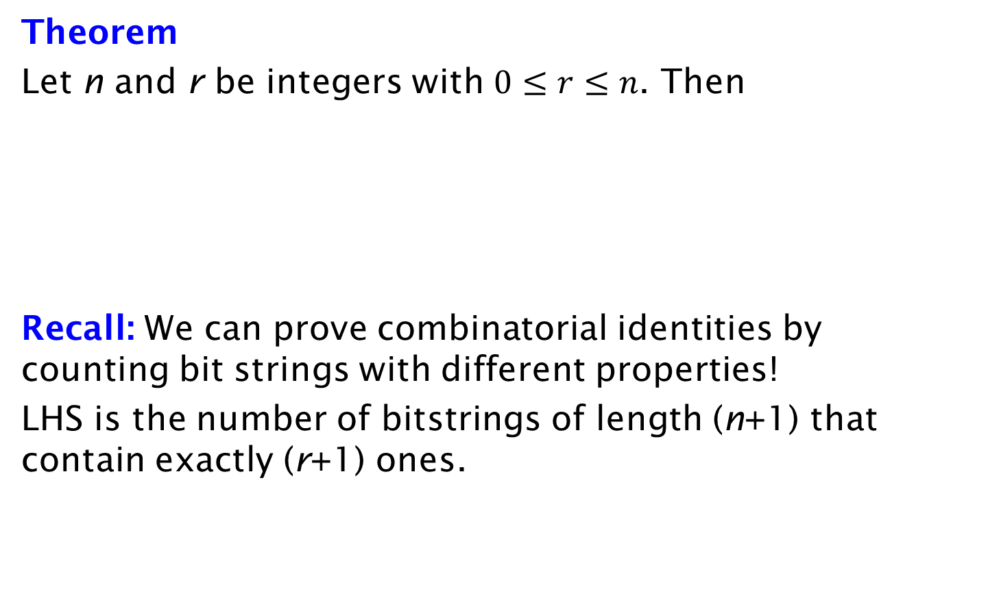
Counting bit strings
Theorem
Let n and r be integers with $0≤r≤n$. Then
Recall: We can prove combinatorial identities by counting bit strings with different properties!
LHS is the number of bitstrings of length (n+1) that contain exactly (r+1) ones.

Slide 39
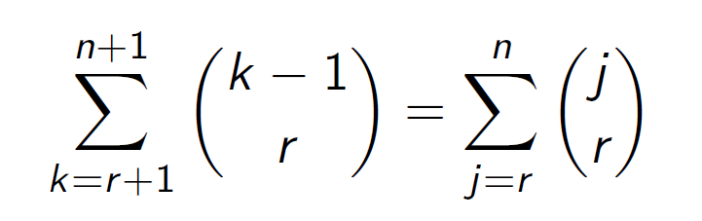
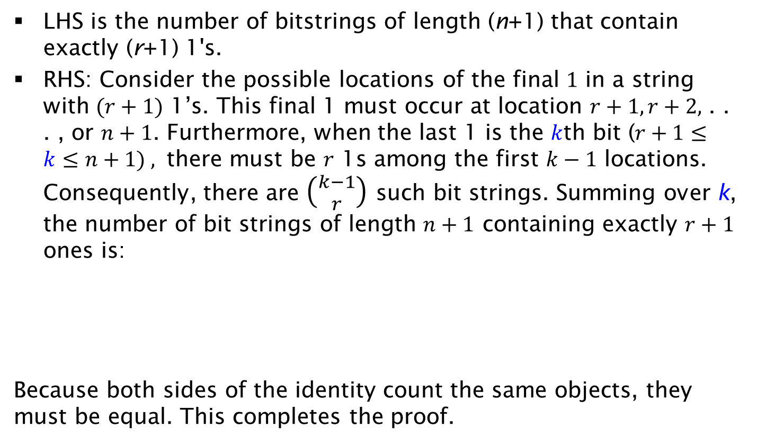
Proof
LHS is the number of bitstrings of length (n+1) that contain exactly (r+1) 1's.
RHS: Consider the possible locations of the final $1$ in a string with $(r+1)$ 1’s. This final 1 must occur at location $r+1, r+2,$ . . . , or $n+1$. Furthermore, when the last 1 is the $k$th bit ($r+1≤k≤n+1) ,$ there must be $r$ 1s among the first $k−1$ locations. Consequently, there are $\left({k−1 \atop r}\right)$ such bit strings. Summing over k, the number of bit strings of length $n+1$ containing exactly $r+1$ ones is:
Because both sides of the identity count the same objects, they must be equal. This completes the proof.

Slide 40
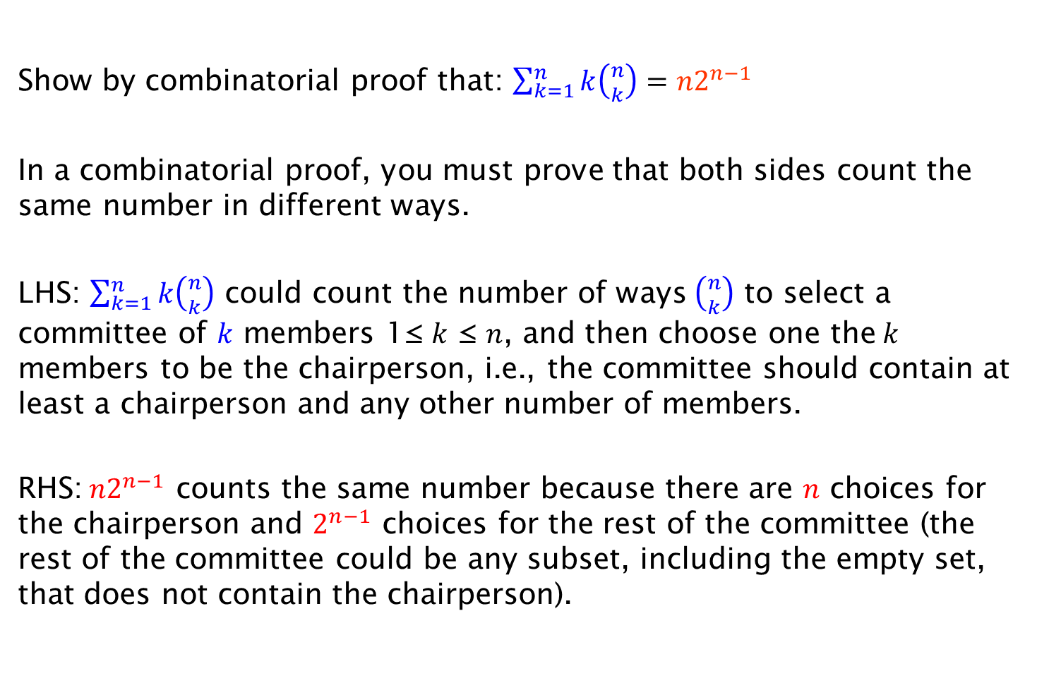
Exercise on Combinatorial Proof
Show by combinatorial proof that: $\sum_{k=1}^{n}{k\left({n \atop k}\right)={n2}^{n−1}}$
In a combinatorial proof, you must prove that both sides count the same number in different ways.
LHS: $\sum_{k=1}^{n}{k\left({n \atop k}\right)}$ could count the number of ways $\left({n \atop k}\right)$ to select a committee of $k$ members 1≤ $k$ ≤ $n$, and then choose one the$k$ members to be the chairperson, i.e., the committee should contain at least a chairperson and any other number of members.
RHS:${n2}^{n−1}$ counts the same number because there are $n$ choices for the chairperson and $2^{n−1}$ choices for the rest of the committee (the rest of the committee could be any subset, including the empty set, that does not contain the chairperson).

Slide 41
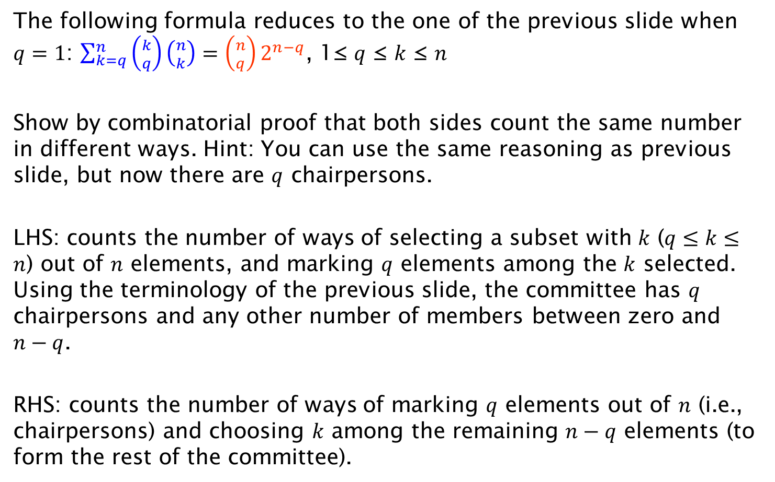
Exercise 2 on Combinatorial Proof
The following formula reduces to the one of the previous slide when $q=1$: $\sum_{k=q}^{n}{\left({k \atop q}\right)\left({n \atop k}\right)=\left({n \atop q}\right)2^{n−q}}$, 1≤ $q$ ≤ $k$ ≤ $n$
Show by combinatorial proof that both sides count the same number in different ways. Hint: You can use the same reasoning as previous slide, but now there are $q$ chairpersons.
LHS: counts the number of ways of selecting a subset with $k$ ($q≤k≤n$) out of $n$ elements, and marking $q$ elements among the $k$ selected. Using the terminology of the previous slide, the committee has $q$ chairpersons and any other number of members between zero and $n−q$.
RHS: counts the number of ways of marking $q$ elements out of $n$ (i.e., chairpersons) and choosing $k$ among the remaining $n−q$ elements (to form the rest of the committee).

