Slide 1
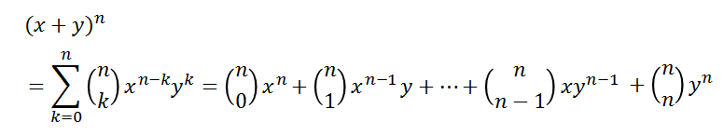
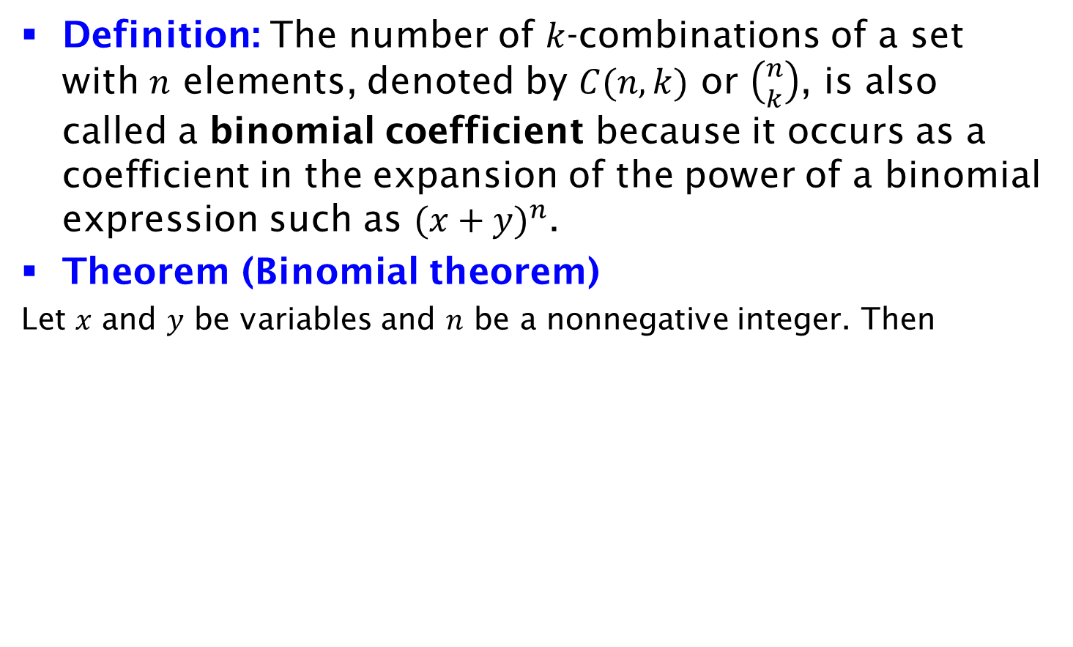
Binomial Theorem
Definition: The number of $k$-combinations of a set with $n$ elements, denoted by $C(n, k)$ or $\left({n \atop k}\right)$, is also called a binomial coefficient because it occurs as a coefficient in the expansion of the power of a binomial expression such as ${(x+y)}^{n}$.
Theorem (Binomial theorem)
Let $x$ and $y$ be variables and $n$ be a nonnegative integer. Then

