Slide 1
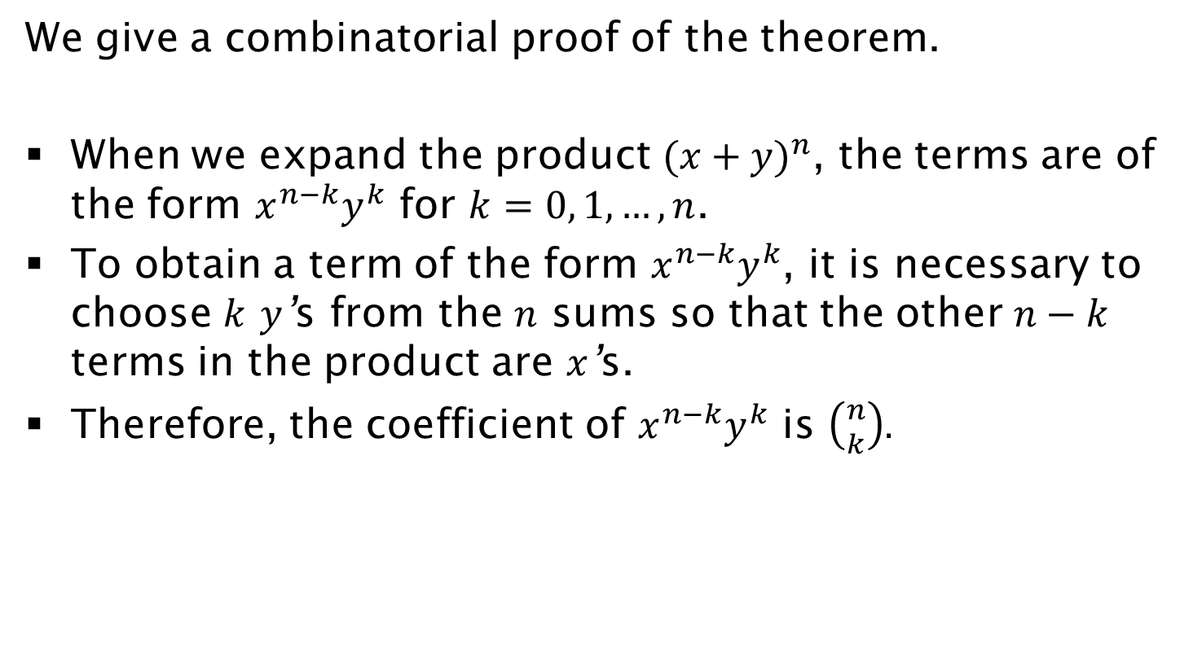
Proof
We give a combinatorial proof of the theorem.
When we expand the product ${(x+y)}^{n}$, the terms are of the form $x^{n−k}y^{k}$ for $k=0, 1, …, n$.
To obtain a term of the form $x^{n−k}y^{k}$, it is necessary to choose $k$ $y$’s from the $n$ sums so that the other $n−k$ terms in the product are $x$’s.
Therefore, the coefficient of $x^{n−k}y^{k}$ is $\left({n \atop k}\right).$

