Slide 1
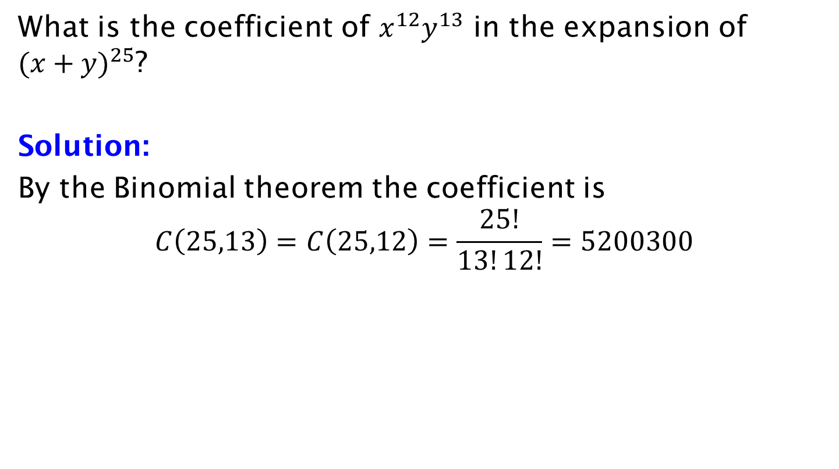
Example
What is the coefficient of $x^{12}y^{13}$ in the expansion of ${(x+y)}^{25}$?
Solution:
By the Binomial theorem the coefficient is
$$C\left(25,13\right)=C\left(25,12\right)=\frac{25!}{13!12!}=5200300$$

