Slide 1
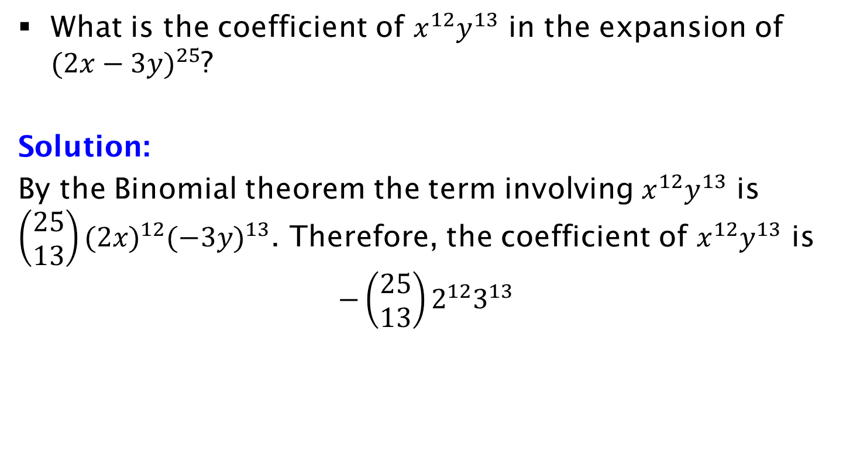
Example
What is the coefficient of $x^{12}y^{13}$ in the expansion of ${(2x−3y)}^{25}$?
Solution:
By the Binomial theorem the term involving $x^{12}y^{13}$ is $\left(\begin{aligned}25 \\ 13\end{aligned}\right){(2x)}^{12}{(−3y)}^{13}$. Therefore, the coefficient of $x^{12}y^{13}$ is
$$−\left(\begin{aligned}25 \\ 13\end{aligned}\right)2^{12}3^{13}$$

