Slide 1
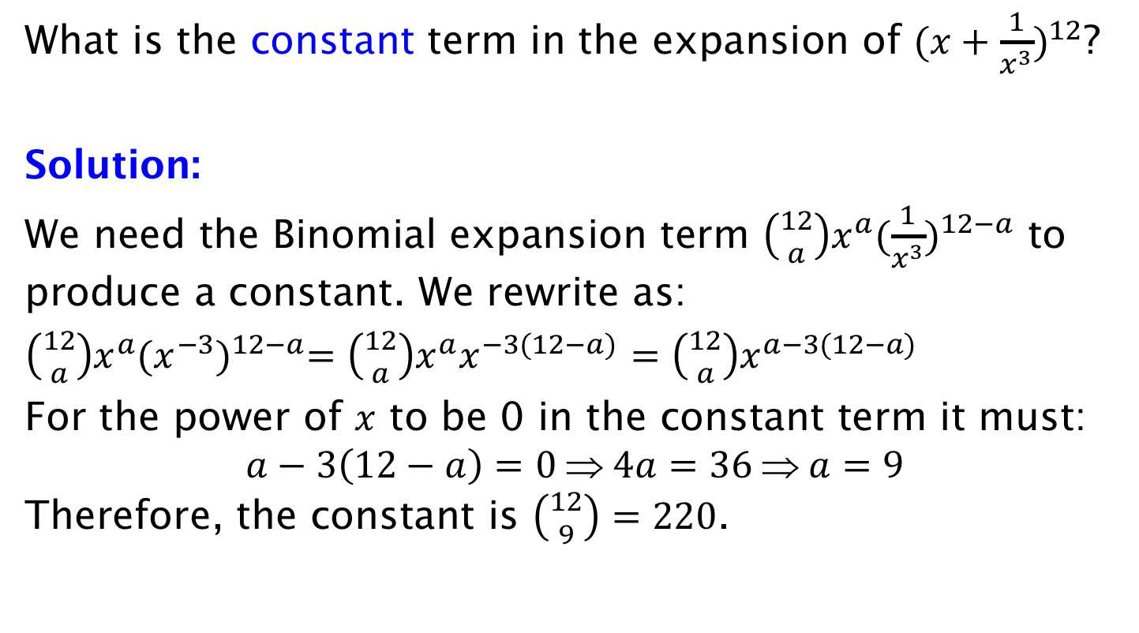
Example
What is the constant term in the expansion of ${(x+\frac{1}{x^{3}})}^{12}$?
Solution:
We need the Binomial expansion term $\left({12 \atop a}\right)x^{a}{(\frac{1}{x^{3}})}^{12−a}$ to produce a constant. We rewrite as:
$\left({12 \atop a}\right)x^{a}{(x^{−3})}^{12−a}=\left({12 \atop a}\right)x^{a}x^{−3(12−a)}$ $=\left({12 \atop a}\right)x^{a−3(12−a)}$
For the power of $x$ to be 0 in the constant term it must:
$$a−3\left(12−a\right)=0 ⇒ 4a=36 ⇒ a=9$$
Therefore, the constant is $\left({12 \atop 9}\right)=220$.

