Slide 1
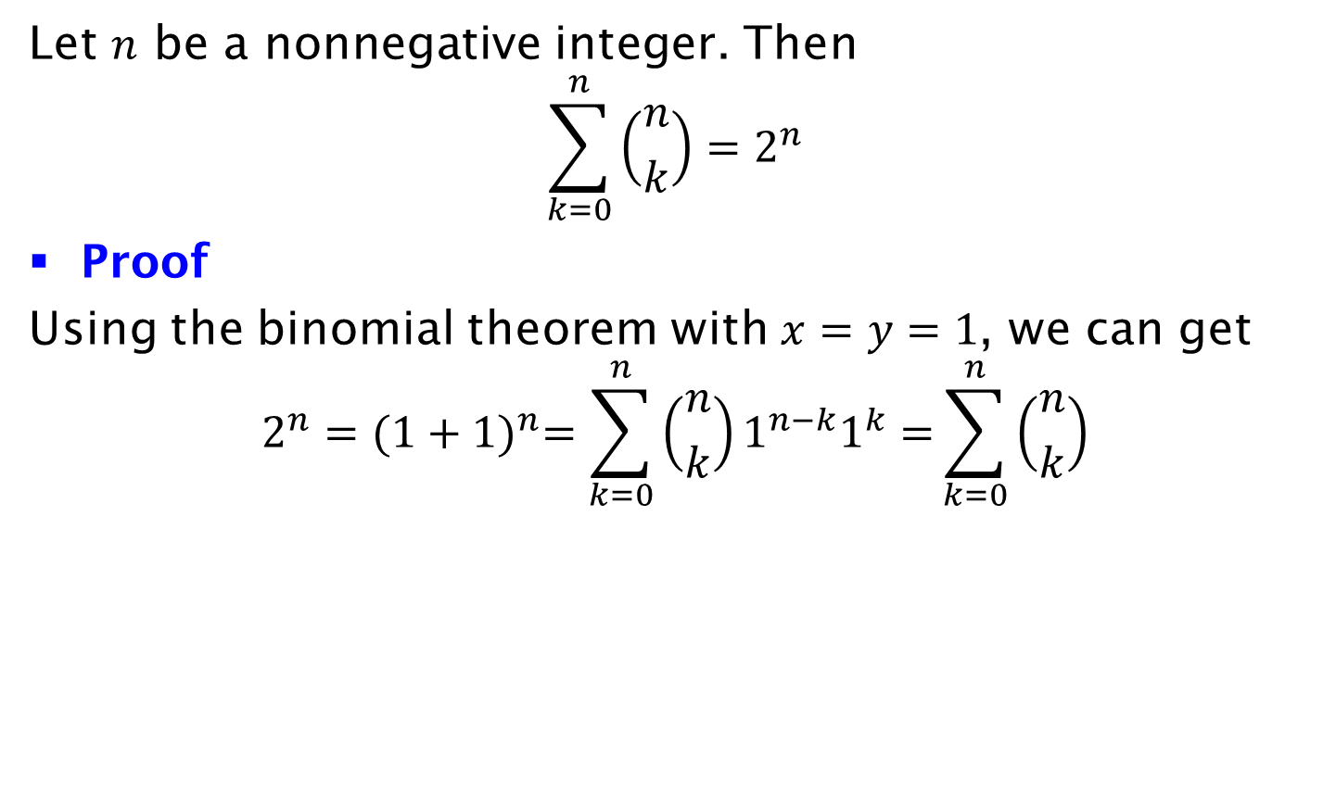
Corollary
Let $n$ be a nonnegative integer. Then
$$\sum_{k=0}^{n}{\left({n \atop k}\right)=2^{n}}$$
Proof
Using the binomial theorem with $x=y=1$, we can get
$$2^{n}={(1+1)}^{n}=\sum_{k=0}^{n}{\left({n \atop k}\right)1^{n−k}1^{k}=}\sum_{k=0}^{n}{\left({n \atop k}\right)}$$

