Slide 1
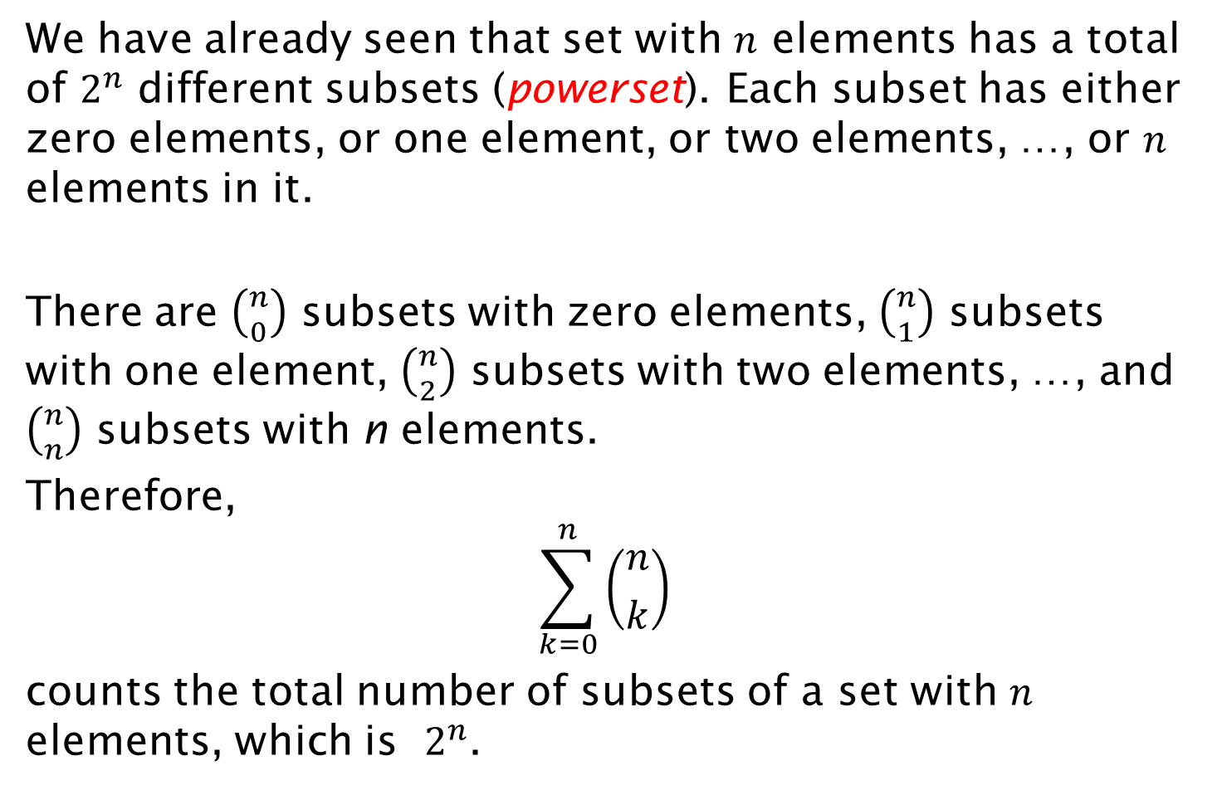
Alternative: Combinatorial Proof
We have already seen that set with $n$ elements has a total of $2^{n}$ different subsets (powerset). Each subset has either zero elements, or one element, or two elements, …, or $n$ elements in it.
There are $\left({n \atop 0}\right)$ subsets with zero elements, $\left({n \atop 1}\right)$ subsets with one element, $\left({n \atop 2}\right)$ subsets with two elements, …, and $\left({n \atop n}\right)$ subsets with n elements.
Therefore,
$$\sum_{k=0}^{n}{\left({n \atop k}\right)}$$
counts the total number of subsets of a set with $n$ elements, which is $2^{n}$.

