Slide 1
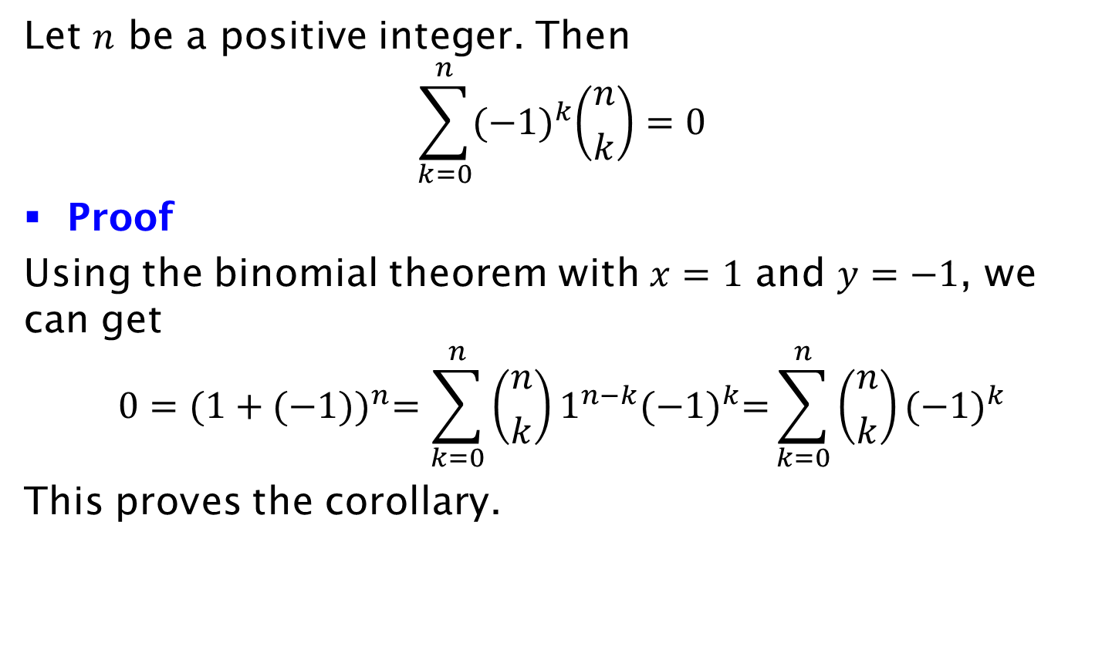
Corollary
Let $n$ be a positive integer. Then
$$\sum_{k=0}^{n}{{(−1)}^{k}\left({n \atop k}\right)=0}$$
Proof
Using the binomial theorem with $x=1$ and $y=−1$, we can get
$$0={(1+(−1))}^{n}=\sum_{k=0}^{n}{\left({n \atop k}\right)1^{n−k}{(−1)}^{k}=}\sum_{k=0}^{n}{\left({n \atop k}\right){(−1)}^{k}}$$
This proves the corollary.

