Slide 1
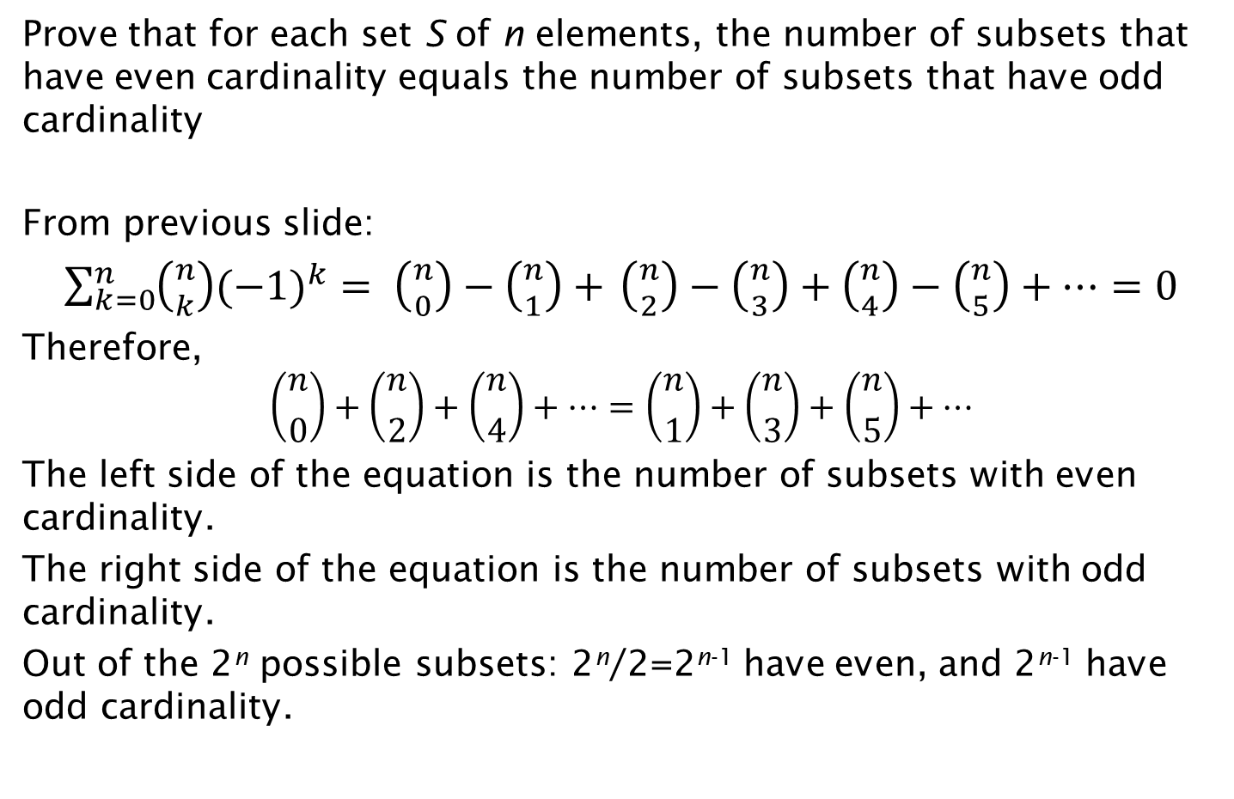
Exercise on Number of Subsets
Prove that for each set S of n elements, the number of subsets that have even cardinality equals the number of subsets that have odd cardinality
From previous slide:
$\sum_{k=0}^{n}{\left({n \atop k}\right){(−1)}^{k}}= \left({n \atop 0}\right)−\left({n \atop 1}\right)+$ $\left({n \atop 2}\right)−\left({n \atop 3}\right)+\left({n \atop 4}\right)−\left({n \atop 5}\right)+…=0$
Therefore,
$$\left({n \atop 0}\right)+\left({n \atop 2}\right)+\left({n \atop 4}\right)+…=\left({n \atop 1}\right)+\left({n \atop 3}\right)+\left({n \atop 5}\right)+…$$
The left side of the equation is the number of subsets with even cardinality.
The right side of the equation is the number of subsets with odd cardinality.
Out of the 2^{n} possible subsets: 2^{n}/2=2^{n-1} have even, and 2^{n-1} have odd cardinality.

