Slide 1
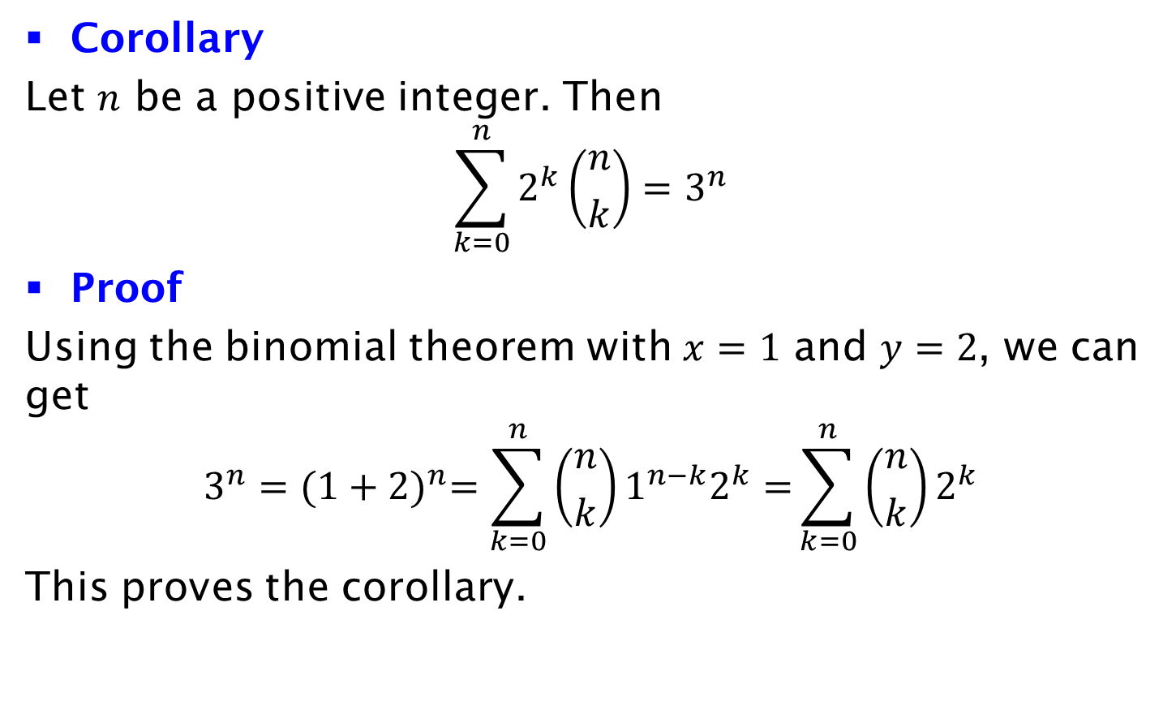
Corollary
Corollary
Let $n$ be a positive integer. Then
$$\sum_{k=0}^{n}{2^{k}\left({n \atop k}\right)=3^{n}}$$
Proof
Using the binomial theorem with $x=1$ and $y=2$, we can get
$$3^{n}={(1+2)}^{n}=\sum_{k=0}^{n}{\left({n \atop k}\right)1^{n−k}2^{k}=}\sum_{k=0}^{n}{\left({n \atop k}\right)2^{k}}$$
This proves the corollary.

