Slide 1
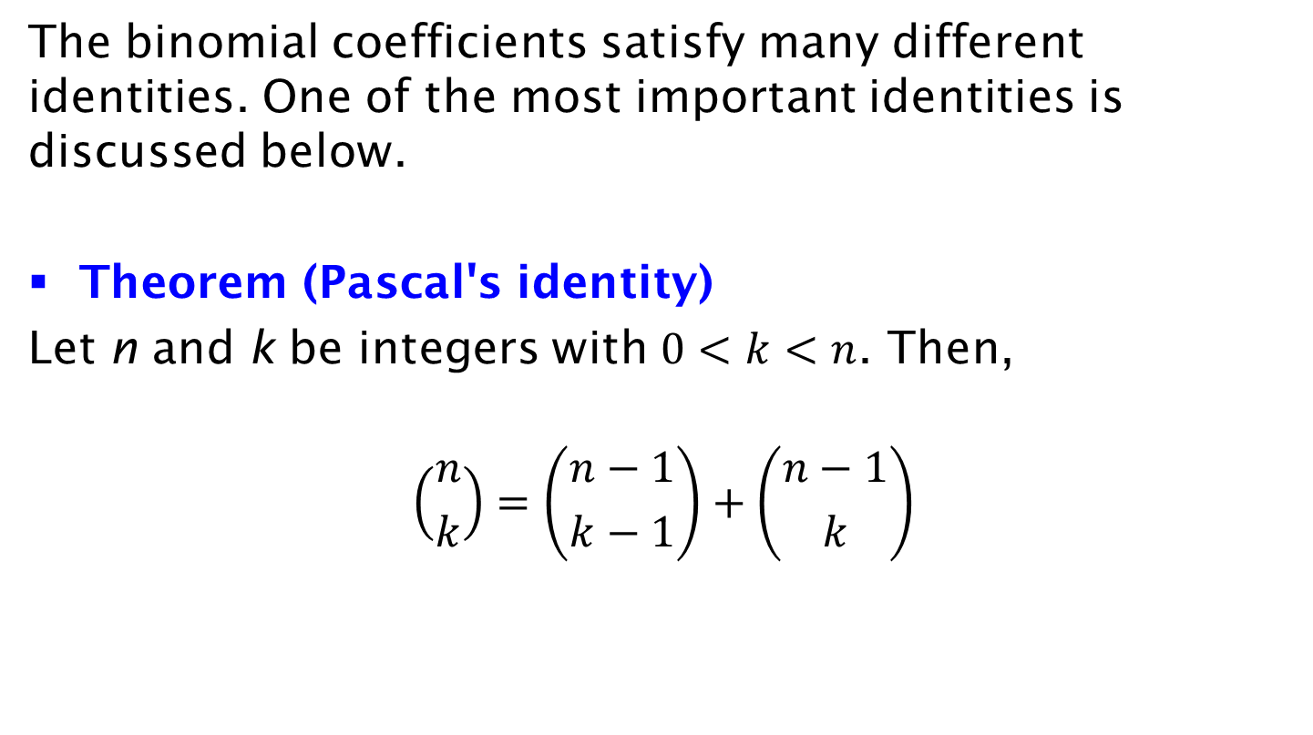
Pascal's Identity
The binomial coefficients satisfy many different identities. One of the most important identities is discussed below.
Theorem (Pascal's identity)
Let n and k be integers with $0<k<n$. Then,
$$\left({n \atop k}\right)=\left({n−1 \atop k−1}\right)+\left({n−1 \atop k}\right)$$

