Slide 1
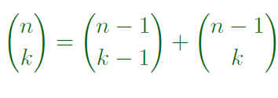
Proof
#k-combinations of {1,2,3,…,n}
#k-combinations of {1,2,3,…, n-1} not containing last element
#(k-1)-combinations of {1,2,3, …, n-1} containing last element
Use the Sum Rule for the total number of combinations

