Slide 1
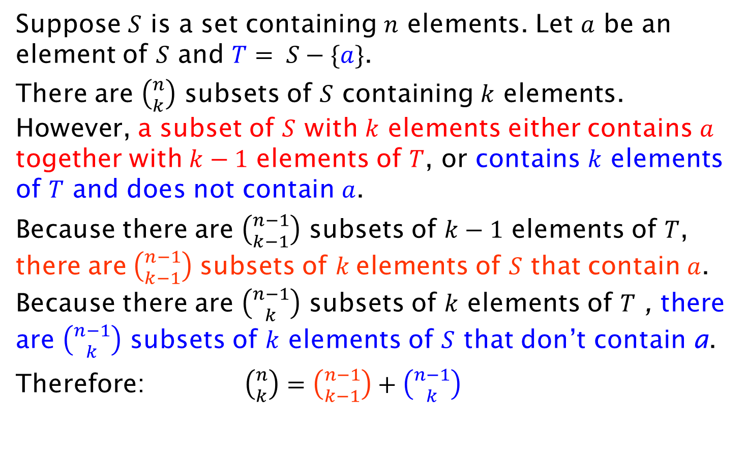
Combinatorial proof of Pascal’s identity
Suppose $S$ is a set containing $n$ elements. Let $a$ be an element of $S$ and $T= S−\{a\}$.
There are $\left({n \atop k}\right)$ subsets of $S$ containing $k$ elements. However, a subset of $S$ with $k$ elements either contains $a$ together with $k−1$ elements of $T$, or contains $k$ elements of $T$ and does not contain $a$.
Because there are $\left({n−1 \atop k−1}\right)$ subsets of $k−1$ elements of $T$, there are$\left({n−1 \atop k−1}\right)$ subsets of $k$elements of $S$ that contain $a$. Because there are $\left({n−1 \atop k}\right)$ subsets of $k$ elements of $T$ , there are $\left({n−1 \atop k}\right)$ subsets of $k$ elements of $S$ that don’t contain a.
Therefore: $\left({n \atop k}\right)=\left({n−1 \atop k−1}\right)+\left({n−1 \atop k}\right)$

