Slide 1



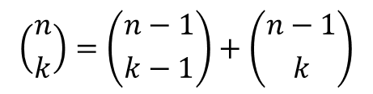
Pascal’s Triangle (1641)
$$\left({n \atop k}\right)=\left({n−1 \atop k−1}\right)+\left({n−1 \atop k}\right)$$
Corollary
Pascal's identity, together with the initial conditions $\left({n \atop 0}\right)=\left({n \atop n}\right)=1$ for all integers n, can be used to give a geometric arrangement of the binomial coefficients in a triangle, called Pascal's triangle, as follows:

