Slide 1
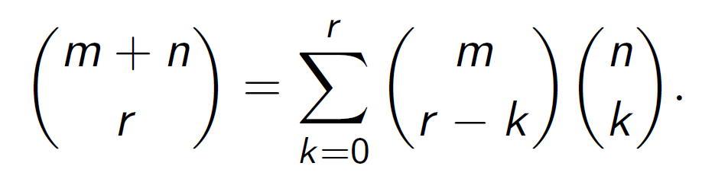
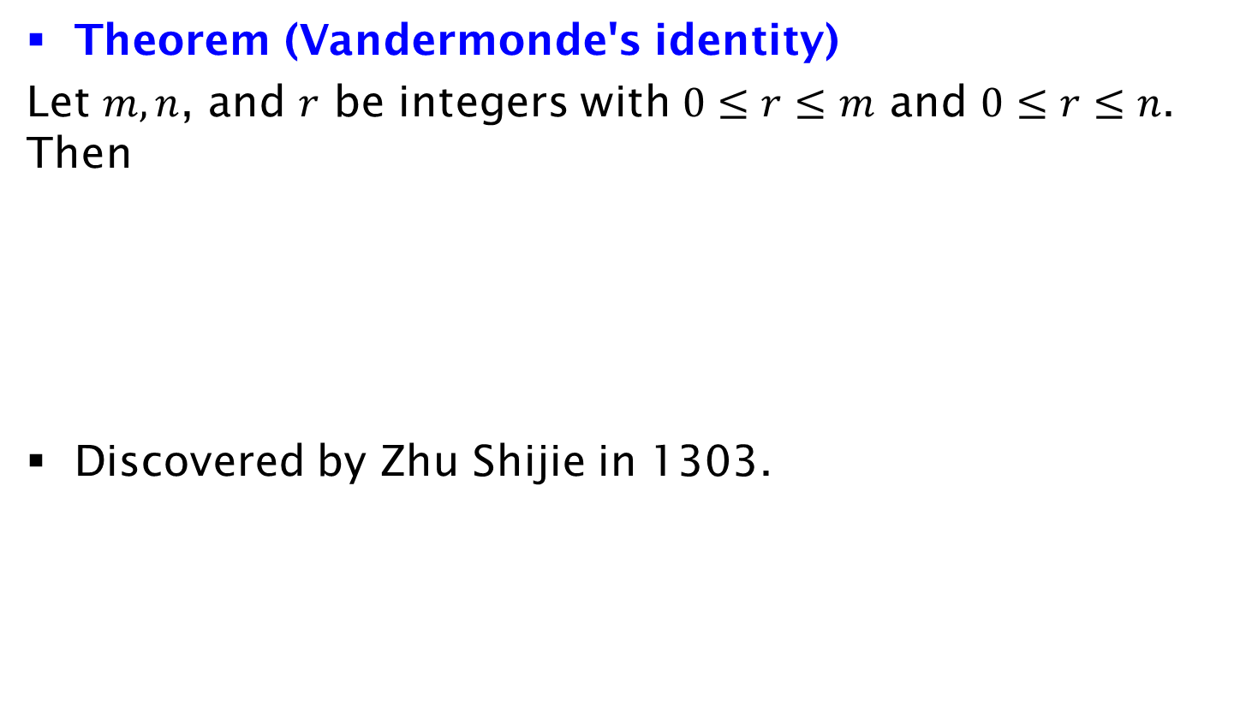
Vandermonde's Identity
Theorem (Vandermonde's identity)
Let $m, n$, and $r$ be integers with $0≤r≤m$ and $0≤r≤n$. Then
Discovered by Zhu Shijie in 1303.

