Slide 1
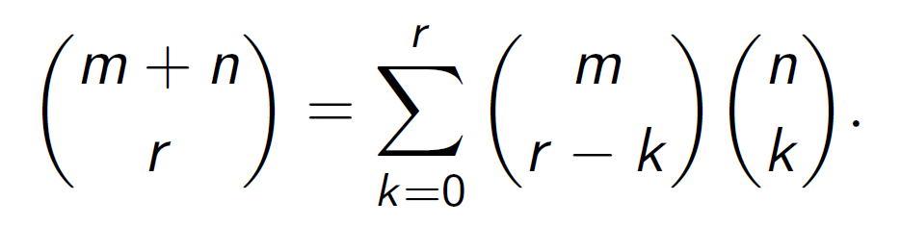
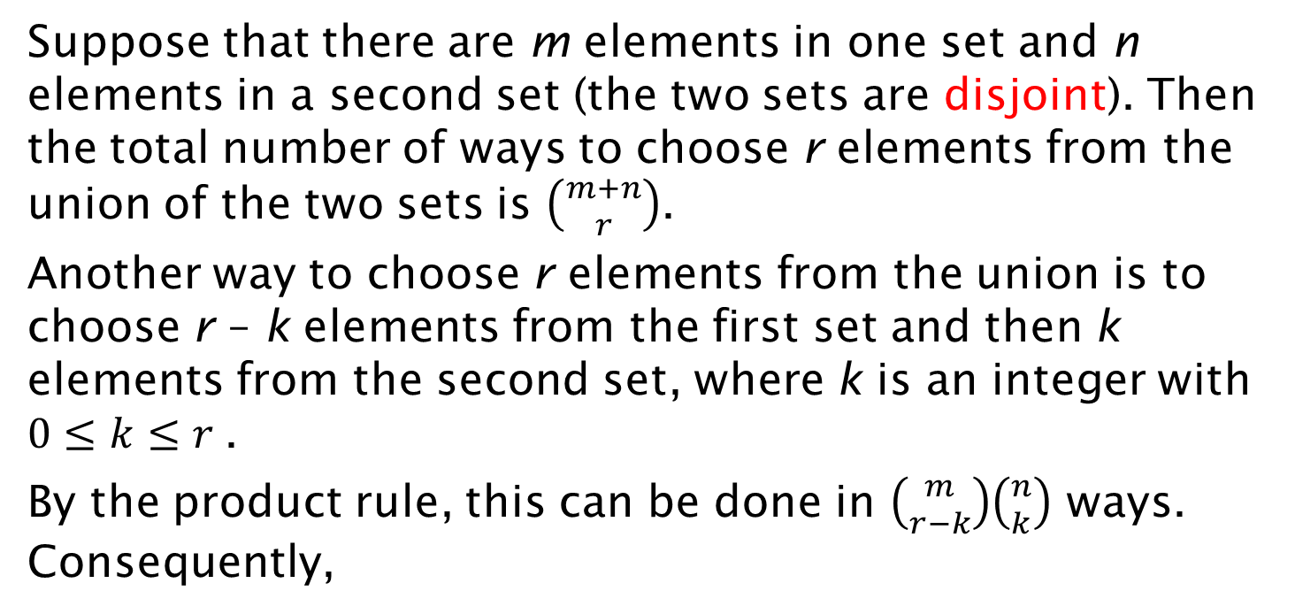
Combinatorial Proof
Suppose that there are m elements in one set and n elements in a second set (the two sets are disjoint). Then the total number of ways to choose r elements from the union of the two sets is $\left({m+n \atop r}\right)$.
Another way to choose r elements from the union is to choose r – k elements from the first set and then k elements from the second set, where k is an integer with $0≤k≤r$.
By the product rule, this can be done in $\left({m \atop r−k}\right)\left({n \atop k}\right)$ ways. Consequently,

