Slide 1
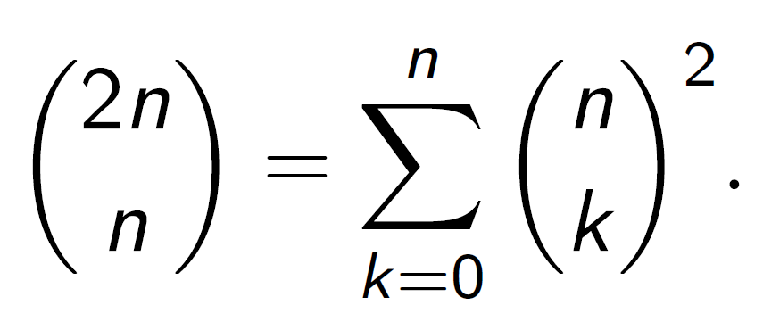
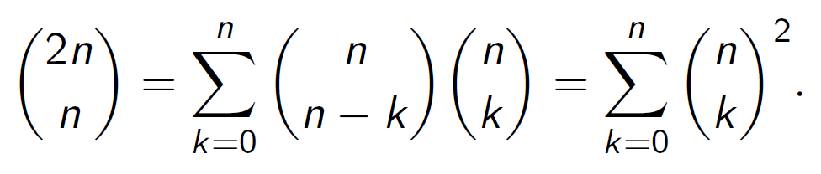
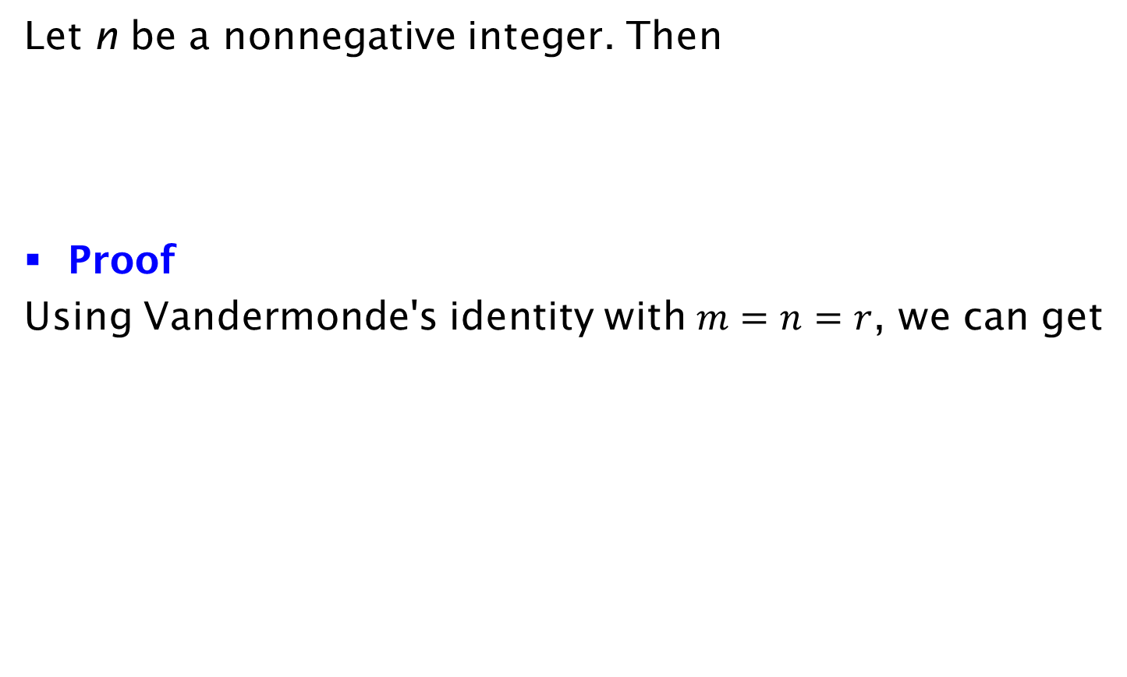
Corollary
Let n be a nonnegative integer. Then
Proof
Using Vandermonde's identity with $m=n=r$, we can get

