Slide 1
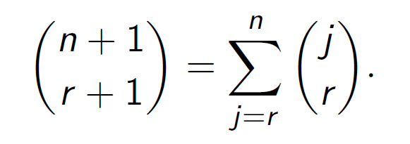
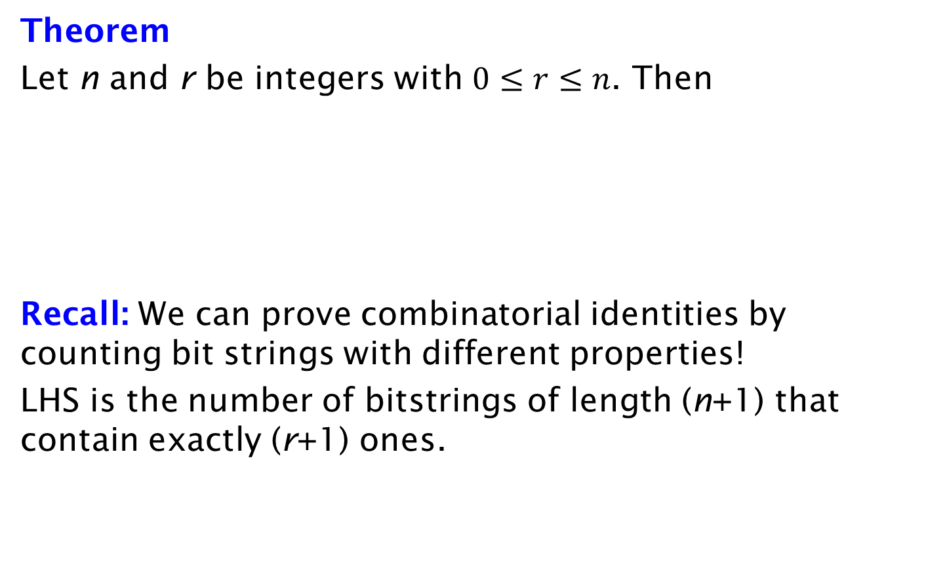
Counting bit strings
Theorem
Let n and r be integers with $0≤r≤n$. Then
Recall: We can prove combinatorial identities by counting bit strings with different properties!
LHS is the number of bitstrings of length (n+1) that contain exactly (r+1) ones.

