Slide 1
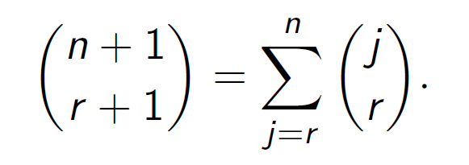
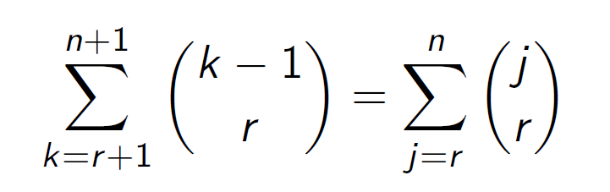
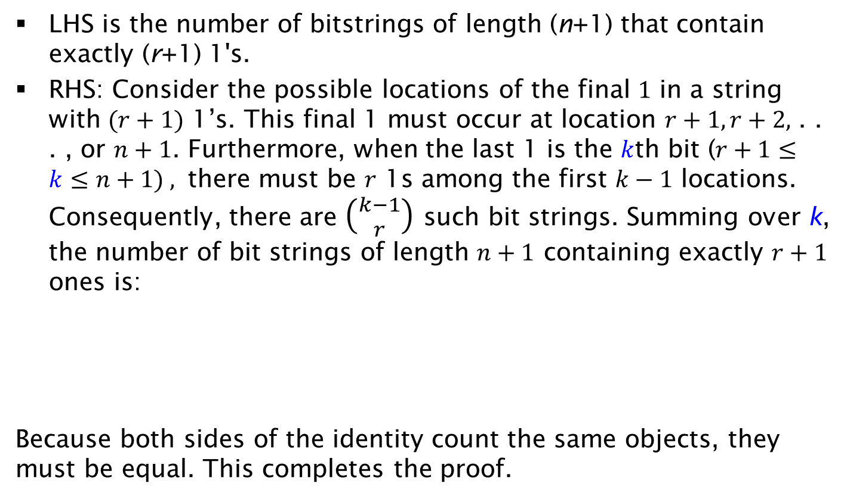
Proof
LHS is the number of bitstrings of length (n+1) that contain exactly (r+1) 1's.
RHS: Consider the possible locations of the final $1$ in a string with $(r+1)$ 1’s. This final 1 must occur at location $r+1, r+2,$ . . . , or $n+1$. Furthermore, when the last 1 is the $k$th bit ($r+1≤k≤n+1) ,$ there must be $r$ 1s among the first $k−1$ locations. Consequently, there are $\left({k−1 \atop r}\right)$ such bit strings. Summing over k, the number of bit strings of length $n+1$ containing exactly $r+1$ ones is:
Because both sides of the identity count the same objects, they must be equal. This completes the proof.

