Slide 1
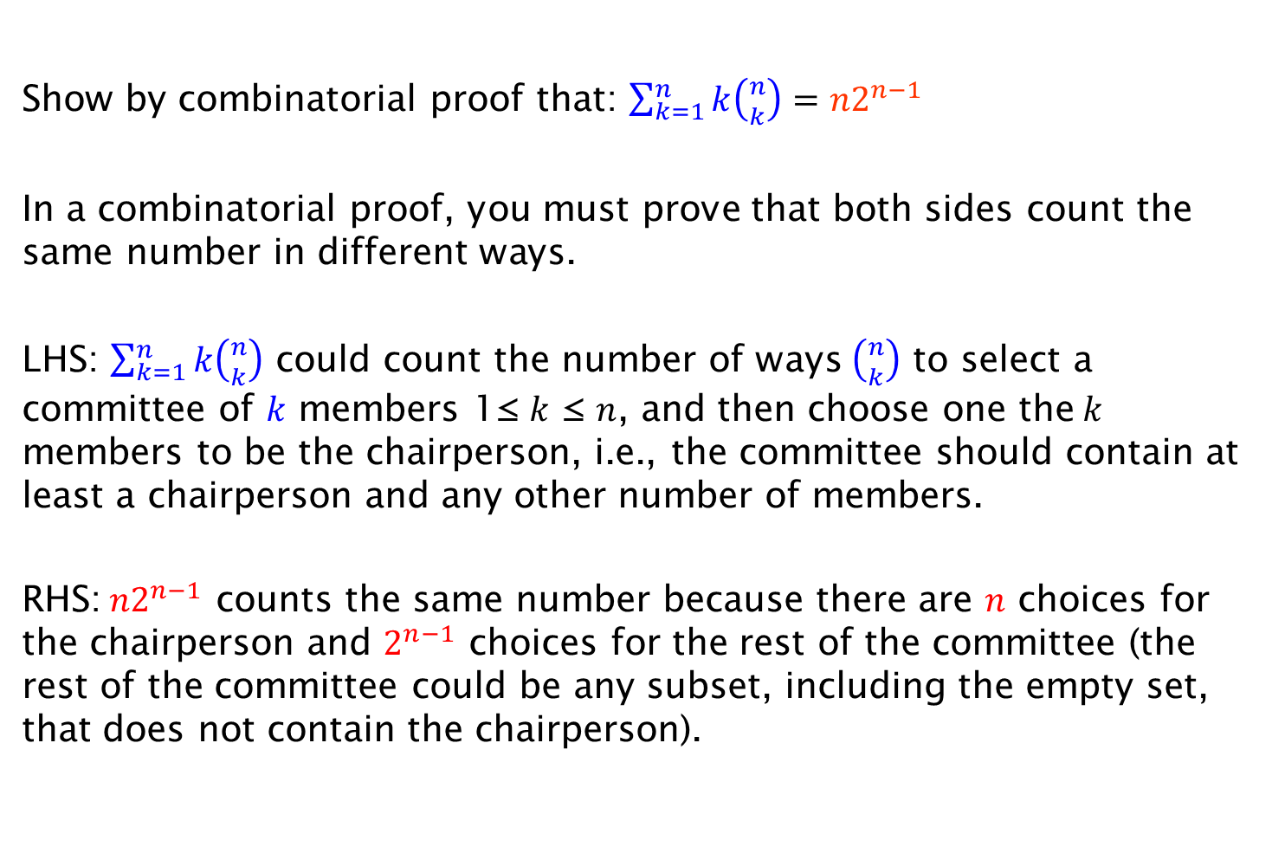
Exercise on Combinatorial Proof
Show by combinatorial proof that: $\sum_{k=1}^{n}{k\left({n \atop k}\right)={n2}^{n−1}}$
In a combinatorial proof, you must prove that both sides count the same number in different ways.
LHS: $\sum_{k=1}^{n}{k\left({n \atop k}\right)}$ could count the number of ways $\left({n \atop k}\right)$ to select a committee of $k$ members 1≤ $k$ ≤ $n$, and then choose one the$k$ members to be the chairperson, i.e., the committee should contain at least a chairperson and any other number of members.
RHS:${n2}^{n−1}$ counts the same number because there are $n$ choices for the chairperson and $2^{n−1}$ choices for the rest of the committee (the rest of the committee could be any subset, including the empty set, that does not contain the chairperson).

