Slide 1
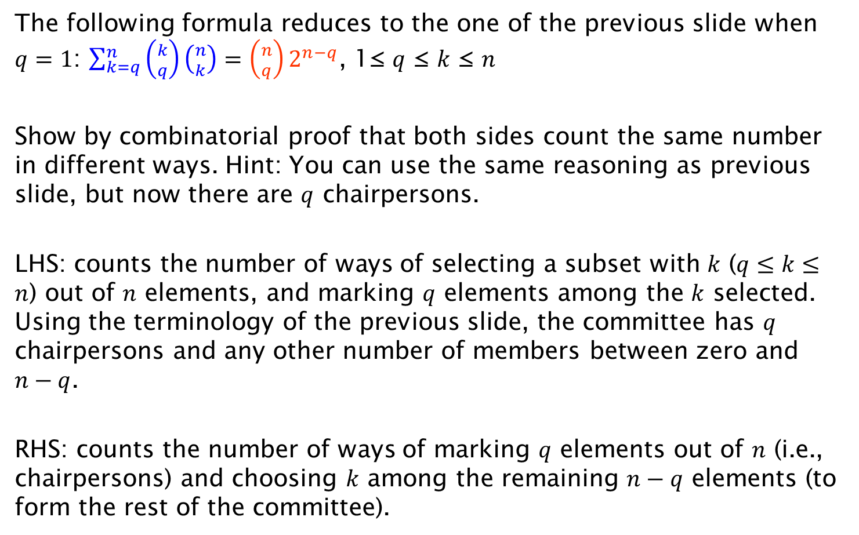
Exercise 2 on Combinatorial Proof
The following formula reduces to the one of the previous slide when $q=1$: $\sum_{k=q}^{n}{\left({k \atop q}\right)\left({n \atop k}\right)=\left({n \atop q}\right)2^{n−q}}$, 1≤ $q$ ≤ $k$ ≤ $n$
Show by combinatorial proof that both sides count the same number in different ways. Hint: You can use the same reasoning as previous slide, but now there are $q$ chairpersons.
LHS: counts the number of ways of selecting a subset with $k$ ($q≤k≤n$) out of $n$ elements, and marking $q$ elements among the $k$ selected. Using the terminology of the previous slide, the committee has $q$ chairpersons and any other number of members between zero and $n−q$.
RHS: counts the number of ways of marking $q$ elements out of $n$ (i.e., chairpersons) and choosing $k$ among the remaining $n−q$ elements (to form the rest of the committee).

