Slide 1

DSD Final Project (MIPS) Presentation
Group member：黃士豪、李筠婕、林瑩昇
Date：2020/6/29

Slide 2



Outline
Baseline
Extensions
Work Distribution

Slide 3
Baseline
Result
Special Design
Debug Method

Slide 4
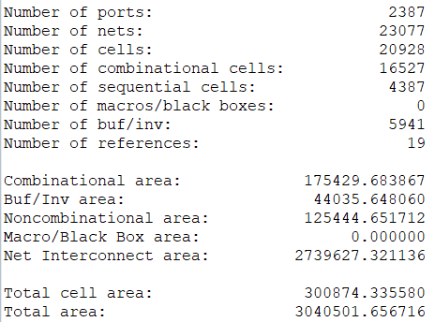
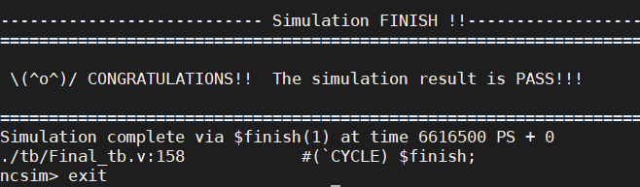
Result
Area : 300,874 (um²)
Synthesis cycle time : 3 (ns)
Simulation Cycle time : 3 (ns)
Total simulation time : 6616.5 (ns)
AT value : 1.9907e9 (um² * ns)

Slide 5
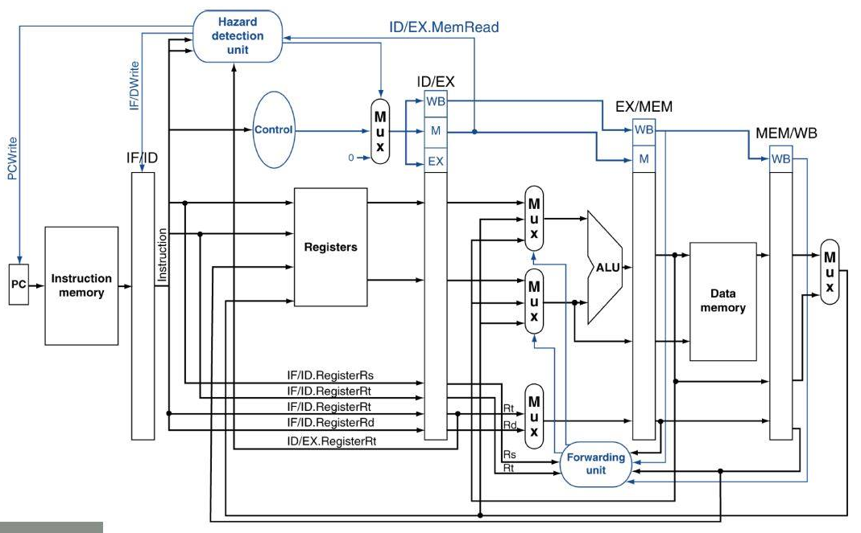
Result – critical path

Slide 6
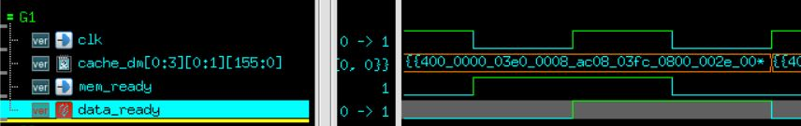
Special Design - cache buffer
Memory change and ready at negedge of clk
Cache design is posedge trigger
Problem : It has to finish the calculation in half a cycle
Solution : Buffer with FF
FF

Slide 7
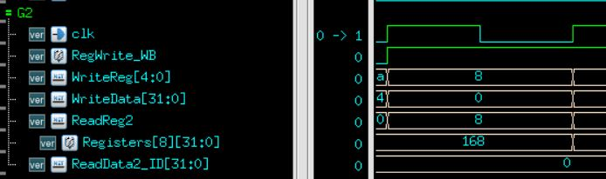
Special Design - lw stall
Problem : If the writeback register == read register
Stall one cycle
Solution : Check writeback register and read register
Output the writeback data
Reduce one cycle

Slide 8
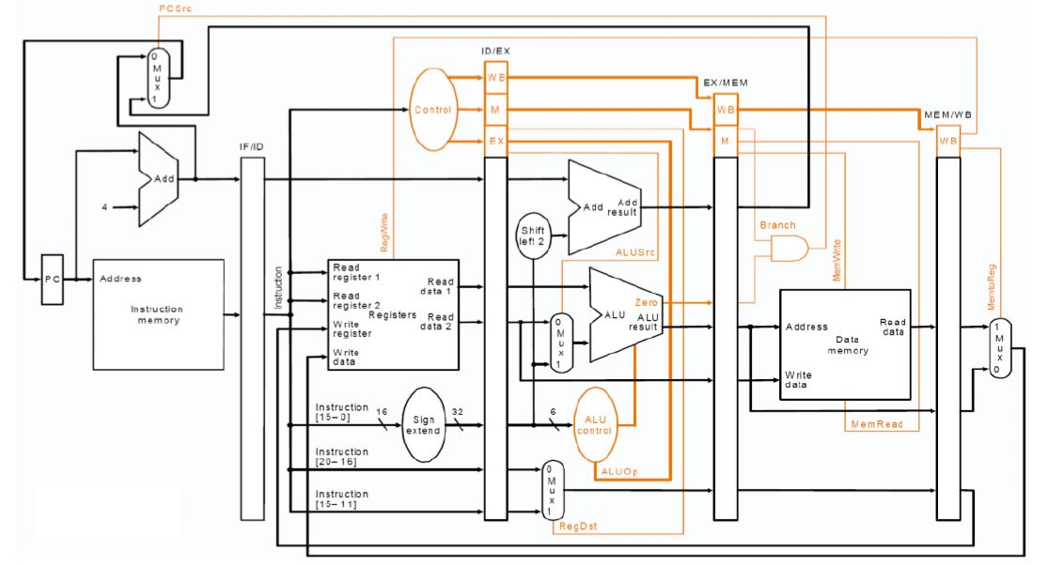
Special Design - lw stall
2. add r2 r1 r3
1. lw r3 r5 0x0000
3. Same register → output new data

Slide 9
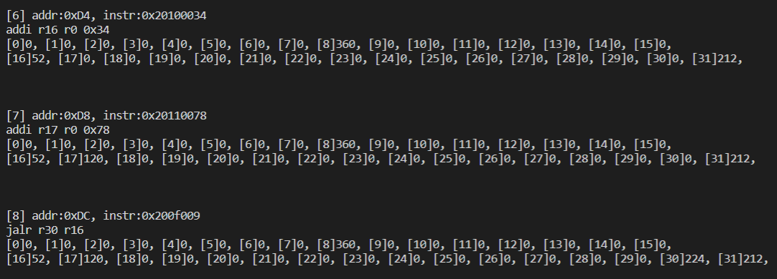
Debug Method
Problem when debugging
Next instruction?
Register file data?
Memory data?
Solution
Use python to traverse patterns and print registers and D_memory 1 by 1

Slide 10
Extensions
Branch Prediction
L2 Cache
Multiply & Divide

Slide 11
Branch Prediction
1-bit predictor
2-bit predictor
Branch cache (Smith algorithm)

Slide 12
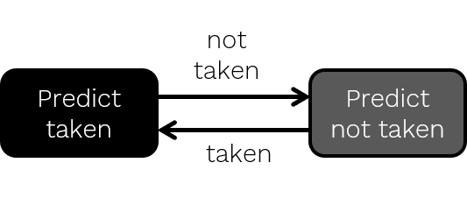
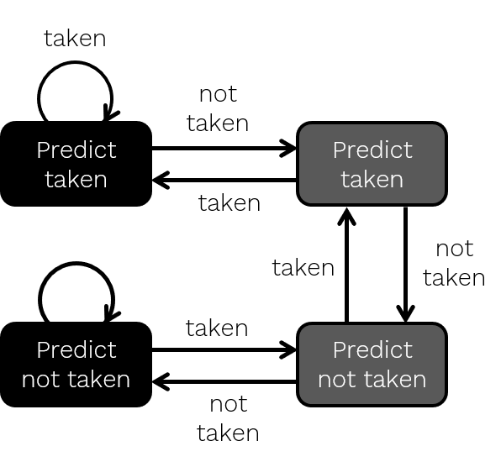
Branch Prediction – 1b & 2b predictor
If 2 consecutive for loops
1- bit predictor miss 1 prediction
for loop
Branch * n
Not branch
for loop
miss
Branch * n

Slide 13
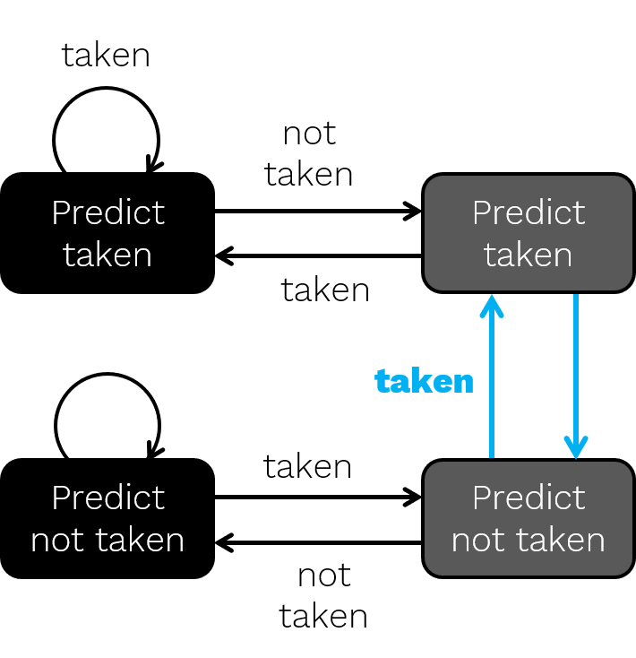
Branch Prediction – 2b & branch cache
If branch & not branch interleave
Jump between states
Reason : Different branch instructions affects predictions of each other
not taken

Slide 14
Branch Prediction – branch cache
Each branch instruction has its own prediction state
Current
branch address
Address 1
Address 2
…
Address 2^n-1
Address 2^n
…
Branch
control
…
n bits
(choose n=2)

Slide 15
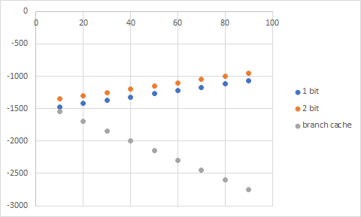
Branch Prediction – experiments
1b, 2b, branch cache v.s. baseline
under different (nb_notBr, nb_interBr, nb_Br) 100 in total
nb_inter_br
Saved cycles

Slide 16
Branch Prediction – experiments
AT : Prediction unit (A↑), faster execution(T↓)
BrPred (a=10, b=20, c=30)
cycle = 6 | A | T(ns) | AT
Baseline | 263,256 | 2523 | 664,196,285
With BPU | 270,066 | 1053 | 284,380,047
2.3x

Slide 17
L2 Cache - design
i_MIPS
L1_I$
I_mem
L2_I$
Write back
2way
dm
L1_D$
D_mem
L2_D$

Slide 18
L2 Cache - experiments
Different L2 cache size (nb20incre3)
Cache size | Total memory access cycle | D_mem access | I_mem access | Execution time
64 | 7,370 | 1,455 | 19 | 509135
128 | 1,545 | 294 | 15 | 439,235
256 | 180 | 21 | 15 | 422,855
baseline | 6,365 | 1,253 | 20 | 476,655

Slide 19
L2 Cache - experiments
Different nb & incre
 |  | Baseline |  |  | Extension
nb | incre | total mem access cycle | D_mem access | I_mem access | total mem access cycle | D_mem access | I_mem access | Saved cycles | Faster
10 | 3 | 530 | 86 | 20 | 130 | 11 | 15 | 400 | 4x
20 | 3 | 6365 | 1253 | 20 | 180 | 21 | 15 | 6185 | 35x
30 | 3 | 16365 | 3253 | 20 | 230 | 31 | 15 | 16135 | 71x
40 | 3 | 30345 | 6049 | 20 | 280 | 41 | 15 | 30065 | 108x
20 | 10 | 58640 | 11708 | 20 | 355 | 56 | 15 | 58285 | 165x
20 | 20 | 216130 | 43206 | 20 | 605 | 106 | 15 | 215525 | 357x
20 | 30 | 469610 | 93902 | 20 | 855 | 156 | 15 | 468755 | 549x
20 | 40 | 818095 | 163599 | 20 | 1105 | 206 | 15 | 816990 | 740x

Slide 20
Multiply & Divide
Iterative approach
Multiple cycles to complete all calculation
Booth algorithm
Reduce the number of partial product

Slide 21
Multiply & Divide - experiments
Accumulate 1 partial product in 1 cycle
Different iteration : Not much difference
Area
Cycle | Iter2 | Iter4 | Iter8 | Iter16 | Iter32
8 | X | 72,747 | X | X | X
7 | 177,661 | 81,885 | X | X | X
6 | 204,696 | 96,144 | X | X | X
5 | Violated | Violated | 56,681 | 27,151 | 15,120
4 | X | X | Violated | 32,413 | 18,370
3 | X | X | X | Violated | 26,613
AT | 2,456,352 | 2,307,456 | 2,267,240 | 2,074,432 | 2,554,848

Slide 22
Multiply & Divide - experiments
Area
Different algorithm : Booth algorithm
Wallace-tree v.s. EDA tool
5% better
Smaller area & critical path
Booth v.s. iterative approach
150% better
Faster execution
Cycle | Booth(+) | Booth(csa)
9 | 103,020 | 93,385
8 | 102,876 | 99,089
7 | 137,367 | 120,871
6 | 145,141 | 138,042
5 | Violated | 201,590
AT | 870,846 | 828,252

Slide 23
Work Distribution
黃士豪：pipelining, L2Cache
李筠婕：hazard handling, brPred
林瑩昇：mult & div, L2Cache

Slide 24
Thanks!
希望大家的暑假到了

