Slide 1
Path Integral Formulation
Everything, everywhere, all at once
CHEM-GA 2665 Quantum Mechanics
Pitch Presentation
Yuchen Shi
2025.12.11

Slide 2
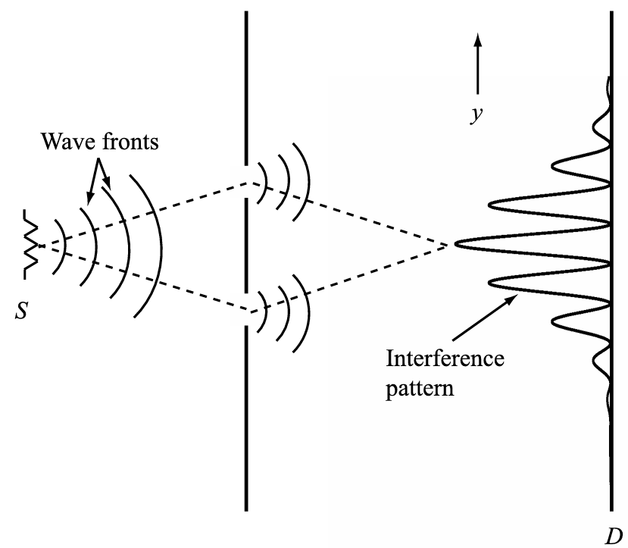
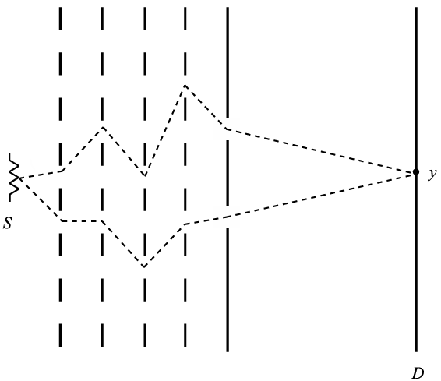
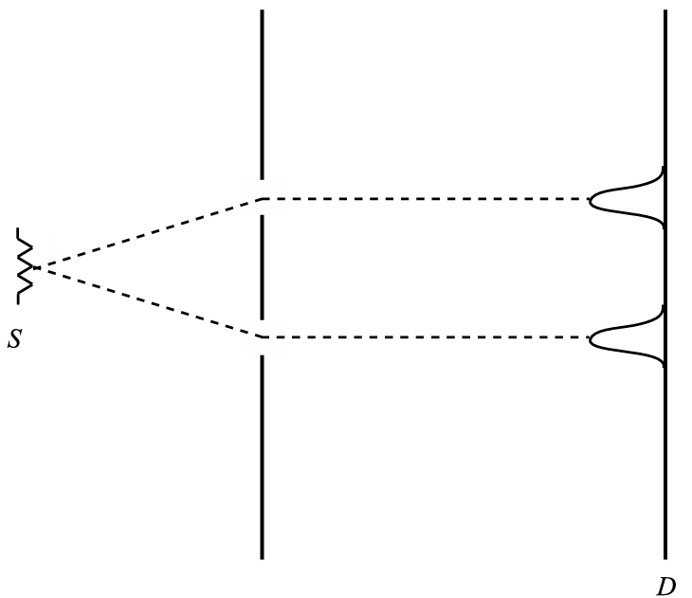
Revisit the Double-slit
P A R T 0 1 Motivation
Understand the Nature of Path Integral
Classical V.S. Quantum
Double-slit experiment proved the wave-like property of particle and guided the development of quantum mechanics.
Infinitely-many Gratings and Slits
If we put infinitely many gratings with infinitely many slits in space, it’s just empty space!
>> It’s possible to rethink Quantum Mechanics as a lot of paths
Fig.1 Double-slit Experiment and Beyond
Tuckerman, Mark E. Statistical mechanics: theory and molecular simulation. Oxford university press, 2023.

Slide 3



Why do we need path integral?
P A R T 0 1 Motivation
Different Pictures of QM
Intricity of Hamiltonian-based Formulation
(1) Schrödinger Picture
Rely on operators >> hard to transit from classical theory to quantum theory
Rely on Hamiltonian >> require canonical coordinates and momentum
Can we use idea in the sibling of Hamiltonian mechanics, Lagrangian mechanics, to fill the gap?
Reply on functions >> consistency and transferability
Rely on action, as a scalar >> symmetry preserved and allow for relativity
Time-evolving Wavefunction + Static Operator
Application: Steady state property (e.g. energy spectra)
(2) Heisenberg Picture
Static Wavefunction + Time-evolving Operator
Application: Dynamic property (e.g. position evolution)
(3) Interaction Picture
Time-evolving Wavefunction + Time-evolving Operator
Application: Time-dependent perturbation
Tuckerman, Mark E. Statistical mechanics: theory and molecular simulation. Oxford university press, 2023.
Notes:
More on the relativity problem
Example: Two Electrons Exchanging a Photon (Quantum Electrodynamics)
>> calculate two completely separate scenarios and add them together (A emits first/B emits first). Hamiltonian picture forces you to treat these as distinct physical processes (Different observers disagree on which term is which)
In path integral, integrates over all spacetime positions, same for all observers (Feynman diagram)
Lorentz Symmetry (covariance) equations if they hold in one inertial frame, then they hold in any inertial frame

Slide 4
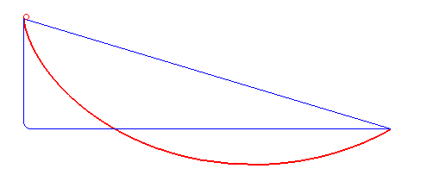
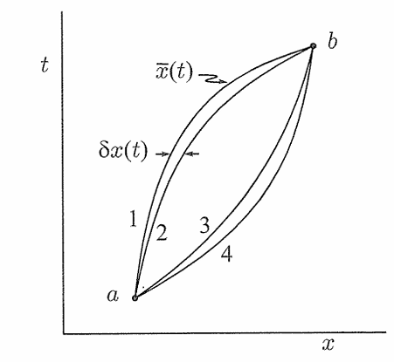





Path Integral Formulation
P A R T 0 2 Introduction to Path Integral
QM as Sum of All Possible Paths
Wavefunction as probability amplitude
>> Weighted sum of all possible paths for probability amplitude
Even better, it can retrieve classical path in classical limit
Fig.2 The Brachistochrone Curve Problem
Classical (Euler-Lagrangian):
h_bar=6.626×10⁻³⁴ J⋅s
Feynman, R. P., and AR Hibbs Quantum Mechanics. "Path integrals." Lecture Notes Phys 106 (1979): 64.
Fig.3 Classical Limit of Path Integral
Notes:
(Feynman’s Book) In classical limit, when the size time and mass are very large, the action will be very large compared to the Planck constant and the resulting ratio S/h becomes a very large number.
So, a very tiny change in the path will result in a dramatic change in the phase and they will cancel out eventually. Only the classical path (minimal action path)

Slide 5
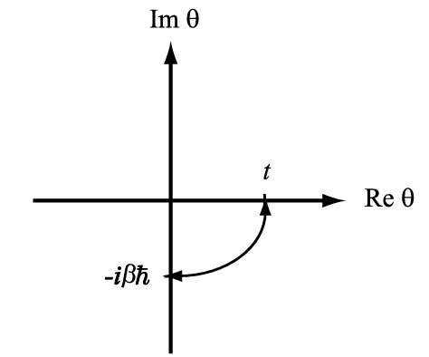



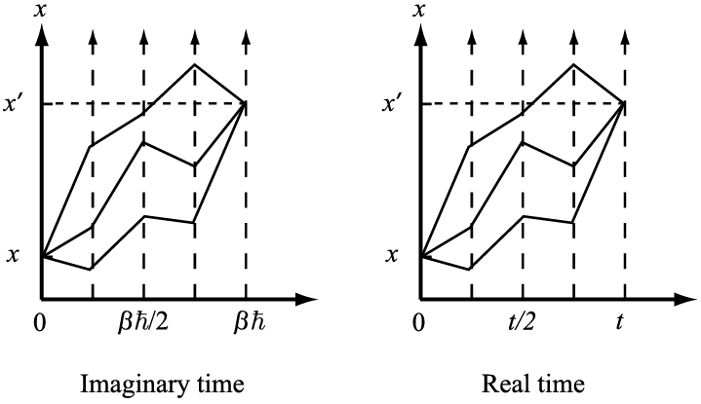
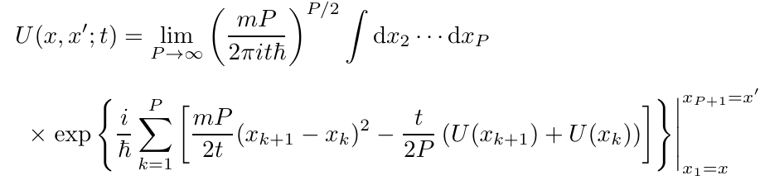



Path Integral Formulation
P A R T 0 2 Introduction to Path Integral
Wick Rotation & Imaginary Time
Density Matrix and the Propagator
Interesting Relationship in between
Fig.4 Wick Rotation on Complex Time Plane
Propagator (real time) in Path Integral Formulation
Dynamical sign problem resolved
Tuckerman, Mark E. Statistical mechanics: theory and molecular simulation. Oxford university press, 2023.
Fig.5 Imaginary and Real Time Propagation
Notes:
The wavefunction we are familiar with assumes perfect knowledge of the system (Zero Temperature, isolated vacuum). But in real world system, we have a statistical mixture of many possible wavefunctions and we need an operator that combines Quantum Probability (superposition) with Classical Probability (temperature/ignorance). That operator is the Density Matrix.

Slide 6
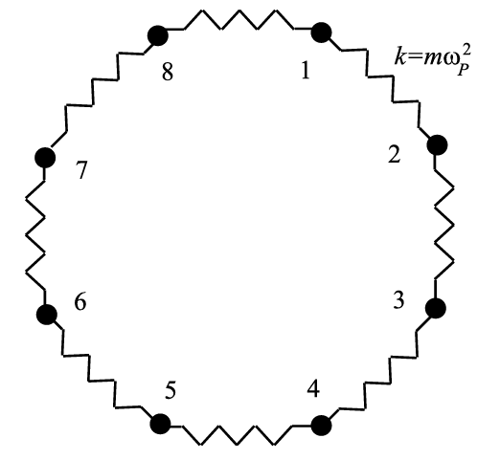
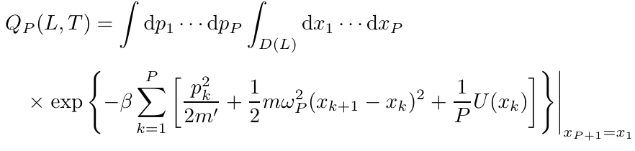


Path Integral Molecular Dynamics
P A R T 0 3 Application
Ring Polymer Isomorphism
We can actually simulate quantum mechanics with classical mechanics only!
Imaginary-time density matrix <-slicing-> Classical ring-polymer
High temperature, large mass >> stiff spring (small ring, like a particle)
Low temperature, small mass >>, loose spring (large ring, delocalization)
>> Allow for nuclear quantum effects, tunneling…
Fig.6 Classic Isomorphism (Ring-polymer) of the Imaginary-time Path Integral

Slide 7
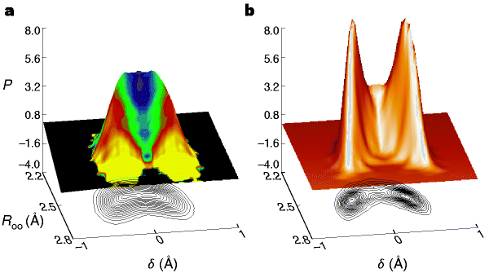
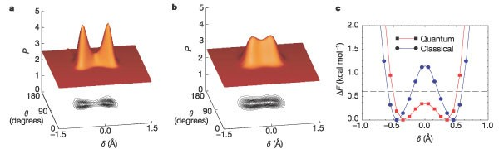
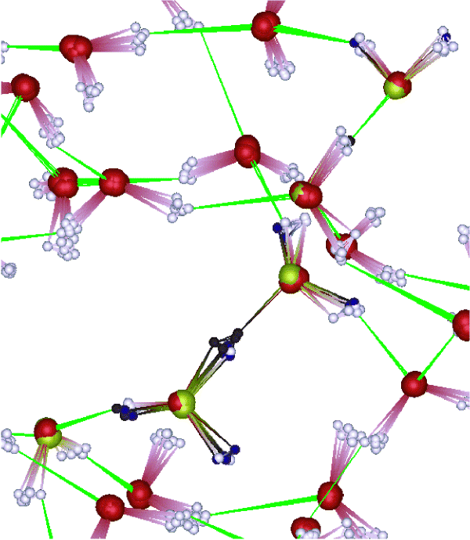
Proton Transfer in Water
P A R T 0 3 Application
Marx, Dominik, et al. "The nature of the hydrated excess proton in water." Nature 397.6720 (1999): 601-604.
Zero-point Energy
Anomalously high mobilities of protons (H⁺) and hydroxide ions (OH⁻) in aqueous solutions
Classical theory failed to capture and explain this phenomenon
Quantum theory (path-integral) explained
  Lowered energy barrier in proton transfer by nuclear quantum effects
  Delocalization of hydrogen atoms
Fig.7 Representation of Relative Proton Positions (Left: quantum; Right: Classical)
Fig.8 Structural Changes in Proton Transfer and Free Energy Landscape
Fig.9 Delocalization of Hydrogens
Tuckerman, Mark E., Dominik Marx, and Michele Parrinello. "The nature and transport mechanism of hydrated hydroxide ions in aqueous solution." Nature 417.6892 (2002): 925-929.

Slide 8
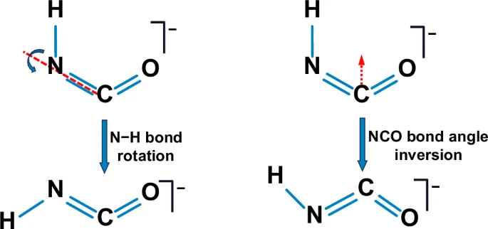
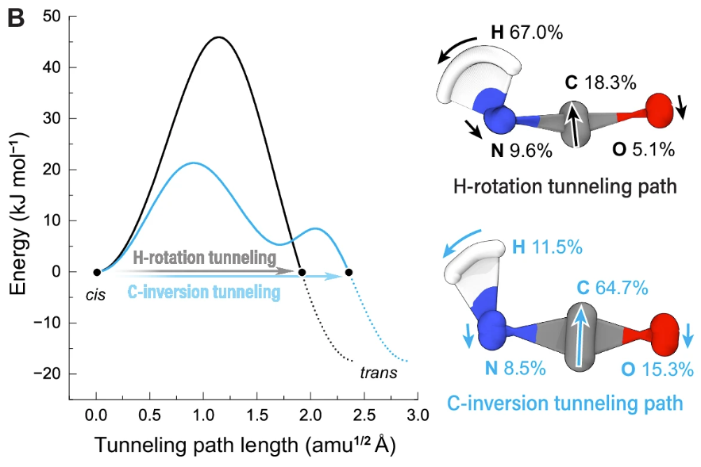
Reaction Rate and Mechanism
P A R T 0 3 Application
Tunneling in Light & Heavy Particles
Isocyanic acid radical anion as a model system to study isomerization in because of its electronic structure
Tunneling allows for overcoming energy barriers that are forbidden classically
Tunneling effects become important in heavy atoms at low temperature (3K)
Fig.10 Two Tunneling Pathways in Isomerization (Left: Hydrogen; Right: Carbon)
Tang, Jingjing, et al. "Competing quantum tunneling processes of heavy and light particles in isocyanic acid radical anions." Nature Communications 16.1 (2025): 10687.
Fig.11 Potential Energy Profiles of Two Pathways

Slide 9
Conclusion
P A R T 0 4 Conclusion
Path integral as an interesting formulation of quantum mechanics and powerful tool to compute quantum dynamics
How far are we from exact quantum dynamics?
  Imaginary Time v.s. Real Time Path integral
  Are we satisfied with imaginary time? (ad hoc dynamics, , non-equilibrium…)
  Is real-time path integral achievable? (dynamical sign, memory cost…)
What can we do with exact (or just better…) quantum dynamics?
  Spectroscopy: Exact predictions of spectral lines for complex molecules, even better than experiments
  Non-equilibrium system: electron transfer, photo-induced process >> solar cell design, artificial photosynthesis, energy storage devices…
Other fields using path integral that you may be interested in: quantum electrodynamics (QED), gauge theory, quantum gravity…
Notes:
If you compute a correlation function $C(\tau)$ in imaginary time (which PIMD does perfectly), you theoretically know everything. But to get the real-world spectrum $C(t)$, you have to perform an Inverse Laplace Transform, which is poorly extremely ill-posed problem numerically because analytic continuation of imaginary-time data to real-time data is such an immense challenge.

Slide 10
Reference
P A R T 0 4
Feynman, R. P., and AR Hibbs Quantum Mechanics. "Path integrals." Lecture Notes Phys 106 (1979): 64.
Marx, Dominik, et al. "The nature of the hydrated excess proton in water." Nature 397.6720 (1999): 601-604.
Tang, Jingjing, et al. "Competing quantum tunneling processes of heavy and light particles in isocyanic acid radical anions." Nature Communications 16.1 (2025): 10687.
Tuckerman, Mark E., Dominik Marx, and Michele Parrinello. "The nature and transport mechanism of hydrated hydroxide ions in aqueous solution." Nature 417.6892 (2002): 925-929.
Tuckerman, Mark E. Statistical mechanics: theory and molecular simulation. Oxford university press, 2023.

Slide 11
Q&A

