Slide 1
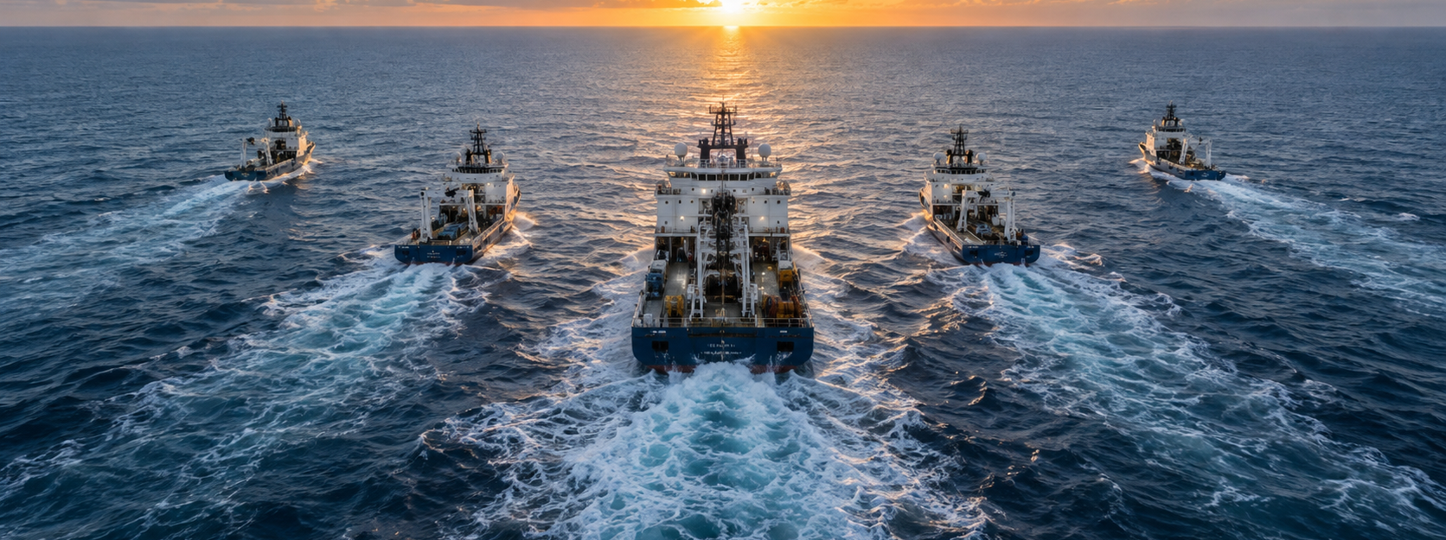

IntelliPath
A shared resource workspace
for maritime operations
RESOURCE WORKSPACE
Notes:
Opening, 20 seconds. IntelliPath is a project demonstration for finding operational resources in a maritime setting. Its workspace brings together documents, equipment, colleagues and security evidence. The fleet illustrates the five access scopes. Seatrium branding identifies the intended project context. This is not an official Seatrium corporate publication.
Project source: https://github.com/EasonXu-HY99/intellipath, README.md, docs/RESOURCE-WORKSPACE.md, docs/OPERATIONS-V2.md and shared/access.js. UI screenshots are the actual demonstration environment, captured 23 September 2026. Official Seatrium logos: https://www.seatrium.com/assets/images/seatrium-logo.svg and https://www.seatrium.com/assets/images/seatrium-logo-white.svg. Logos retain original proportions. All maritime concept scenes are illustrative and do not depict actual Seatrium operations.

Slide 2

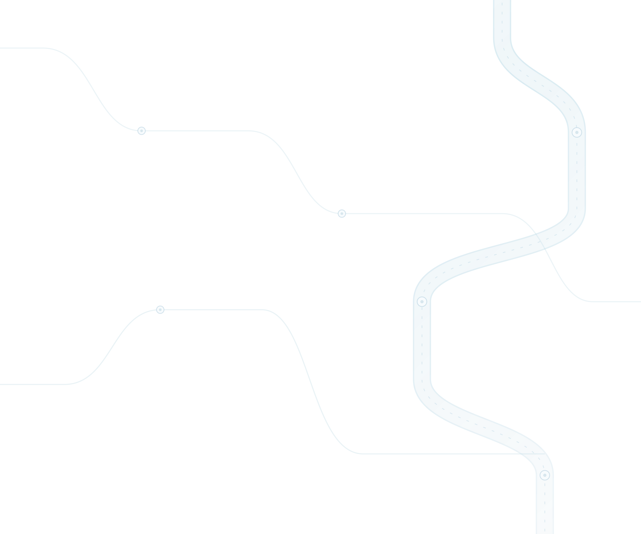
THE INTELLIPATH EXPERIENCE
One continuous Path
A question becomes a route through people, knowledge and action.
Ask
Route
Discover
Locate
Act
Start with a task
or a question.
Select the right
specialist agents.
Find authorized
files and devices.
Connect people
with workplaces.
Review evidence
and follow up.
A connected route from a question to useful action.
IntelliPath / Connected resource workspace
02
Notes:
Introduce Path as the product concept: connected discovery across resources and people. The moving marker visualizes the journey, not a claim of automatic execution of every step. The path is an embedded looping GIF. The stop labels and explanatory text remain editable. All data in screenshots is illustrative.
Project source: https://github.com/EasonXu-HY99/intellipath, README.md, docs/RESOURCE-WORKSPACE.md, docs/OPERATIONS-V2.md and shared/access.js. UI screenshots are the actual demonstration environment, captured 23 September 2026. Official Seatrium logos: https://www.seatrium.com/assets/images/seatrium-logo.svg and https://www.seatrium.com/assets/images/seatrium-logo-white.svg. Logos retain original proportions. All maritime concept scenes are illustrative and do not depict actual Seatrium operations.

Slide 3
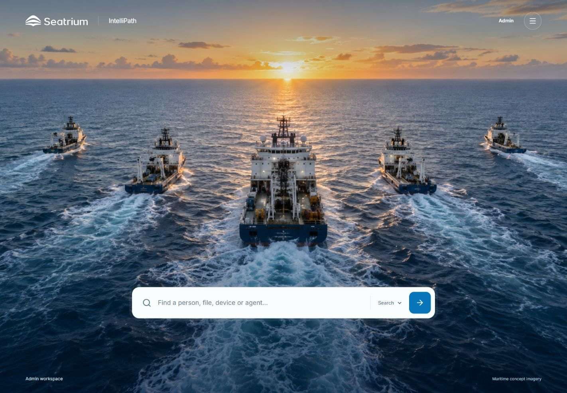
RESOURCE DISCOVERY
One search across the workspace
Find a pump
maintenance record
A practical search example
Search files, people, devices and operational records.
Open the evidence, then follow related resources.
Results respect the signed-in role.
IntelliPath / Connected resource workspace
03
Notes:
40 seconds. Start on the actual search-first home page. Type a concrete query such as pump maintenance and inspect the returned resource details. This example query is illustrative, not a claim that the screenshot already contains those results. Explain that role filtering occurs before result counts and content are returned. The screenshot shows the Admin fleet.
Project source: https://github.com/EasonXu-HY99/intellipath, README.md, docs/RESOURCE-WORKSPACE.md, docs/OPERATIONS-V2.md and shared/access.js. UI screenshots are the actual demonstration environment, captured 23 September 2026. Official Seatrium logos: https://www.seatrium.com/assets/images/seatrium-logo.svg and https://www.seatrium.com/assets/images/seatrium-logo-white.svg. Logos retain original proportions. All maritime concept scenes are illustrative and do not depict actual Seatrium operations.

Slide 4
CONNECTED INTELLIGENCE
Agent-to-Agent collaboration
A specialist’s result becomes the next specialist’s context.
Question
Device
Agent
Knowledge
Agent
People
Agent
Evidence
Find the right help
for this equipment.
Identify the asset
and its context.
Find relevant
procedures.
Find an expert
and their location.
Bring the findings
back together.
Workflow vision: sequential handoffs between specialists
Available today: a coordinator routes local searches and combines their evidence.
IntelliPath / Connected resource workspace
04
Notes:
This is the proposed Agent-to-Agent handoff experience. The current product implements a local coordinator that chooses specialists and merges results; it does not yet implement autonomous sequential agent-to-agent context passing. Present the chain as the workflow vision. Device, Knowledge and People are shortened labels for Device & Equipment, Engineering Knowledge and Human Resources agents. Every hop must retain the original user access scope.
Project source: https://github.com/EasonXu-HY99/intellipath, README.md, docs/RESOURCE-WORKSPACE.md, docs/OPERATIONS-V2.md and shared/access.js. UI screenshots are the actual demonstration environment, captured 23 September 2026. Official Seatrium logos: https://www.seatrium.com/assets/images/seatrium-logo.svg and https://www.seatrium.com/assets/images/seatrium-logo-white.svg. Logos retain original proportions. All maritime concept scenes are illustrative and do not depict actual Seatrium operations.

Slide 5
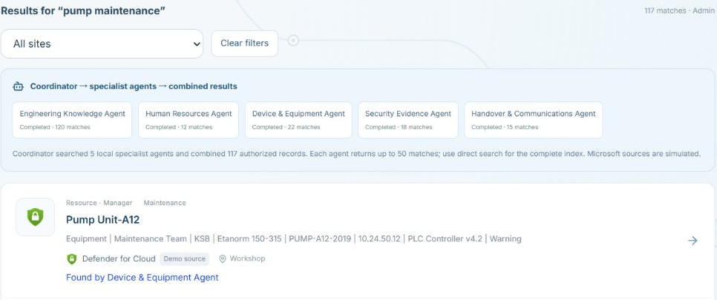
ACTUAL WORKSPACE
Specialist search in action
One query
pump maintenance
Five specialists
A visible execution trace explains the search.
Shared evidence
Results show which agent found each record.
IntelliPath / Connected resource workspace
05
Notes:
Actual UI screenshot captured from the deployed product. The pump maintenance query selects all five local specialists. The execution trace and Found by attribution connect each result to its source agent. The screenshot displays authorized Admin results, not production incident evidence. The page includes seeded records and clearly marked source simulations.
Project source: https://github.com/EasonXu-HY99/intellipath, README.md, docs/RESOURCE-WORKSPACE.md, docs/OPERATIONS-V2.md and shared/access.js. UI screenshots are the actual demonstration environment, captured 23 September 2026. Official Seatrium logos: https://www.seatrium.com/assets/images/seatrium-logo.svg and https://www.seatrium.com/assets/images/seatrium-logo-white.svg. Logos retain original proportions. All maritime concept scenes are illustrative and do not depict actual Seatrium operations.

Slide 6
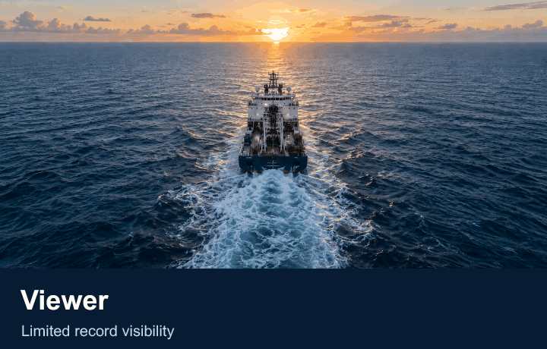
ACCESS SCOPES
Five roles. Five views.
Admin
All five access groups
Manager
Manager and lower groups
Analysis
Analysis and lower groups
Engineer
Engineer and Viewer
Viewer
Viewer records
IntelliPath / Connected resource workspace
06
Notes:
The embedded GIF cycles from Viewer to Admin, showing one through five ships. Even fleets are symmetric. The fleet is a visual metaphor for the access hierarchy, not a count of operational vessels. The product uses role names in the interface, without L1-L7 labels. Record visibility and action permissions remain distinct. The following access matrix gives examples of actions.
Project source: https://github.com/EasonXu-HY99/intellipath, README.md, docs/RESOURCE-WORKSPACE.md, docs/OPERATIONS-V2.md and shared/access.js. UI screenshots are the actual demonstration environment, captured 23 September 2026. Official Seatrium logos: https://www.seatrium.com/assets/images/seatrium-logo.svg and https://www.seatrium.com/assets/images/seatrium-logo-white.svg. Logos retain original proportions. All maritime concept scenes are illustrative and do not depict actual Seatrium operations.

Slide 7
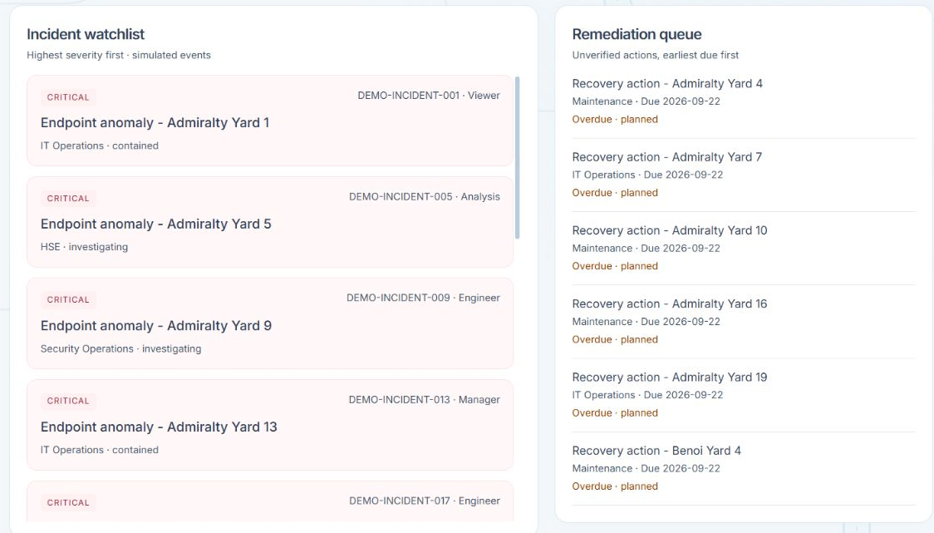
OPERATIONAL ATTENTION
Cybersecurity Center
Incidents
Review severity and status in the incident watchlist.
Remediation
Track the accountable owner, due date and verification state.
Illustrative operational data
IntelliPath / Connected resource workspace
07
Notes:
45 seconds. Use the actual watchlist and remediation screenshot to show how a user moves from a signal to follow-up work. An alert alone is not proof of compromise. Owners and due dates provide accountability, and a verified state requires evidence. All displayed events are demonstration data, not reports of real Seatrium incidents.
Project source: https://github.com/EasonXu-HY99/intellipath, README.md, docs/RESOURCE-WORKSPACE.md, docs/OPERATIONS-V2.md and shared/access.js. UI screenshots are the actual demonstration environment, captured 23 September 2026. Official Seatrium logos: https://www.seatrium.com/assets/images/seatrium-logo.svg and https://www.seatrium.com/assets/images/seatrium-logo-white.svg. Logos retain original proportions. All maritime concept scenes are illustrative and do not depict actual Seatrium operations.

Slide 8
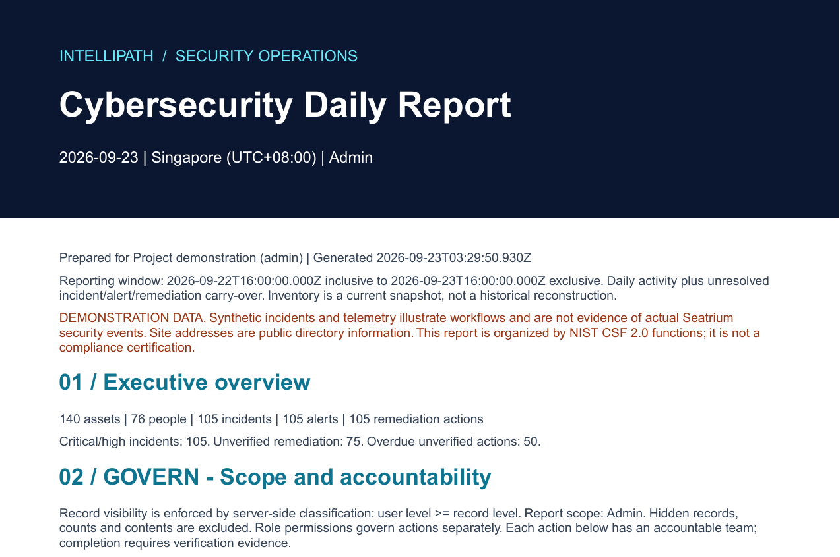
REPORT EXPORT
A daily PDF for security review
NIST CSF structure
Govern
Identify
Protect
Detect
Respond
Recover
Singapore reporting day
Unresolved carryover
Authorized evidence
Reporting structure, not a compliance certification.
Actual generated report, first-page excerpt
IntelliPath / Connected resource workspace
08
Notes:
50 seconds. This is an actual PDF generated by the current project report.js using isolated seeded demo data and Admin scope on 23 September 2026. The displayed first-page excerpt is unaltered. The report includes daily activity and unresolved incident, alert and remediation carryover. Current inventory is a snapshot rather than a reconstruction of historical inventory. NIST CSF functions provide the report structure, without claiming certification. The full report may contain appendices and logs depending on settings.
Project source: https://github.com/EasonXu-HY99/intellipath, README.md, docs/RESOURCE-WORKSPACE.md, docs/OPERATIONS-V2.md and shared/access.js. UI screenshots are the actual demonstration environment, captured 23 September 2026. Official Seatrium logos: https://www.seatrium.com/assets/images/seatrium-logo.svg and https://www.seatrium.com/assets/images/seatrium-logo-white.svg. Logos retain original proportions. All maritime concept scenes are illustrative and do not depict actual Seatrium operations.

Slide 9






DOCUMENTS AND MICROSOFT ECOSYSTEM
File upload and familiar source identities
Platform upload
OneDrive destination
Create a searchable file record with classification and controlled downloads.
Choose a familiar destination. Files currently remain in IntelliPath storage.
Teams
OneDrive
SharePoint
Exchange
Defender
for Cloud
Sentinel
Source logos are illustrative. Microsoft services are not connected.
IntelliPath / Connected resource workspace
09
Notes:
40 seconds. Files up to 5 MB create searchable records and authenticated download entries. UTF-8 text indexing covers the first 50,000 characters, while binary files use metadata; no OCR is claimed. OneDrive is a demo destination that stores bytes locally, not a live synchronization. Teams, OneDrive, SharePoint and Exchange glyphs are Simple Icons 11.15.0 assets. Defender for Cloud and Sentinel icons are official Azure architecture assets. Provenance: docs/BRAND-ASSETS.md.
Project source: https://github.com/EasonXu-HY99/intellipath, README.md, docs/RESOURCE-WORKSPACE.md, docs/OPERATIONS-V2.md and shared/access.js. UI screenshots are the actual demonstration environment, captured 23 September 2026. Official Seatrium logos: https://www.seatrium.com/assets/images/seatrium-logo.svg and https://www.seatrium.com/assets/images/seatrium-logo-white.svg. Logos retain original proportions. All maritime concept scenes are illustrative and do not depict actual Seatrium operations.

Slide 10
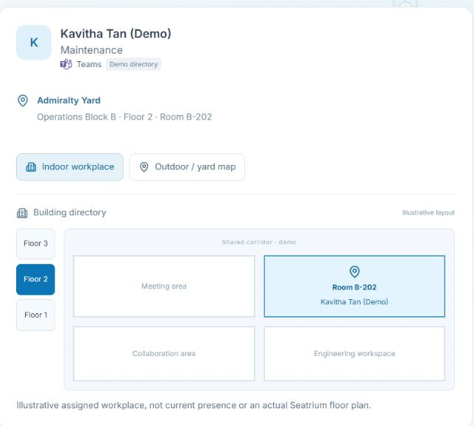
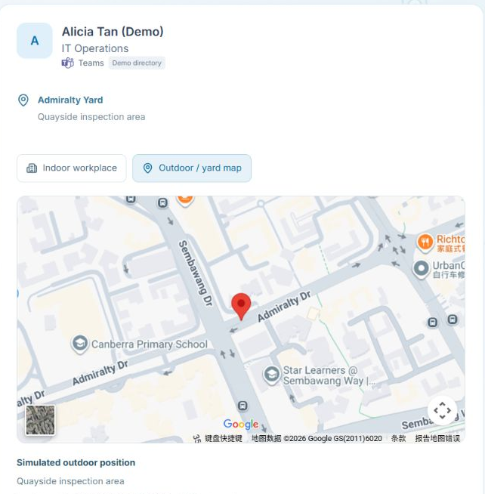
INDOOR AND OUTDOOR LOCATION
People in context
Building and floor
Yard and work zone
Site, building, floor and room
Illustrative map position, not live GPS
IntelliPath / Connected resource workspace
10
Notes:
Two actual workspace views distinguish indoor and outdoor work. The indoor person card uses a synthetic floor plan and room; the outdoor view uses a synthetic recorded yard location. Neither is proof of current employee presence. Internal positions are illustrative. Published site addresses provide geographic context.
Project source: https://github.com/EasonXu-HY99/intellipath, README.md, docs/RESOURCE-WORKSPACE.md, docs/OPERATIONS-V2.md and shared/access.js. UI screenshots are the actual demonstration environment, captured 23 September 2026. Official Seatrium logos: https://www.seatrium.com/assets/images/seatrium-logo.svg and https://www.seatrium.com/assets/images/seatrium-logo-white.svg. Logos retain original proportions. All maritime concept scenes are illustrative and do not depict actual Seatrium operations.

Slide 11
ROLE PERMISSIONS
Access follows the user through every step
Search, agents, files and reports share the same authorized record scope.
Role | Find resources | Upload files | Use AI | Manage users
Admin | Yes | Yes | Yes | Yes
Manager | Yes | Yes | Yes | No
Analysis | Yes | Yes | Yes | No
Engineer | Yes | Yes | Yes | No
Viewer | Yes | No | No | No
Visibility controls what users see. Permissions control what they can do.
IntelliPath / Connected resource workspace
11
Notes:
Representative permission matrix derived from server/auth.js. All resource reads remain restricted to the role’s record scope. Admin alone has the users permission. Viewer can search and read its permitted records but cannot upload or use the AI endpoints. Higher roles have additional permissions not exhaustively shown in this matrix. Agents never widen the caller’s authorization.
Project source: https://github.com/EasonXu-HY99/intellipath, README.md, docs/RESOURCE-WORKSPACE.md, docs/OPERATIONS-V2.md and shared/access.js. UI screenshots are the actual demonstration environment, captured 23 September 2026. Official Seatrium logos: https://www.seatrium.com/assets/images/seatrium-logo.svg and https://www.seatrium.com/assets/images/seatrium-logo-white.svg. Logos retain original proportions. All maritime concept scenes are illustrative and do not depict actual Seatrium operations.

Slide 12
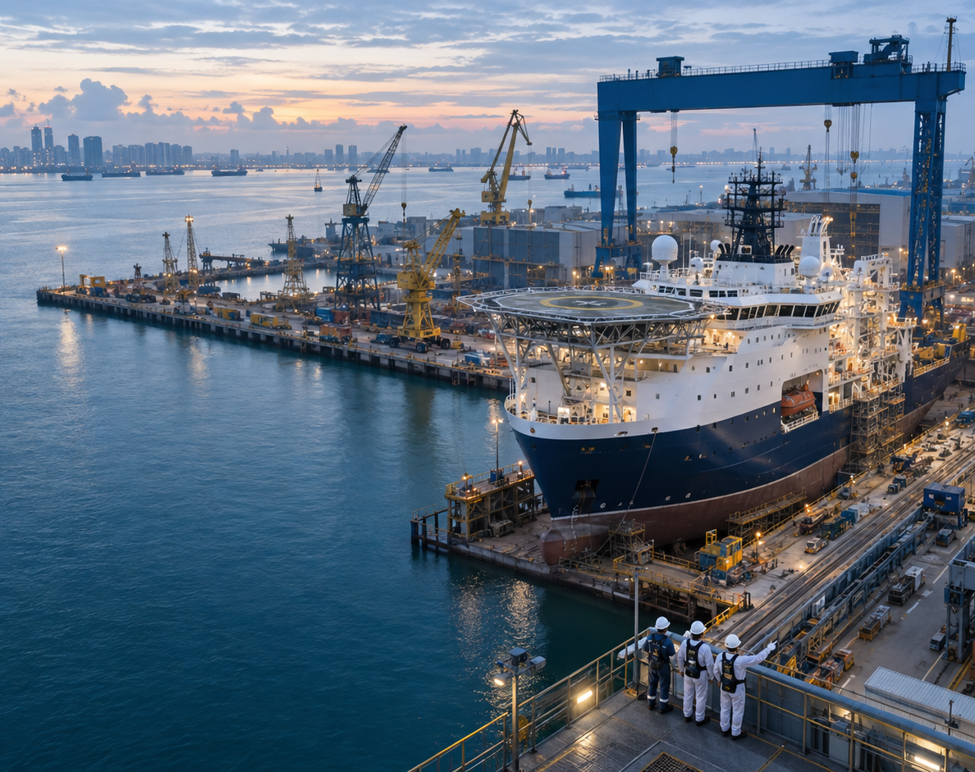
NEXT STEPS
The path to a production pilot
Validate the work
Test search and reporting journeys with real users.
Prepare the data
Replace sample records and establish durable storage.
Connect approved systems
Plan identity, Microsoft sources and location consent.
intellipath-mroh.onrender.com
IntelliPath / Connected resource workspace
12
Notes:
Closing, 30 seconds. Invite feedback on workflow usefulness, search success, access clarity and reporting needs. Pilot readiness depends on trusted data, persistence, identity and approved integrations. These are proposed next steps, not delivery commitments. Demo URL: https://intellipath-mroh.onrender.com/. Design exploration included Gamma Marine as a dark maritime reference; the final slide layouts are authored for this project.
Project source: https://github.com/EasonXu-HY99/intellipath, README.md, docs/RESOURCE-WORKSPACE.md, docs/OPERATIONS-V2.md and shared/access.js. UI screenshots are the actual demonstration environment, captured 23 September 2026. Official Seatrium logos: https://www.seatrium.com/assets/images/seatrium-logo.svg and https://www.seatrium.com/assets/images/seatrium-logo-white.svg. Logos retain original proportions. All maritime concept scenes are illustrative and do not depict actual Seatrium operations.

