Slide 1
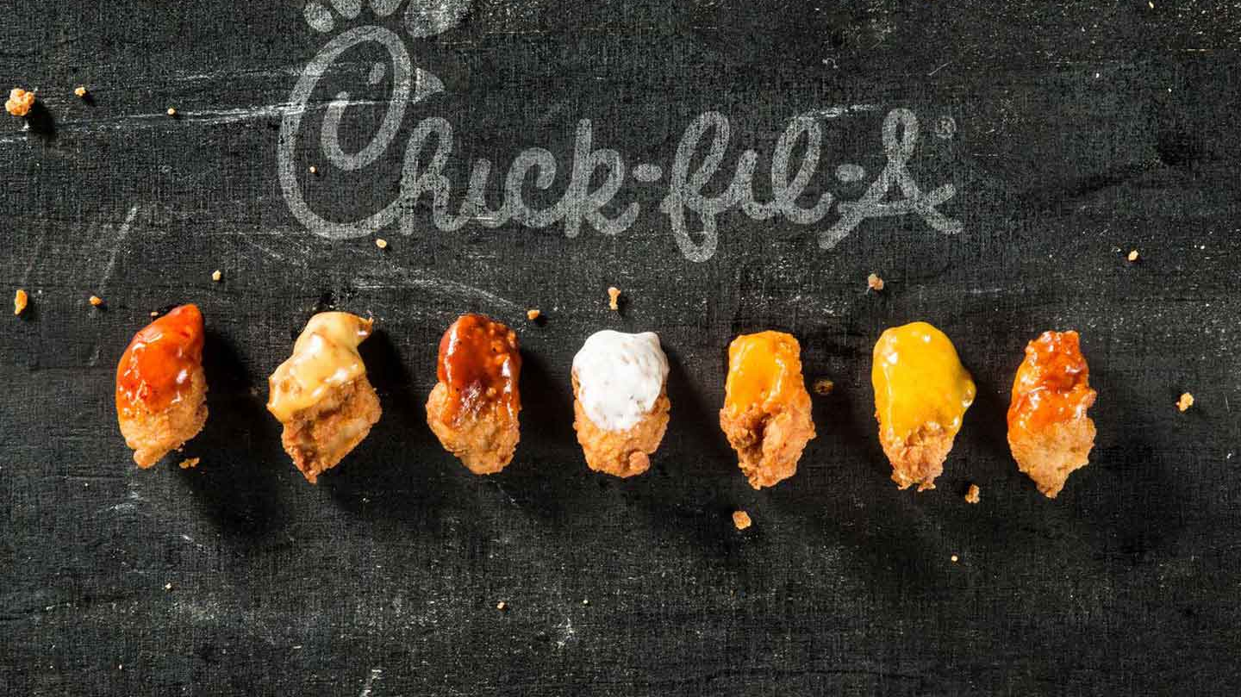
Effects of Covid 19

Slide 2
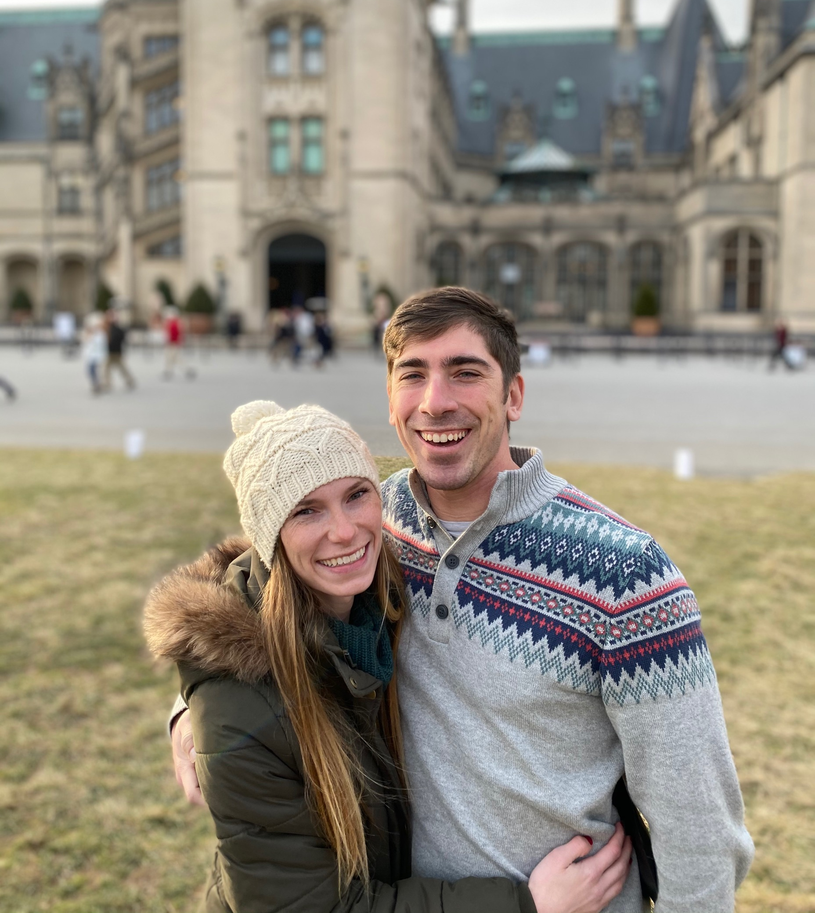
Damon Manley
BS in Exercise Science
Director of Hospitality at Chick-fil-A
Working in Chick-fil-A since 2016
Analyzing business trends has helped in my career at Chick-fil-A and has led me to pursue the path to data science

Slide 3
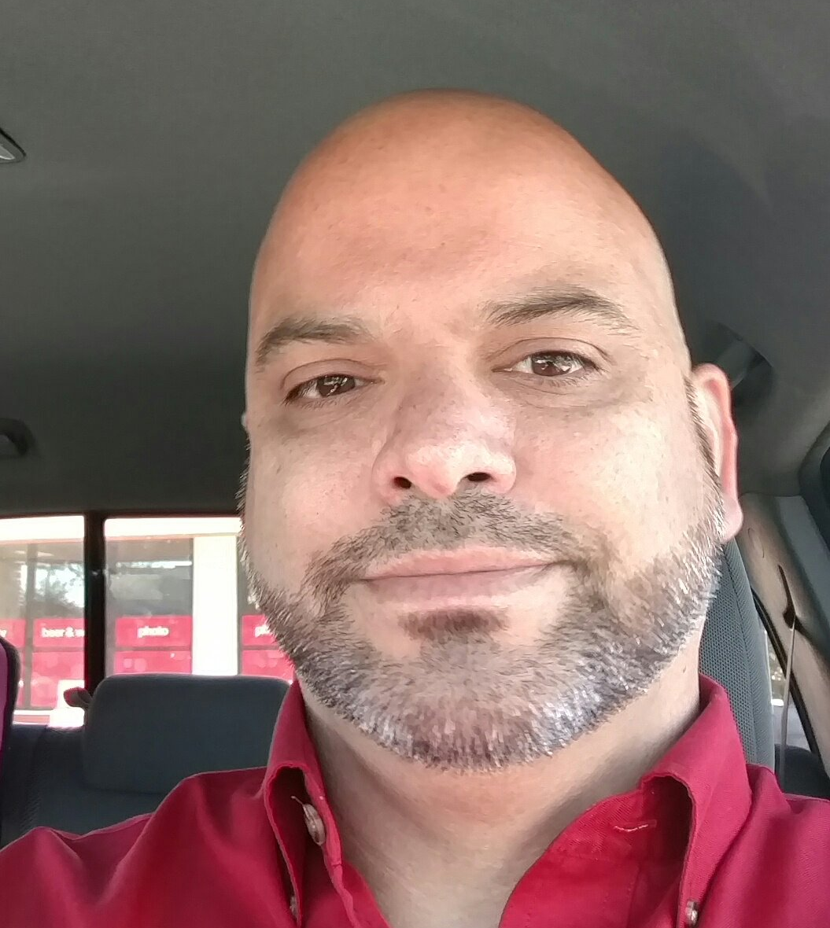
Doug Timothy
BS in Mathematics
BS in Cartography
Professional Surveyor and Mapper since Dec 2011
Been in the mapping field for about 23 years
Currently working for Pickett and Associates and have been with them for about 17 years
Soon-to-be graduate of Bethel Tech Coding Bootcamp

Slide 4
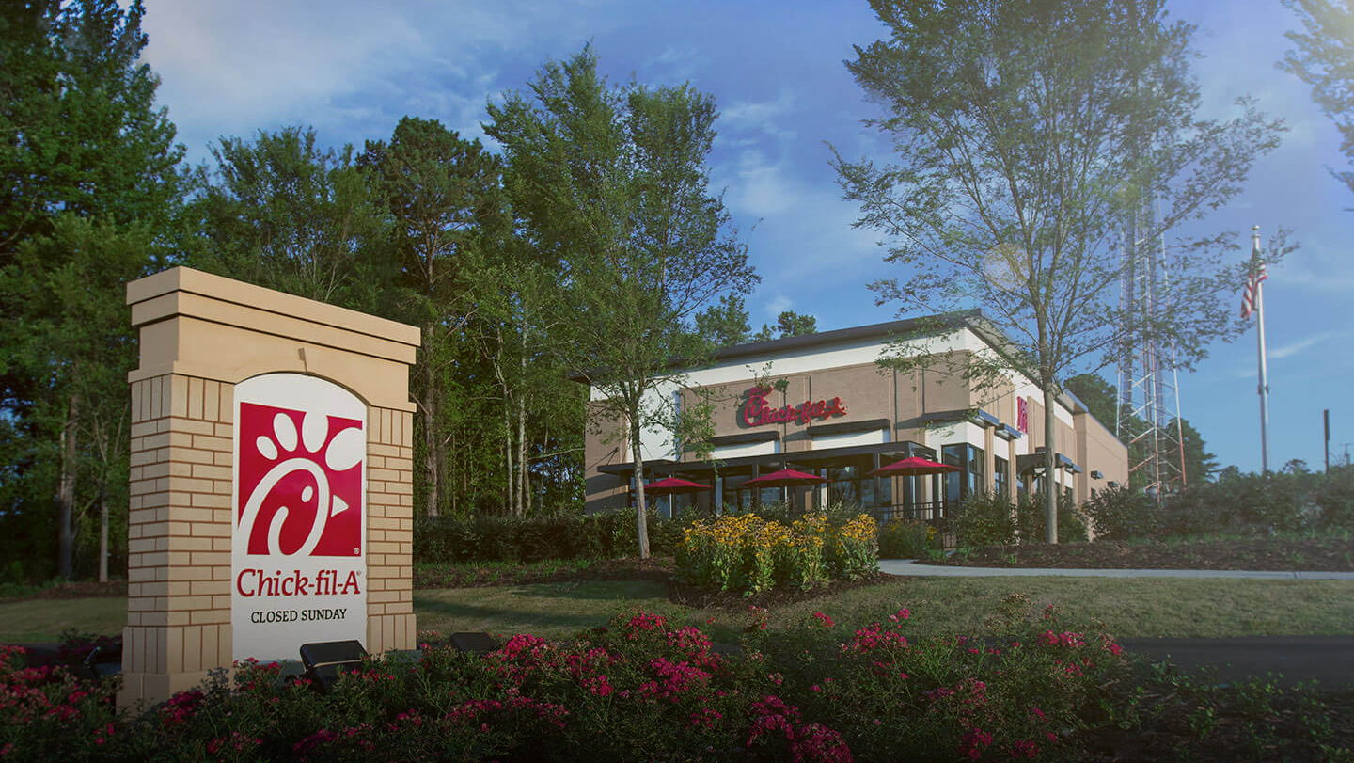
Covid 19 has negatively impacted the restaurant industry, but how has it impacted one specific location of the CFA restaurant chain? This project will analyze data from a CFA location in Charleston, SC. CFA has given access to unlimited data but due to the time constraints of this project, we will only be considering a few questions.
How successful has CFA evolved to fit the new norm of drive-thru only?
How have labor cost been affected by Covid?
How has ordering changed during Covid?

Slide 5
Methods of Analysis used for this project:
Objective 1 – We used an ANOVA analysis and the following variables: Sales, NormDT, 3rdParty and Time.
Objective 2 – We used a linear regression analysis using the variables Productivity and Time.
Objective 3 – We used a MANOVA analysis and looked at the following variables: MobCO, MobDI, DineIn, Catering, CarryO, NormDT, 3rdParty, and Time.

Slide 6
Variables used in analysis:
Sales: Total amount of sales in USD.
HoursUsed: Total number of man hours.
MobCO: Total sales by Mobile Carryout orders - guests orders on the app, pick up order in restaurant, and leaves with order.
MobDI: Total sales by Mobile Dine-In orders - orders on the app, finds and scan a table in the dining room, order is brought to you.
MobDT: Total sales by Mobile Drive-Thru orders - guests orders on the app and picks up the order in the drive-thru line.
Mobile Sales: Total sales done through the mobile app.
3rd party: Total sales done through a 3rd party delivery company, typically Uber Eats or DoorDash.
NormDT: Total sales done through the traditional drive-thru process
CarryO: Total sales through the traditional carryout process.
DineIn: The guest places their order at the counter and goes to find a seat that the team member will bring their order to.
Catering: Total sales for event catering.
Time:
Before: “Pre-Covid19” or any time in the weeks leading up to the 6-week lockdown period.
During: During the 6-week lockdown period.
After: After the 6-week lockdown period and people started to understand what the new norm may look like.
Productivity: Sales/ HoursUsed – CFA’s metric for productivity

Slide 7
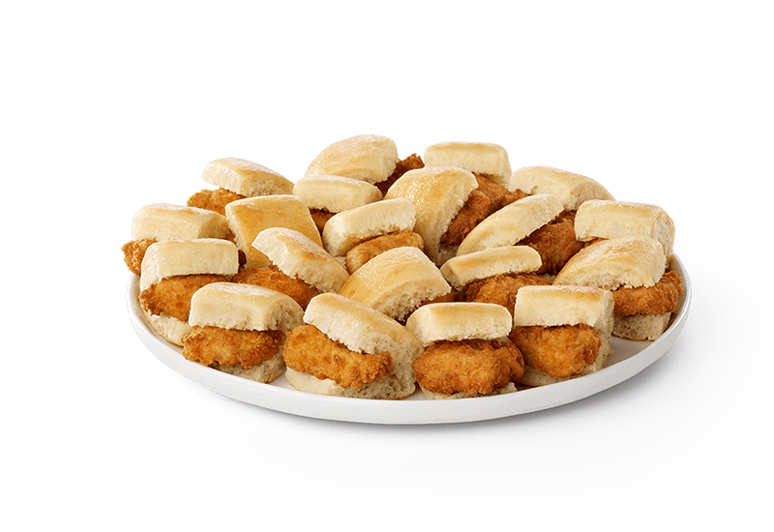
Obj 1: How successful has Chick fil-A evolved to fit the new norm (drive-thru only)?

Slide 8
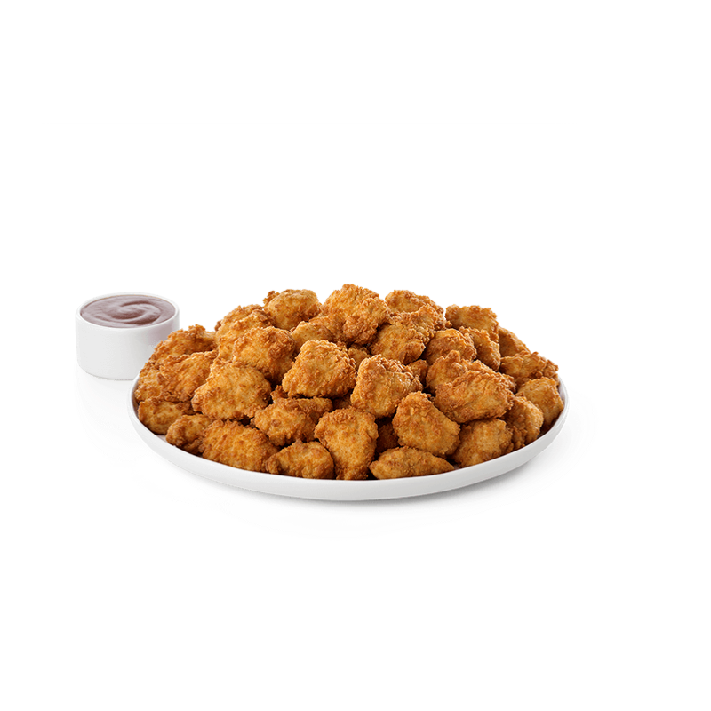
Obj 2: How has labor costs been affected by Covid? Was there a change in productivity?

Slide 9
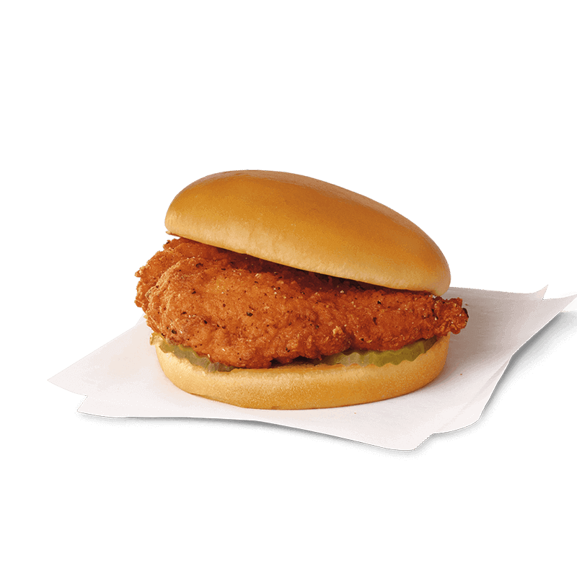
Obj 3: How has ordering changed during Covid?

Slide 10
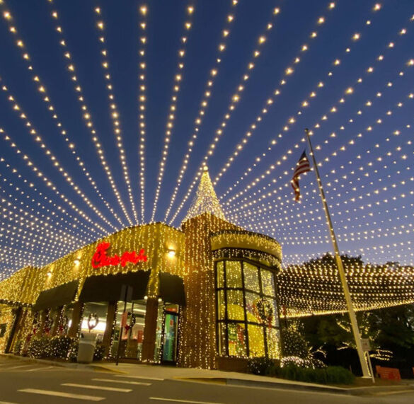
Summary

Slide 11
Questions

Slide 12
