Slide 1
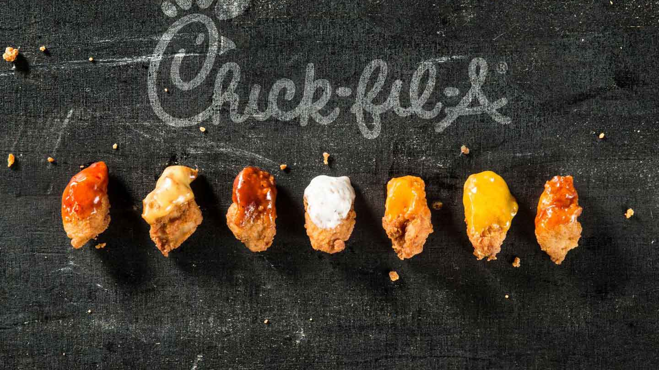
Effects of Covid-19 on a Quick-Service Restaurant
Notes:
Doug

Slide 2
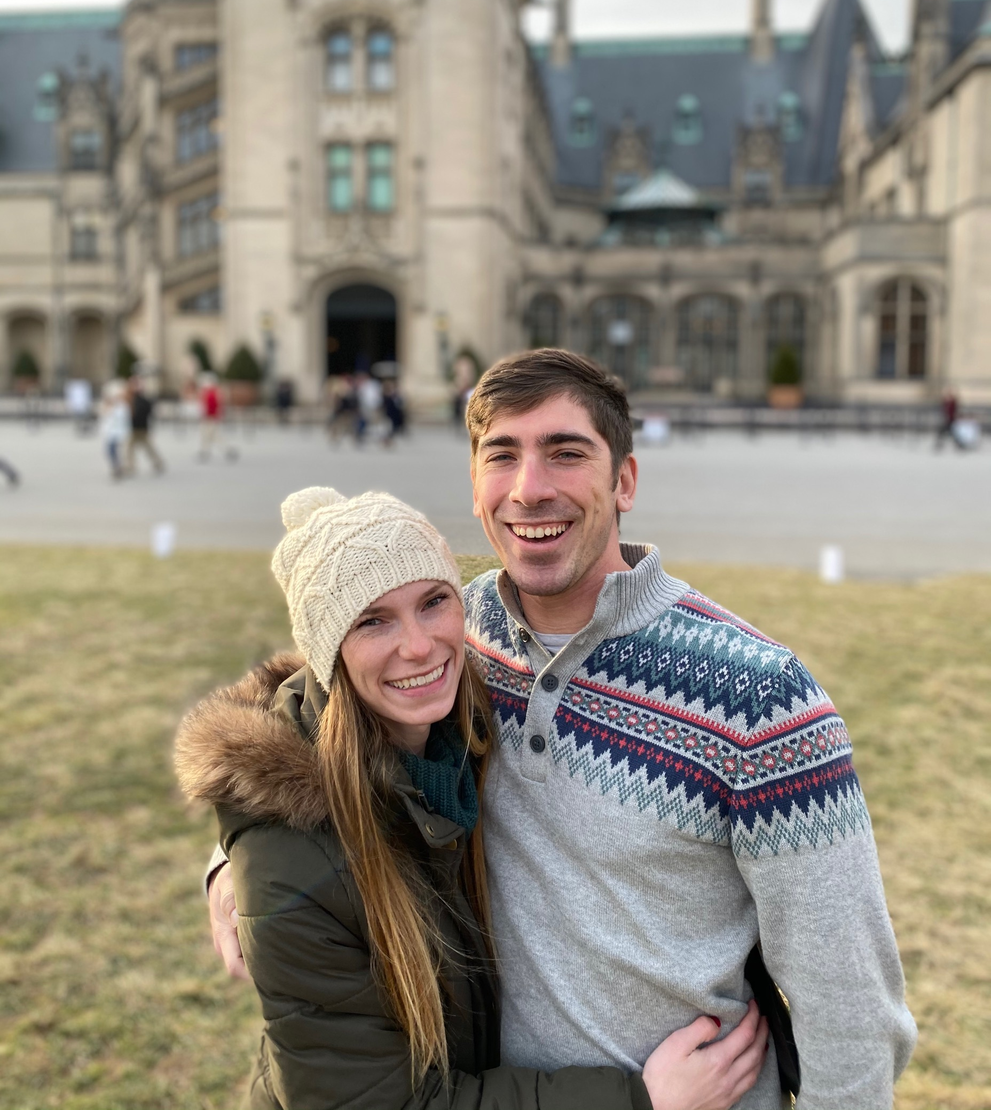
Damon Manley
Born and raised in Charleston, South Carolina
Graduated with a BS in Exercise Science from College of Charleston in 2017
Married to my wife Kelsey in November 2017
Working at Chick-fil-A since 2016
Director of Hospitality, Kitchen Director, Scheduling, Inventory
Analyzing business trends has helped in my career at Chick-fil-A and has led me to pursue the path to data science
Notes:
Damon

Slide 3

Doug Timothy
BS in Mathematics
BS in Cartography
Professional Surveyor and Mapper since Dec 2011
Been in the mapping field for about 23 years
Currently working for Pickett and Associates and have been with them for about 17 years
Soon-to-be graduate of Bethel Tech Coding Bootcamp
Notes:
Doug

Slide 4
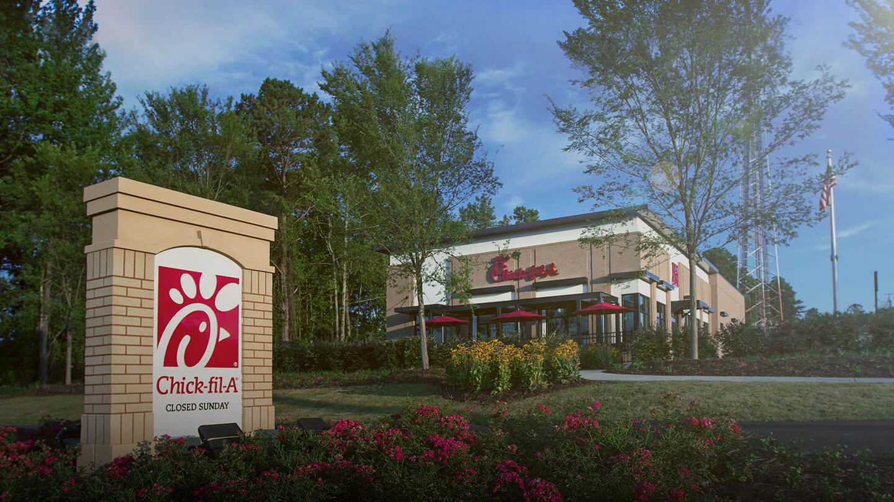
Covid 19 has negatively impacted the restaurant industry, but how has it impacted one specific location of the Chick-fil-A (CFA) restaurant chain? This project will analyze data from a CFA location in Charleston, SC. CFA has given access to unlimited data but due to the time constraints of this project, we will only be considering a few questions.
Background

Slide 5
Objectives:
How has CFA evolved to fit the new norm of drive-thru only?
How has labor been affected by Covid?
How has the way guests order changed during Covid?
Notes:
Damon

Slide 6
Methods: The Data
Gathered data from the Sales Activity from November 2019 through November 2020 to create the dataset that was used.
Added Productivity column: Sales divided by HoursUsed
Added WeekNum column: Actual week of the year, where 1 is the first week of January.
Different from the “Week” column where 1 is the first week accounted for.
Added Time column: Before (pre-lockdown), During (lockdown) and After (post-lockdown)
The dataset has a sample size of 52 weeks.
Notes:
Doug

Slide 7
Methods of Analysis:
ANOVA analysis to test if there is a significant difference in sales over time for each variable.
Linear Regression analysis to analyze how productivity changed through time.
MANOVA analysis to see which ordering methods have become more popular since the start of the pandemic.
Notes:
Damon

Slide 8
Programs and Wrangling:
R and R studio for Statistical Analyses
Python and Jupyter Notebook for Data Wrangling
Tableau for Visualization
Excel for Pivot Table
Notes:
Doug

Slide 9
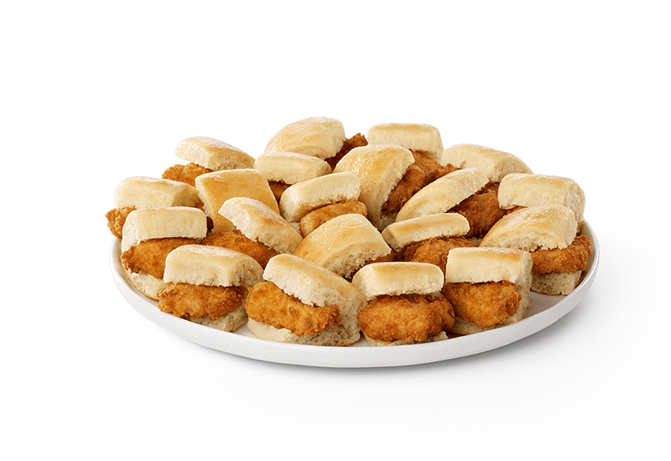
How successfully has Chick fil-A evolved to fit the new norm (drive-thru only)?
3rd Party Delivery:
Chick-fil-A started partnering with 3rd party delivery companies not too long before Covid started.
This proved to be a very timely decision as 3rd party sales grew 3 times during the course of our data,
Traditional Drive-Thru:
When it came to the traditional drive-thru method, the restaurant had a significant increased the sales from an average of ~$75,000/wk before and during the lockdown, to ~$95,000/wk after the 6-week period.
Mobile Drive-Thru Ordering:
~$7,300/wk before the start of Covid
~$17,000/wk during the 6-week lockdown
~$26,000/wk after the lockdown was over
Notes:
Damon

Slide 10
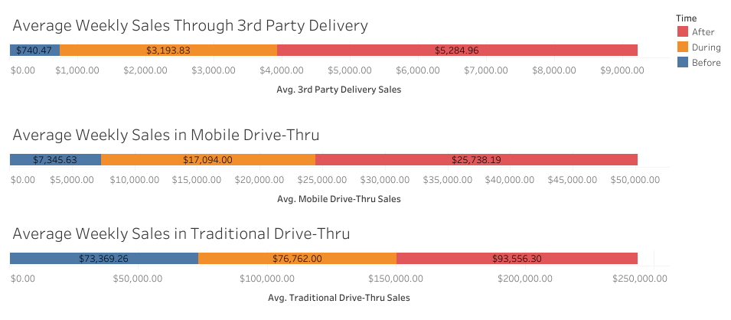
Notes:
Damon

Slide 11
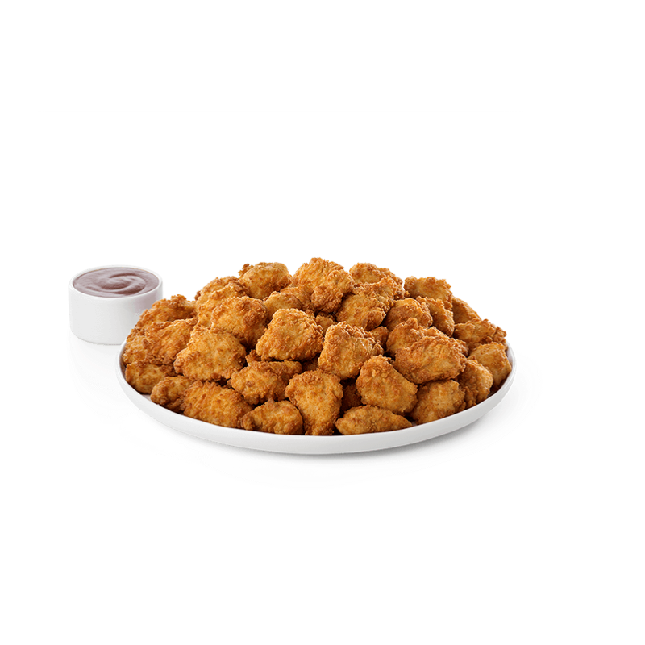
How has labor costs been affected by Covid? Was there a change in productivity?
Productivity was proven to stay constant, with not a lot of error or overall change, throughout the entire year.
There were a few outliers (weeks 20, 25 and 29), which we will show you and talk through in the next slide.
Overall, this location seems to have handled labor well, even through unsettling circumstances.
Notes:
Doug

Slide 12
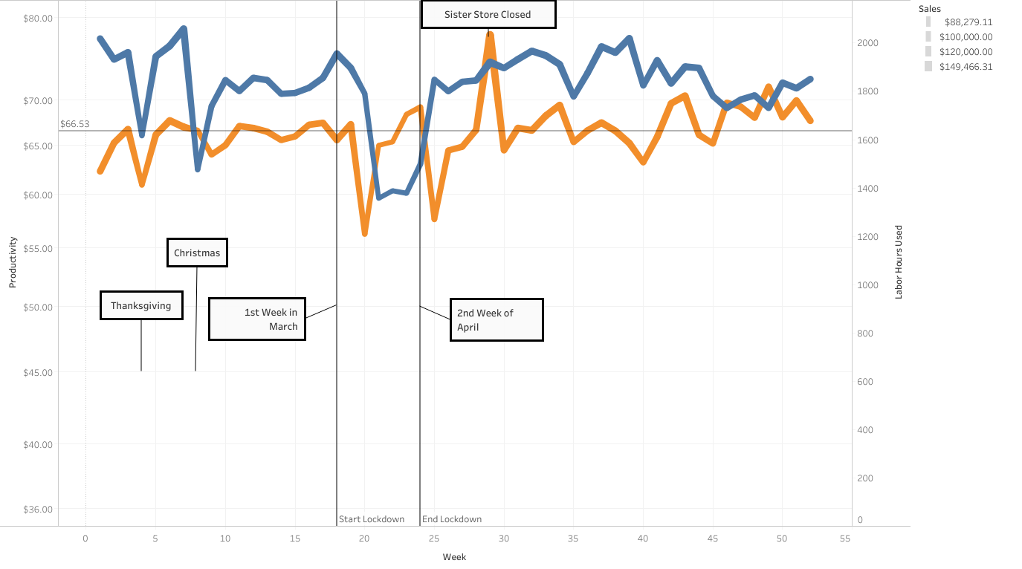
Notes:
Damon

Slide 13
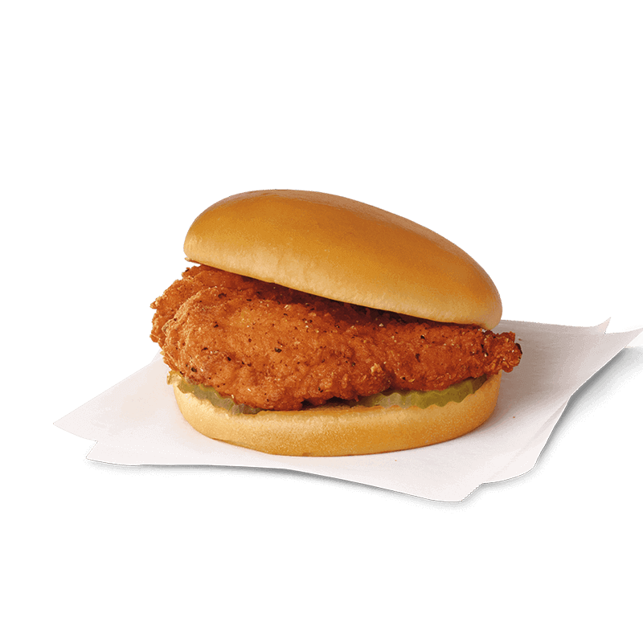
How has ordering changed during Covid?
By looking at this pivot table, we can tell that there has been changes to how people typically choose to order.
Values | Before | During | After
Average of CarryO | 12,732.05 | 0.00 | 0.00
Average of MobCO | 7,170.84 | 29.60 | 0.00
Average of DineIn | 17,305.05 | 0.00 | 0.00
Average of MobDI | 1,151.47 | 0.00 | 0.00
Average of MobDT | 7,345.63 | 16,315.80 | 25,568.43
Average of NormDT | 73,369.26 | 76,075.60 | 93,079.07
Average of Catering | 2,260.21 | 297.40 | 1,504.00
Average of 3rdParty | 740.47 | 2,878.40 | 5,266.61
All dining room access had been cut off, explaining the zeros in 4 of the variables in the after column.
Notes:
Doug

Slide 14
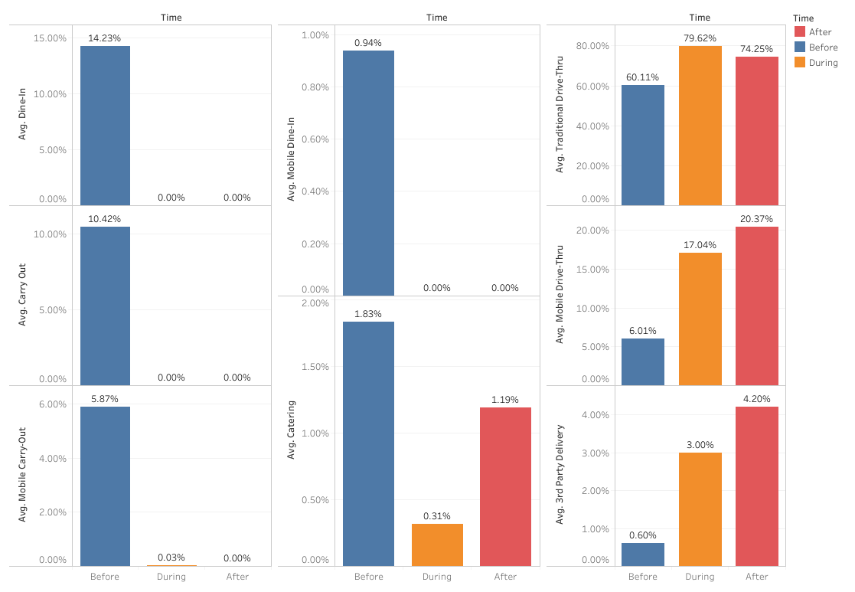
Notes:
Doug

Slide 15
Summary
Average 3rd Party Delivery sales increased from approximately $700/wk before the lockdown to around $5300/wk after
Tradition Drive-Thru Average has increased by $20,000/wk
Mobile Drive-Thru Average has tripled
Productivity finished above average
Overall, Mobile and 3rd party ordering have increased significantly in popularity
Notes:
Damon

Slide 16
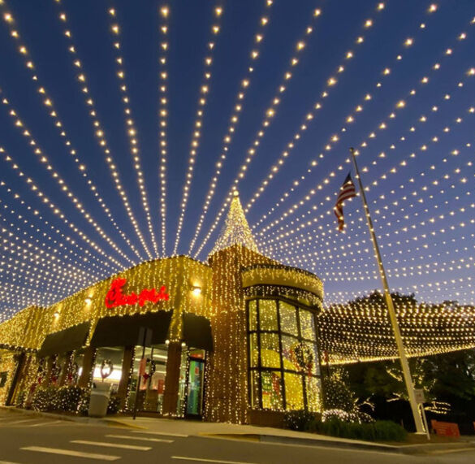
Conclusions
Overall, we believe that this Chick-fil-A location has responded well to the circumstances! They maintained productivity numbers through the dining room being shut down, a state-wide lockdown and then after.
Strategies have evolved as the business coped with the pandemic, which has helped to capitalize on as many opportunities as possible.
Some opportunities were disappearing, such as the dine-in experience that Chick-fil-A is known for, but they excelled in drive-thru experience to make up for it.
WE WOULD LIKE TO THANK YOU ALL FOR YOUR TIME!
And Chick-fil-A for the use of their data and images <3
Notes:
Doug

Slide 17
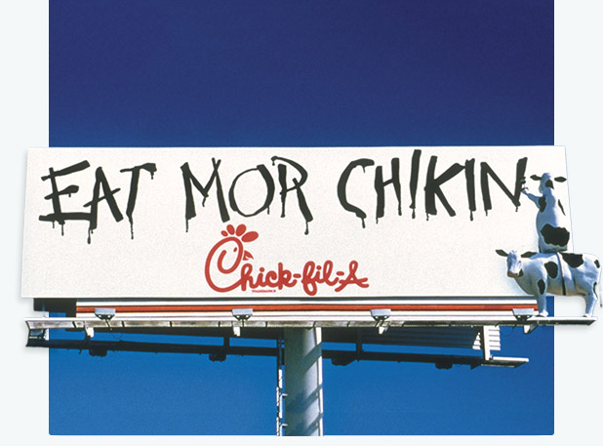
ALWAYS REMEMBER…

