Slide 1
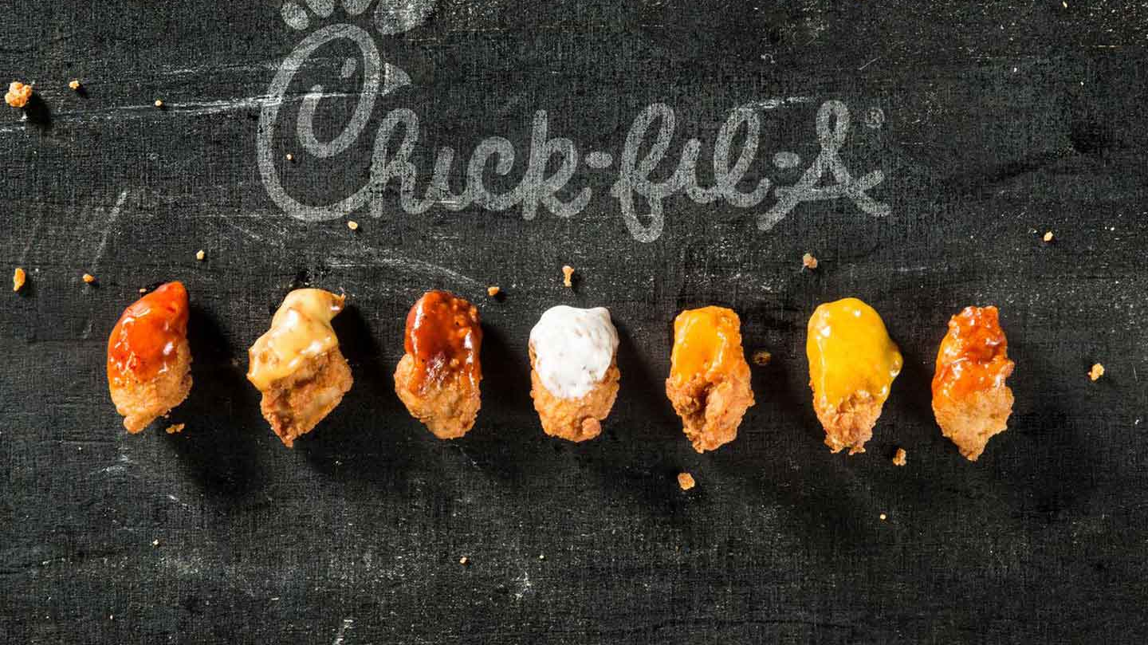
Effects of Covid-19 on a Quick-Service Restaurant

Slide 2
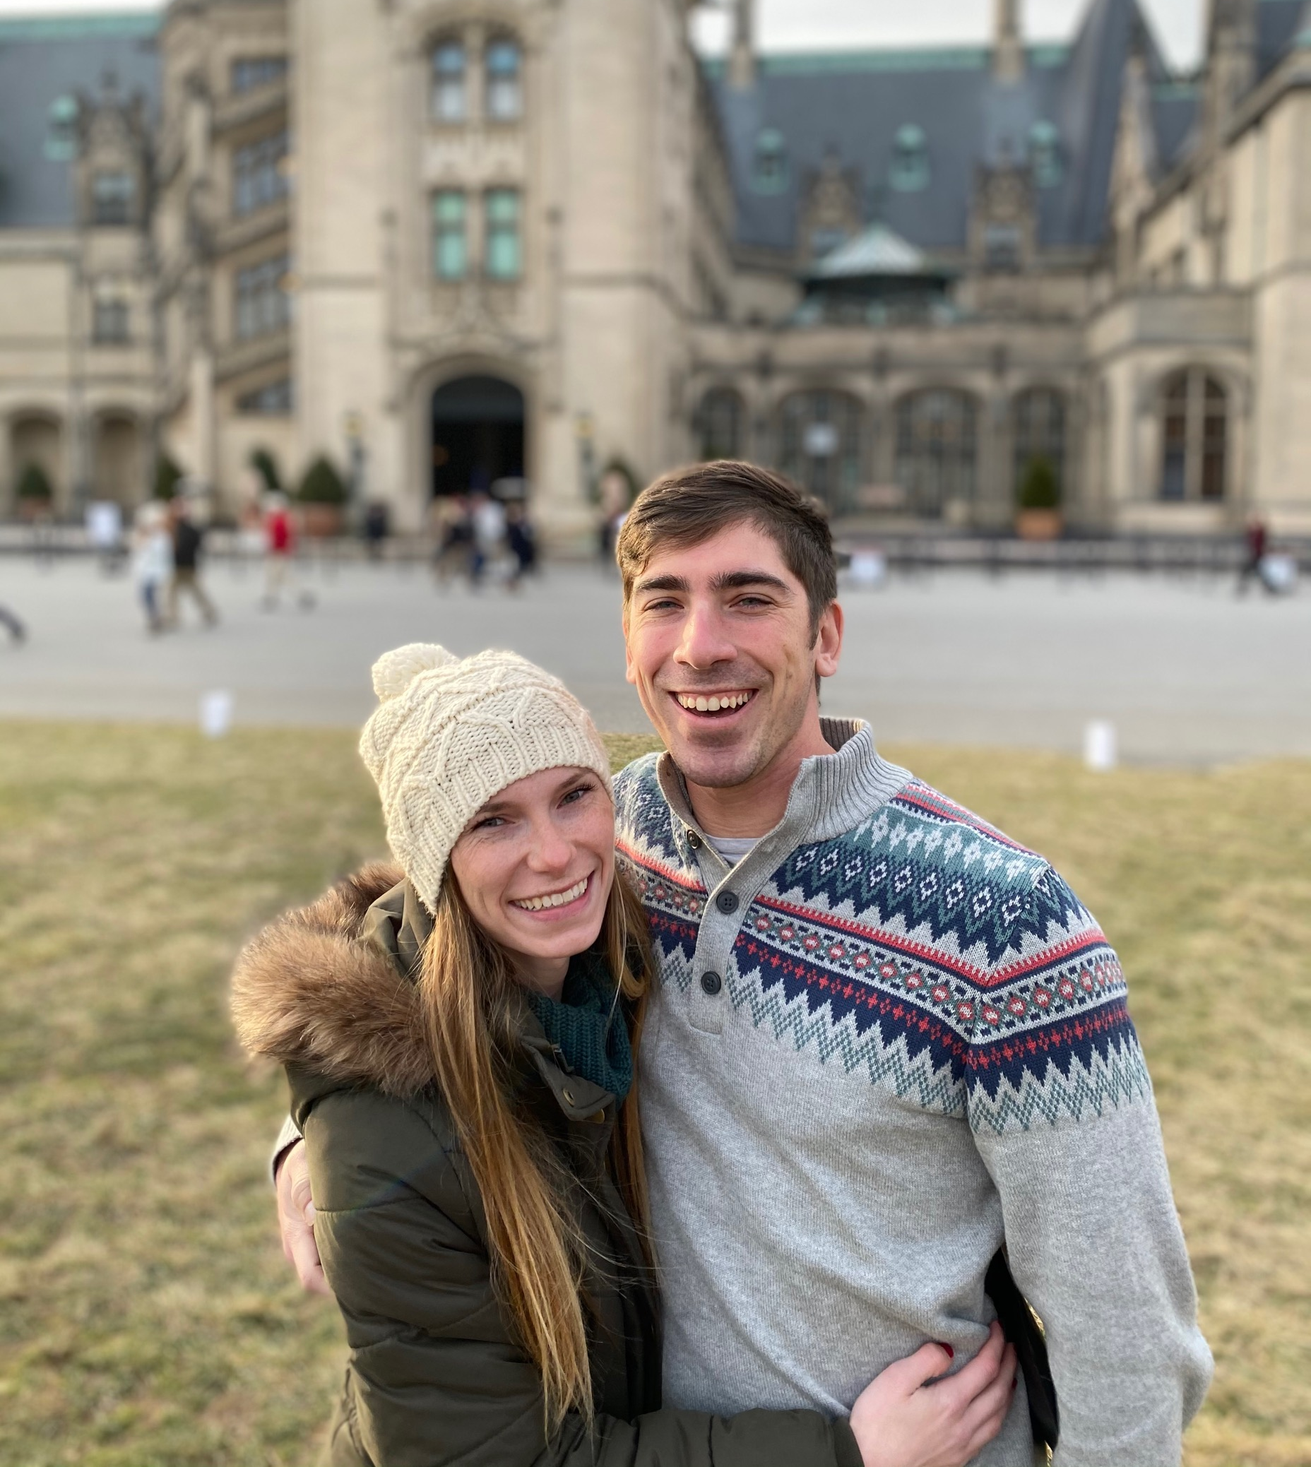
Damon Manley
Born and raised in Charleston, South Carolina
Graduated with a BS in Exercise Science from College of Charleston in 2017
Married to my wife Kelsey in November 2017
Working at Chick-fil-A since 2016
Director of Hospitality, Kitchen Director, Scheduling, Inventory
Analyzing business trends has helped in my career at Chick-fil-A and has led me to pursue the path to data science

Slide 3
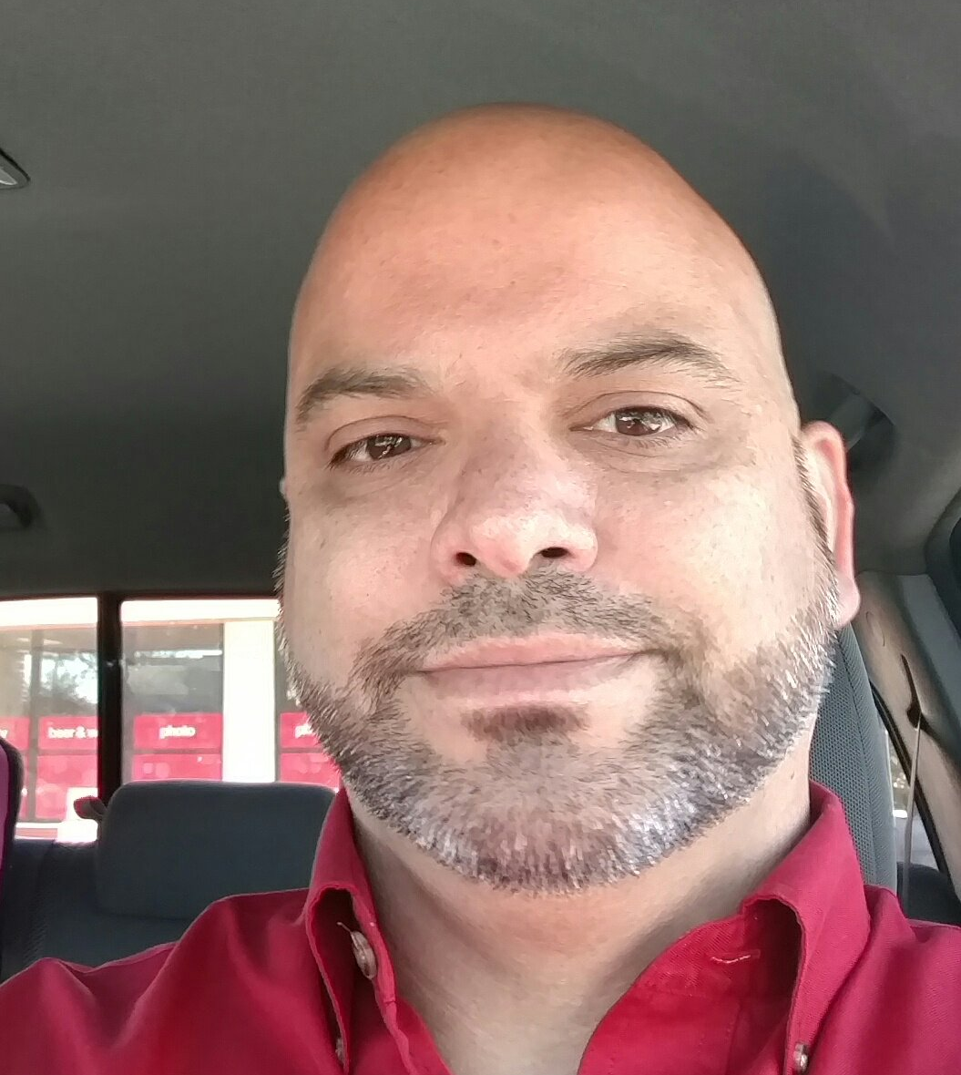
Doug Timothy
BS in Mathematics
BS in Cartography
Professional Surveyor and Mapper since Dec 2011
Been in the mapping field for about 23 years
Currently working for Pickett and Associates and have been with them for about 17 years
Soon-to-be graduate of Bethel Tech Coding Bootcamp

Slide 4
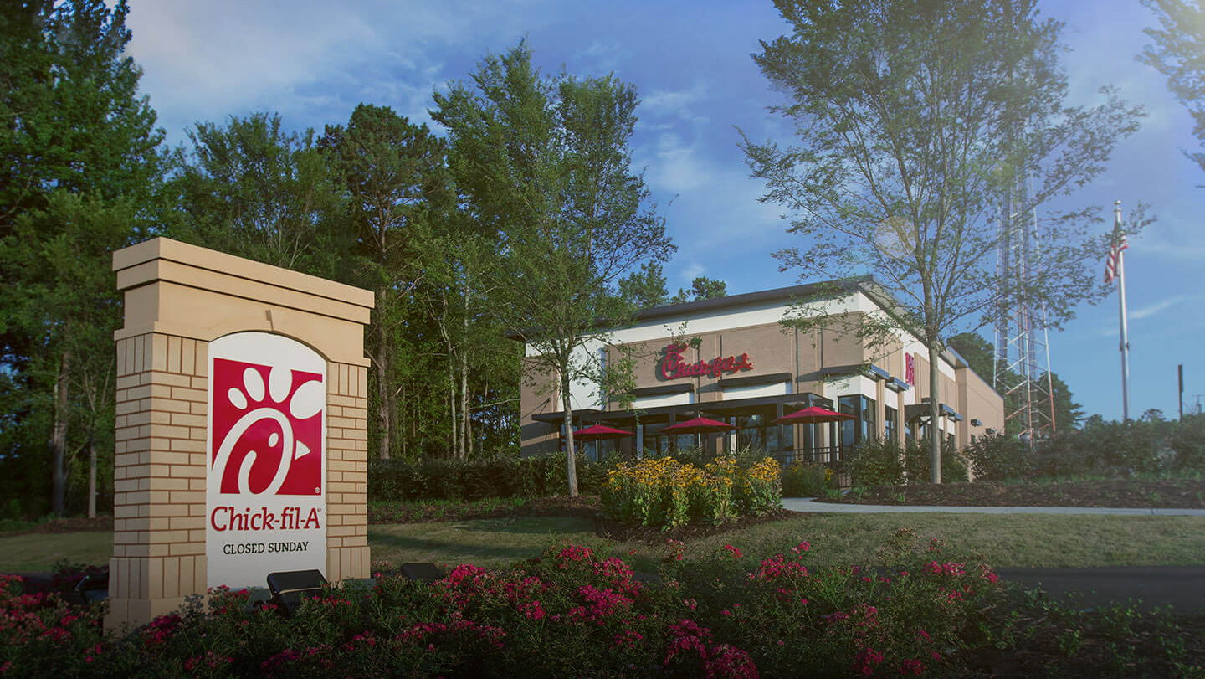
Covid 19 has negatively impacted the restaurant industry, but how has it impacted one specific location of the CFA restaurant chain? This project will analyze data from a CFA location in Charleston, SC. CFA has given access to unlimited data but due to the time constraints of this project, we will only be considering a few questions.
How has CFA evolved to fit the new norm of drive-thru only?
How has labor been affected by Covid?
How has the way guests order changed during Covid?

Slide 5
Methods of Analysis:
Gathered data from the Sales Activity from November 2019 through November 2020.
Added Productivity column: Sales divided by HoursUsed
Added WeekNum column: Actual week of the year, where 1 is the first week of January.
Different from the “Week” column where 1 is the first week accounted for.
Added Time column: Before (pre-lockdown), During (lockdown) and After (post-lockdown)
The dataset has a sample size of 52 weeks.

Slide 6
Methods of Analysis (cont):
Statistical analyses that were used:
ANOVA analysis to test if there is a significant difference in sales over time for each variable.
Dependent Variables: Sales, NormDT, MobDT, and 3rdParty
Independent Variable: Time
Linear regression analysis to analyze how productivity changed through time.
Dependent Variable: Productivity
Independent Variable: Time
MANOVA analysis to see which ordering methods have become more popular since the start of the pandemic.
Dependent Variables: MobCO, MobDI, DineIn, Catering, CarryO, NormDT, 3rdParty
Independent Variable: Time.

Slide 7
Variables used in analysis (Meta-Data):
Sales: Total amount of sales in each week in USD.
HoursUsed: Total number of man hours used each week.
MobCO: Total sales by Mobile Carryout - guest orders on the app, pick up meal inside the restaurant, and take their meal to go.
MobDI: Total sales by Mobile Dine-In orders – guest orders on the app, finds a table and scan the barcode in the dining room, and order is brought to them.
MobDT: Total sales by Mobile Drive-Thru orders - guest orders on the app and picks up their meal in the drive-thru line.
Mobile Sales: Total sales done through the mobile app in total. MobCO + MobDI + MobDT
3rdParty: Total sales done through a 3rd party delivery company, typically Uber Eats or DoorDash.
NormDT: Total sales done through the traditional drive-thru process.
CarryO: The guest walks inside, orders at the counter, then takes their meal to go.
DineIn: The guest places their order at the counter and goes to find a seat that the team member will bring their order to.
Catering: Total sales for event catering.
Time:
Before: “Pre-Covid19” or any time in the weeks leading up to the 6-week lockdown period.
During: During the 6-week lockdown period.
After: After the 6-week lockdown period and people started to understand what the new norm may look like.
Productivity: Sales/HoursUsed – Total Sales per person on the clock per hour.

Slide 8
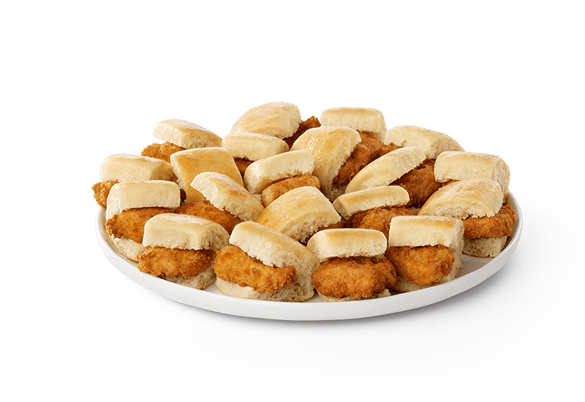
How successfully has Chick fil-A evolved to fit the new norm (drive-thru only)?
Looked at how each drive-thru variable changed in relationship to the pandemic.
We found that before and after were almost equal when it came to overall sales. Even through the pandemic, this Chick-fil-A location increased their sales.
When it came to the traditional drive-thru method, the restaurant had a significant increased the sales from an average of ~$75,000/wk before and during the lockdown, to ~$95,000/wk after the 6-week period.
Before the start of Covid, this location was averaging ~$7,300/wk in Drive-Thru Mobile orders. During the 6-week lockdown period, this rose to ~$17,000/wk. After the lockdown, these sales increased significantly again up to ~$26,000/wk.

Slide 9
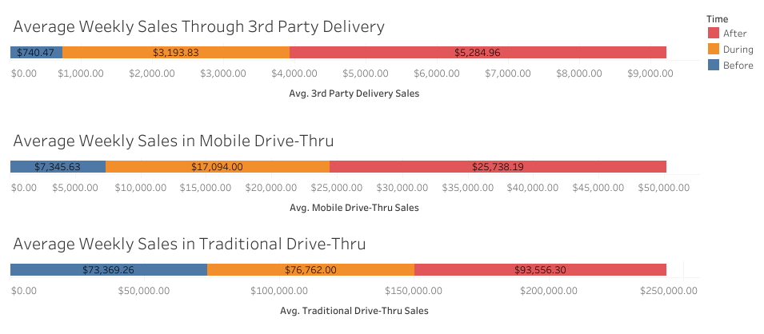

Slide 10
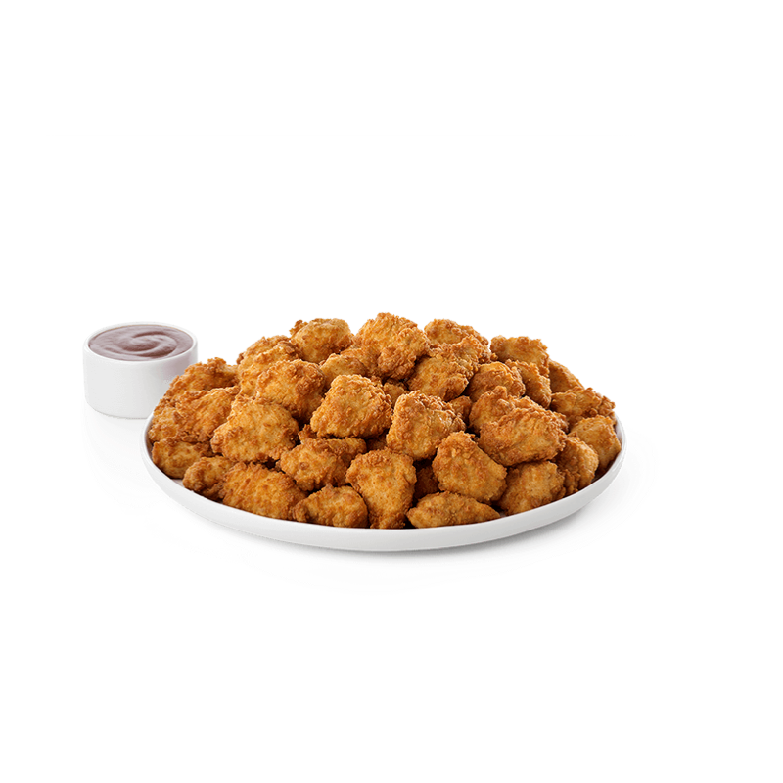
How has labor costs been affected by Covid? Was there a change in productivity?
Productivity was proven to stay constant, with not a lot of error or overall change, throughout the entire year.
There were a few outliers (weeks 20, 25 and 29), which we will show you and talk through in the next slide.
Overall, this location seems to have handled labor well, even through unsettling circumstances.

Slide 11
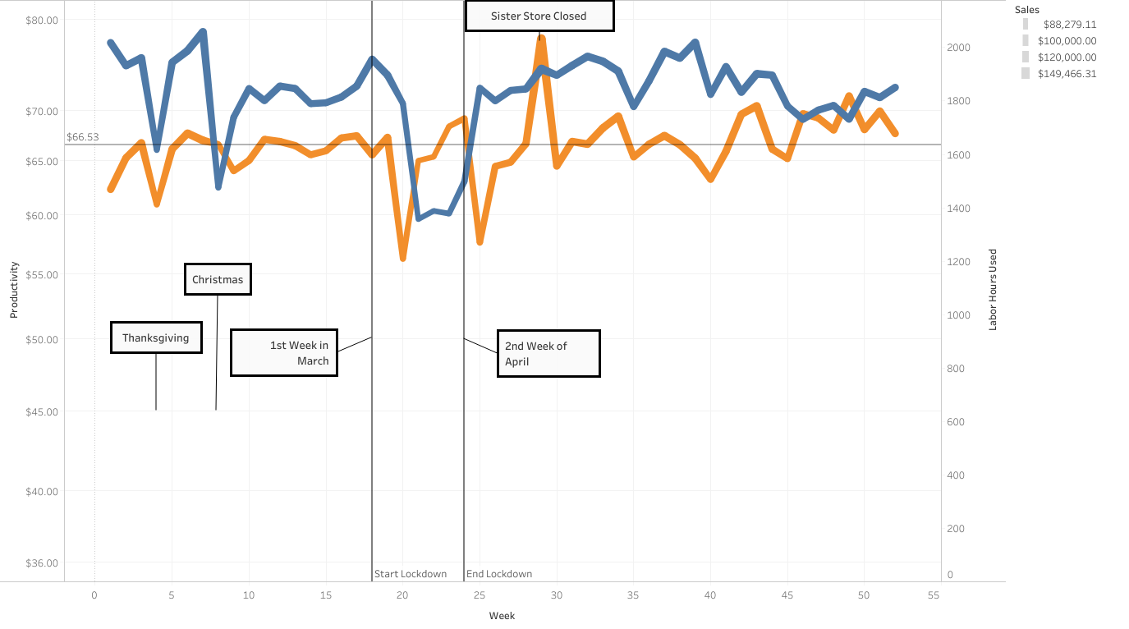

Slide 12
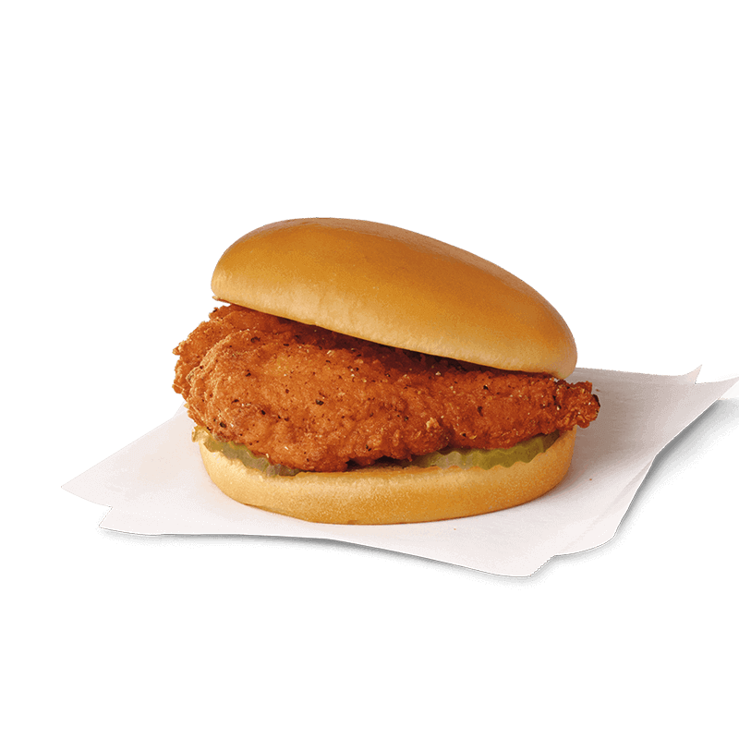
How has ordering changed during Covid?
By looking at this pivot table, we can tell that there has been changes to how people typically choose to order.
Values | Before | During | After
Average of CarryO | 12,732.05 | 0.00 | 0.00
Average of MobCO | 7,170.84 | 29.60 | 0.00
Average of DineIn | 17,305.05 | 0.00 | 0.00
Average of MobDI | 1,151.47 | 0.00 | 0.00
Average of MobDT | 7,345.63 | 16,315.80 | 25,568.43
Average of NormDT | 73,369.26 | 76,075.60 | 93,079.07
Average of Catering | 2,260.21 | 297.40 | 1,504.00
Average of 3rdParty | 740.47 | 2,878.40 | 5,266.61
All dining room access had been cut off, explaining the zeros in 4 of the variables in the after column.

Slide 13
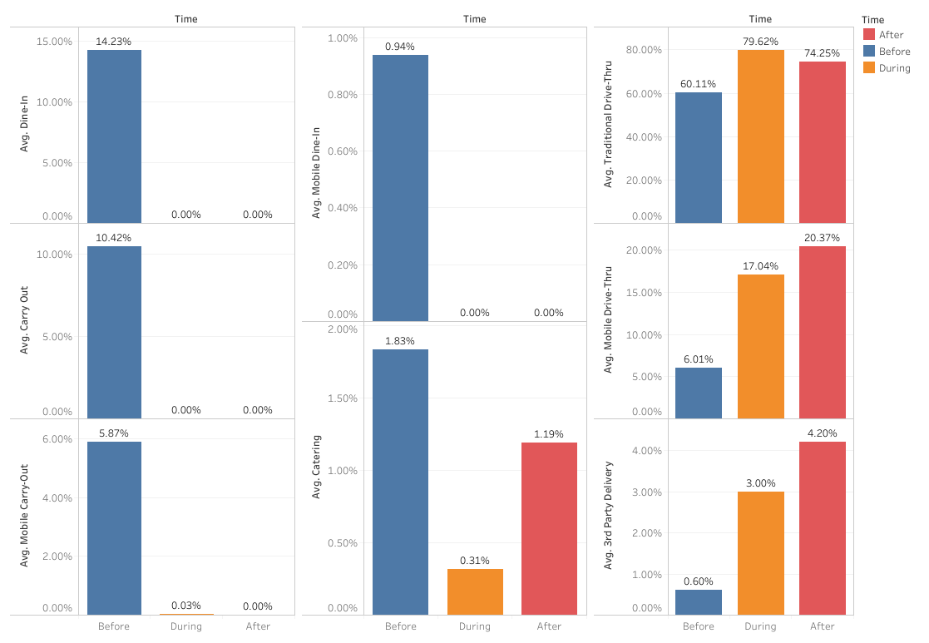

Slide 14
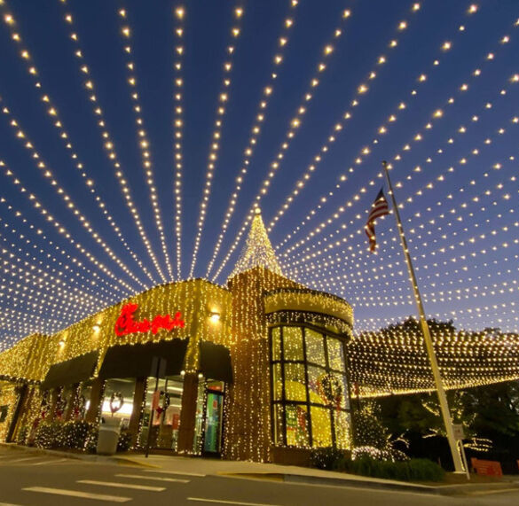
Summary
Overall, we believe that this Chick-fil-A location has responded well to the circumstances! They maintained productivity numbers through the dining room being shut down, a state-wide lockdown and then after.
Strategies have evolved as the business coped with the pandemic, which has helped to capitalize on as many opportunities as possible.
Some opportunities were disappearing, such as the dine-in experience that Chick-fil-A is known for, but they excelled drive-thru experience to make up for it.
WE WOULD LIKE TO THANK YOU ALL FOR YOUR TIME!
And Chick-fil-A for the use of their data and images <3

Slide 15
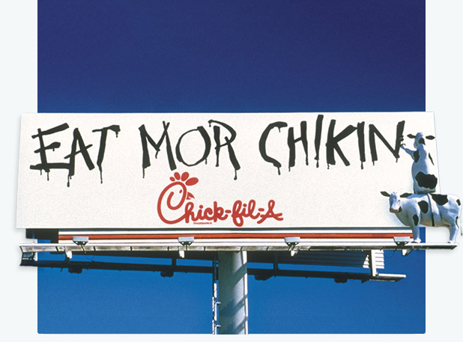
ALWAYS REMEMBER…

