Slide 1
Spread Spectrum Steganography
Nick Sterling
Sarah Wahl
Sarah Summers

Slide 2
Motivation
Data Security is one of the largest issues that we are faced with in today’s world.
Spread Spectrum Steganography is a technology that can address data security

Slide 3
Steganography and Spread Spectrum History
Stegnography
Dates back to the time of Herodotus (2000 years ago).
Means of concealing information so that its existence is known only to sender and recipient.
Spread Spectrum
Dates back to 1930’s.
First patent 1941 – Hedy Lamar (actress) and George Antheil (composer) – secret communications system used by the military.

Slide 4
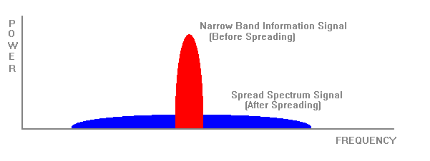
Spread Spectrum
  A form of Radio Frequency communication.
  Data sent using spread spectrum is intentionally spread over a wide frequency range.

Slide 5
Spread Spectrum
  Appears as noise, so it is difficult to detect and jam.
  Resistant to noise and interference thus increasing the probability that the signal will be received correctly.
  Unlikely to interfere with other signals even if they are transmitted on the same frequency.
  The data can be transmitted without additional hiding or to provide added security may be embedded in another medium (images, articles, music).

Slide 6

Spread Spectrum Techniques
Direct Sequence Spread Spectrum (DSSS)
Data to be transmitted is divided into small pieces and each piece is allocated to a frequency channel across the spectrum.
Transmitter utilizes a phase varying modulation technique to modulate each piece of data with a higher data rate bit sequence.

Slide 7
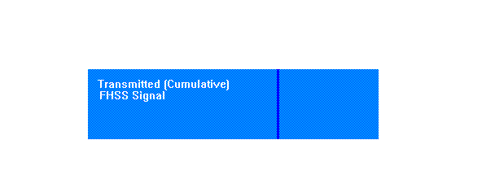
Spread Spectrum Techniques
Frequency Hopped Spread Spectrum (FHSS)
Data carrier frequency is periodically modified (hopped) across a specific range of frequencies (spreading).
The shifting pattern is determined by the chosen code sequence (FSK – Frequency Shift Key).

Slide 8
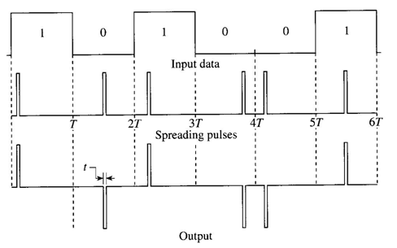
Spread Spectrum Techniques
Time Hopped Spread Spectrum
Short information burst (chirp ) transmitted with pseudorandom pulse duration, or transmitted in a random position.
Method 1: The chirp interval is determined by the PN code generator.

Slide 9
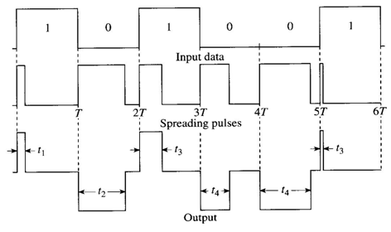
Spread Spectrum Techniques
Time Hopped Spread Spectrum (continued)
Method 2: Chirp goes at the same time in each bit period, the PN code generator changes its duration.

Slide 10
Audio Steganography
Audio Steganography takes advantages in failings in the Human Auditory System.
Careful selection of audio files allow hiding of data.
Current steganographic applications with audio media are primarily limited to providing proof of copyright and assurance of content integrity.

Slide 11
Audio Steganography
Transmission through air – signal prone to changes in phase, amplitude and drift of different frequency components – spread spectrum can help.
Frequently used formats for audio WAV and AIFF - use 16-bit linear quantization. Quantization methods used can introduce some signal distortion.
Various audio steganographic methods:
Low-Bit Encoding, Polarity Inversion, Echo Hiding, Phase Coding, Cepstral Hiding, Perceptual Masking and Spread Spectrum

Slide 12
Spread Spectrum Steganography Using Audio Media
Spread Spectrum can be used to:
    Embed data in an audio file.
    Send an audio file.
Additional Security
    Encrypt data before embedding in audio file.
    Embed encrypted data in audio file using spread spectrum.
    Transmit audio file using spread spectrum.

Slide 13
Conclusions
Spread Spectrum Steganography has significant potential in secure communications – commercial and military
Audio Steganography in conjunction with Spread Spectrum may provide added layers of security

