Slide 1
A HIGH CAPACITY WATERMARKING TECHNIQUE FOR STEREO AUDIO
Acoustics, Speech, and Signal Processing, 2004. Proceedings. (ICASSP '04). IEEE International Conference on

Slide 2
outline
THE PROPOSED SYSTEM
Interaural Phase Difference (IPD) Relationships
Watermarking Encoder
Watermarking Decoder
PERFORMANCE

Slide 3
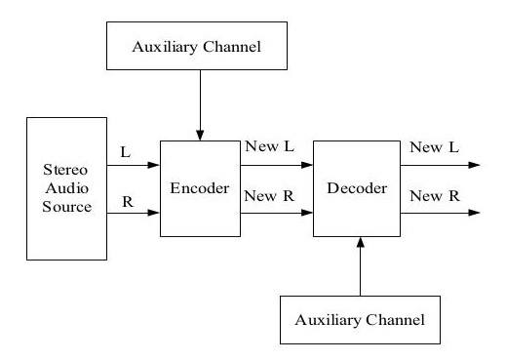
THE PROPOSED SYSTEM
Stereo audio兩個聲道會經過encoder，encoder決定會嵌入多少auxiliary channel的資料。
新的兩個聲道會進入decoder，然後將auxiliary channel取出。

Slide 4
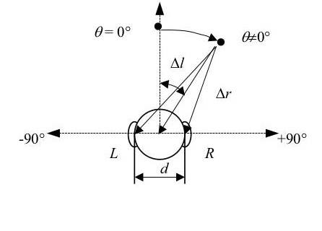
Interaural Phase Difference (IPD) Relationships
人耳在分辨聲音的方向是透過聲音來源到兩耳距離不同來區分，如圖所示，∆l為聲音來源到左耳的距離，∆r為聲音來源到右耳的距離，∆d為兩者的距離差，d為左耳到右耳的距離，r為聲音來源到中心點位置。假設目前方位角為θ，則：
∆r² = (r*cosθ)² + (r*sinθ – d/2)²
∆l² = (r*cosθ)² + (r*sinθ + d/2)²
∆d = |∆r - ∆l|
IPD(這裡假設為Φ)值的算法為：
Φ = ∆d *( f / c ) *360º
有了Interaural Phase Difference值，就可以進行以下的energy threshold計算。

Slide 5
Watermarking Encoder
psychoacoustical phase threshold：
psychoacoustical phase threshold決定資料在什麼時候嵌入，在頻率(Fourier analysis提供)滿足下列式子時，可以進行watermark。
cos{(phase[X_{L}(f_{i})] - phase[X_{R}(f_{i})]} < cos (-0.003104*f_{i})
energy threshold：
在特定頻率依照下列不同情況嵌入相對的值，嵌入時改變的是左邊的聲道：
phase[X_{L}(f_{i})] = phase[X_{R}(f_{i})] → logical 0
phase[X_{L}(f_{i})] = 1/2 * IPD_{max}(f_{i}) → logical 1
phase[X_{L}(f_{i})] >= IPD_{max}(f_{i}) → no encoding

Slide 6
Watermarking Decoder
在取資料時，會先經由psychoacoustical phase threshold比較與偵測，在利用下列式子決定取出的訊息為多少：
| phase[X_{L}(f_{i})] - phase[X_{R}(f_{i})] | =< r₁IPD_{max}(f_{i}) → logical 0
r₁IPD_{max}(f_{i}) < | phase[X_{L}(f_{i})] - phase[X_{R}(f_{i})] | =< r₂IPD_{max}(f_{i}) → logical 1
| phase[X_{L}(f_{i})] - phase[X_{R}(f_{i})] | > r₂IPD_{max}(f_{i}) → no data
(r₁ = 1/4, r₂ = 3/4 )

Slide 7
PERFORMANCE
System Robustness
Cutting and splicing
Temporal shifting
Downsampling

Slide 8
reference
A high capacity watermarking technique for stereo audio

