Slide 1
Image steganographic scheme based on pixel-value differencing and LSB replacement methods
H.-C. Wu, National Taichung Institute of Technology, N.-I. Wu, Chaoyang University of Technology, M.-S. Hwang and C.-S. Tsai, National Chung Hsing University, Taichung, Taiwan, R.O.C.
IEE Proceedings - Vision, Image and Signal Processing
7 Oct. 2005

Slide 2
Outline
Introduction
Proposed method
Analyses and discussions
Conclusions

Slide 3
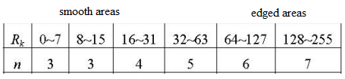
Introduction
In pixel value differencing the capacity of hidden data in edged areas is higher than that of smooth areas.
Propose a method to increase the capacity of hidden data by using a fixed-size least-significant-bits (LSB) method.

Slide 4
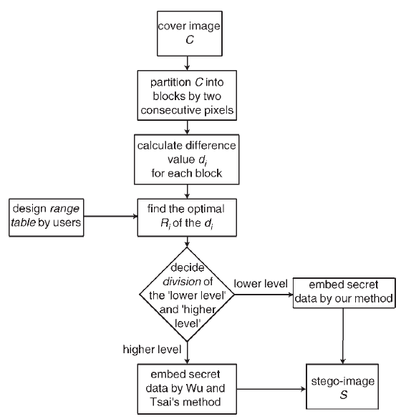
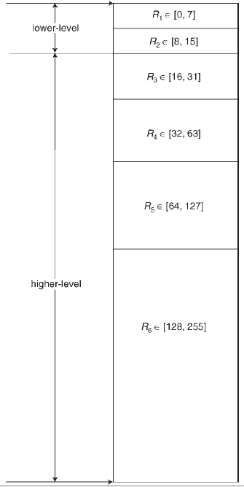
Proposed method
Div = 15

Slide 5
如果差值落在lower-level，就進行LSB隱藏。
P_{i}
P_{i+1}
30
15
30 : 00011110
15: 00001111
15
Lower-level (8-15)
d
Message stream : 111000101101
P’_{i} = 31 – 8 = 23
P’_{i+1} = 8 + 8 = 16
00011111 : 31 00001000 : 08
d’ = 7
Let d’ < Div
adjusting
d’ = 31 – 8 = 23 > 15 = Div

Slide 6
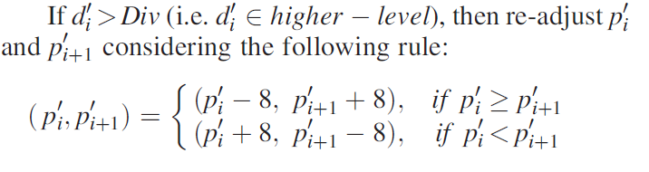
如果做完此步驟後差值(d’)還是一樣在higher-level的話繼續此步驟，直到差值落在lower-level

Slide 7
取回資料
先計算出相鄰像素差值，如果差值在higher-level，取法與PVD一樣；如果差值是在lower-level，則取P_{i}後三個bit與P_{i+1}後三個bit。
P_{i}
P_{i+1}
23
16
23: 00010111
16: 00010000
Lower-level (8-15)
7
d
Message : 111000

Slide 8
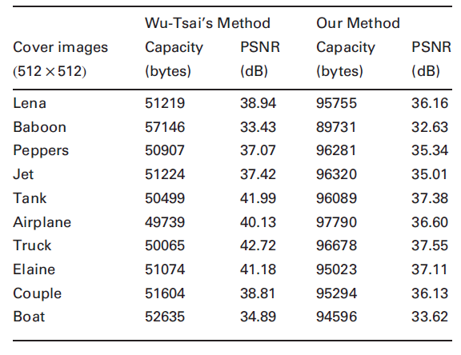
Analyses and discussions
The proposed scheme has about1.57 ~1.97 greater hiding capacity than PVD,however, the PSNR value dropped between 0.8 ~ 5.17 dB.
LSB 3 bit

Slide 9
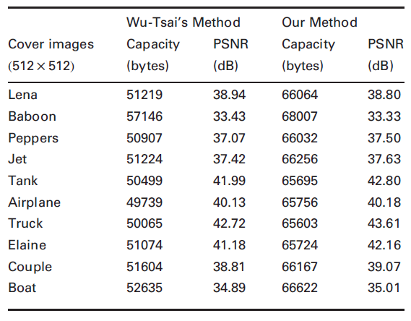
LSB 2 bit
We not only obtained
more capacity but also the same stego-image quality as with Wu and Tsai’s method.

Slide 10
Conclusions
The experimental results demonstrate that the proposed method not only has an acceptable image quality but also can provide a large embedded secret data capacity.
(我的結論)優點跟他的結論一致，缺點是論文裡有幾個敘述是錯誤的。像是2bit – LSB那張比較表，table說明是The same stego-image quality with more hiding capacity.

Slide 11
Reference
Wu, D.C., and Tsai, W.H.: ‘A steganographic method for images by pixel-value differencing’, Pattern Recognit. Lett., 2003, 24, (9-10),pp. 1613–1626
PVD介紹
PVD範例

