Slide 1
Spread Spectrum Audio Steganography using Sub-band Phase Shifting

Slide 2
outline
Spread Spectrum Audio Steganography
Sub-Band Phase Shifting
Subjective Quality Testing
Conclusions

Slide 3
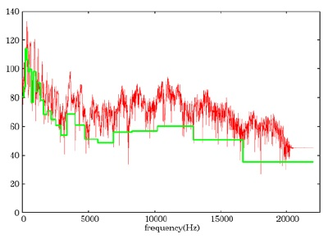
Spread Spectrum Audio Steganography
Calculates the frequency masking threshold using psycho acoustic model

Slide 4
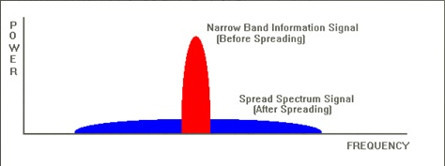
Spread Spectrum: Data sent using spread spectrum is intentionally spread over a wide frequency range

Slide 5
M-sequence code
M-sequence codes have good autocorrelation properties where the autocorrelation function has peaks equal to 1 at 0, N, 2N… (approximately 1/N elsewhere). Because of these periodic peaks, the M-sequence code is self-clocking, so the receiver can easily synchronize the data frame and retrieve the embedded data by de-spreading with the same M-sequence code.

Slide 6
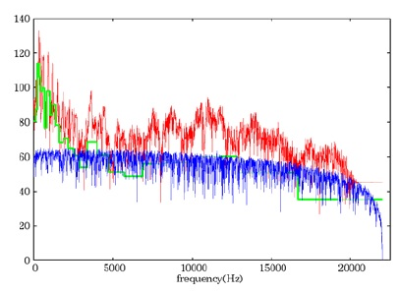
The spectrum is almost flat in the wide frequency range.

Slide 7
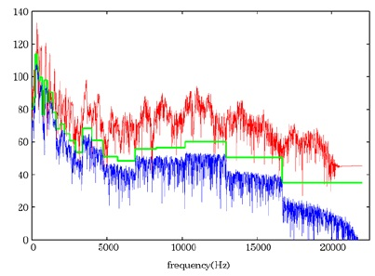
Then the output signal is power-adjusted below the masking threshold and added to the original audio.

Slide 8
Sub-Band Phase Shifting
High spreading rates take long time to send 1 bit information, so the data transmission speed decreases. Therefore, in order to improve the performance, the encoding method with a low spreading rate has to provide the good robustness of the embedded information.

Slide 9
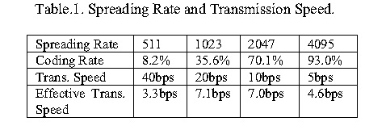
In the case that the spreading rate is 511, 1 bit data can be embedded in a frame of 1022 samples, and the transmission speed is approximately 40bps. The coding rate of the error correcting code is 8.2% to provide the robustness of the embedded information against the aerial transmission at a
distance of 1m. Therefore, the effective data
transmission speed becomes 3.3bps.

Slide 10
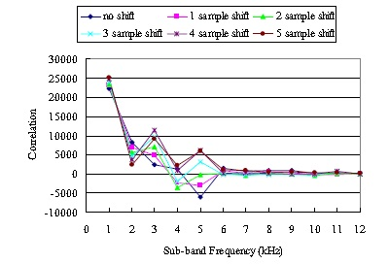
Correlations in each sub-band
figure shows the correlations in each sub-band
separated by 1kHz bandwidth.

Slide 11
Subjective Quality Testing
(1) Data embedded audio without the phase shifting.
(2) Data embedded audio with the phase shifting.
(3) Bandwidth limited original audio to 7kHz.
(4) Bandwidth limited original audio to 3.5kHz.

Slide 12
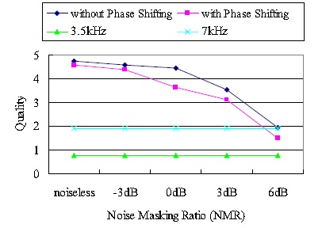
For the case of (1) and (2), the testing is made by setting the NMR (Noise Masking Ratio)
In the case of (3) and (4), since the spread data
signal is not embedded, the scores were respectively 1
and 2 regardless of the NRM.

Slide 13
Comparing (1) and (2), because of the phase shifting, the quality of (2) is (1) lower than that of (1) at every NMR. The quality difference is almost equal to the degradation of +3dB NRM. Therefore, if (2) has higher noise tolerance than +3dB of (1), (2) has better performance in total.

Slide 14
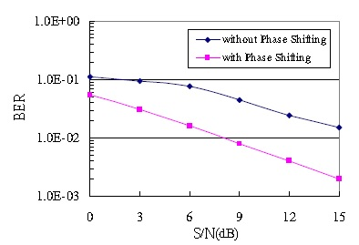
The BER of (2) is lower than that of (1) in the same S/N. even if (2) suppresses the spread data signal to -3dB NMR to provide the same audio quality as (1), the noise tolerance is still +3dB higher than that of (1).

Slide 15
Conclusions
This paper proposes the sub-band phase shifting as a method of processing the original audio signal so that the data signal can be easily retrieved at the receiver.

Slide 16
Reference
Spread Spectrum Audio Steganography using Sub-band Phase Shifting

