Slide 1
A Novel Technique for Image Authentication in Frequency Domain using Discrete Fourier Transformation Technique (IAFDDFTT)
Malaysian Journal of Computer Science, EJUM(Electronic Journal of University Malaya)
Vol. 21(1), 2008
Nabin Ghoshal, Dept. of USIC, University of Kalyani ;
Jyotsna Kumar Mandal, Dept. of Computer Science and Engineering, University of Kalyani

Slide 2
outline
Algorithm
Insertion
Extraction
Analysis
Histogram Analysis
Noise Analysis
Conclusions

Slide 3
Insertion
File
File
MD5
key
(Message-Digest Algorithm 5)
size File + key

Slide 4
Image
(spatial domain)
Discrete Fourier Transformation
Image
(frequency domain)
File
Key
size File + key
Insert
Image
(frequency domain)
Image
(frequency domain)
Inverse Discrete Fourier Transformation
Image
(spatial domain)

Slide 5
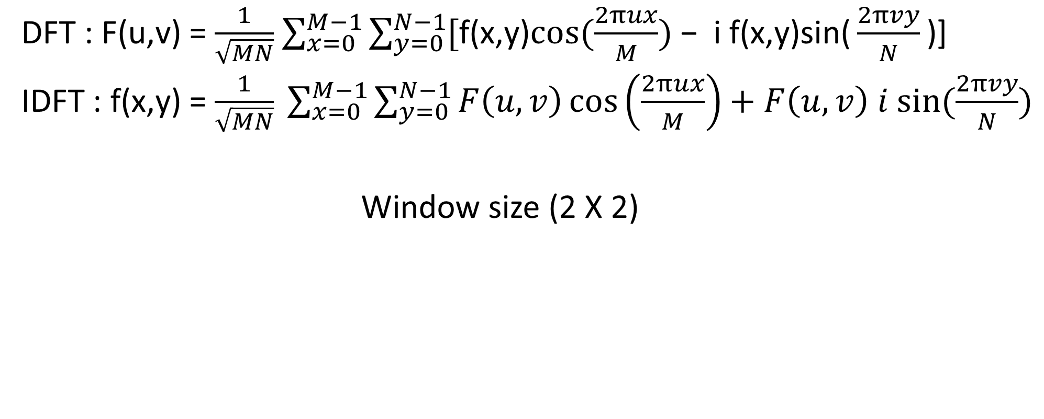
Discrete Fourier Transformation
DFT : F(u,v) = $\frac{1}{\sqrt{MN}}$ $\sum_{x=0}^{M−1}{\sum_{y=0}^{N−1}{[\text{f}\text{(}\text{x}\text{,}\text{y}\text{)}cos⁡(\frac{2πux}{M}) \text{− }\text{i} \text{f}\text{(}\text{x}\text{,}\text{y}\text{)}\text{sin}\text{(}\frac{2πvy}{N}\text{)] }}}$
IDFT : f(x,y) = $\frac{1}{\sqrt{MN}} \sum_{x=0}^{M−1}{\sum_{y=0}^{N−1}{F\left(u,v\right)\cos\left(\frac{2πux}{M}\right)+F\left(u,v\right) i sin⁡(\frac{2πvy}{N})}}$
Window size (2 X 2)
X | F(0,1)
F(1,0) | F(1,1)

Slide 6
Insert
F(u,v) = A + Bi 將機密訊息藏入A，其中A為8bit
使用者決定藏入s個bit，1 ≤ s ≤ 8，s ϵ N，則在第 7%(s-1)的bit以LSB藏入s個bit。
例：A = 00111001，secret = 10011111，使用者決定藏入3bit，7%2 = 1，A = 0011 001 1

Slide 7
Extraction
Image
(spatial domain)
Discrete Fourier Transformation
Image
(frequency domain)
File
Key
size File + key
Image
(frequency domain)
Extraction
7

Slide 8
Authorized
File
MD5
keyA
key
keyA = key → Authorized
keyA ≠ key → Unauthorized

Slide 9
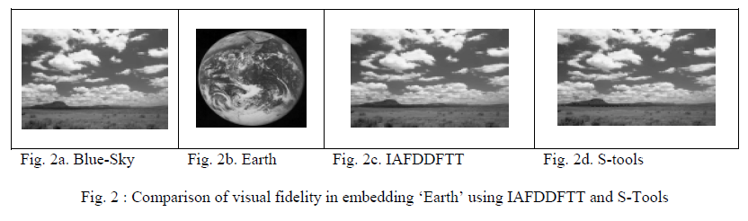
Analysis
80 X 80(Earth) 藏進 250 X 150(Blue-Sky)

Slide 10
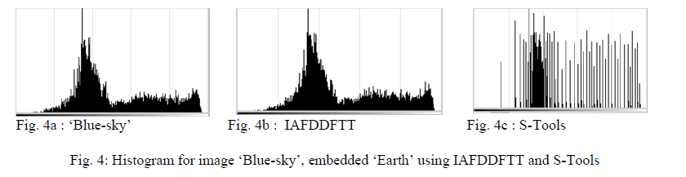
Histogram Analysis
Frequency Histogram

Slide 11
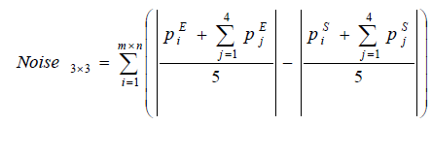
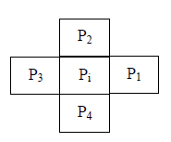
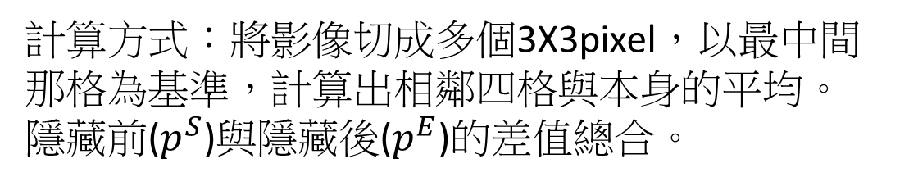
Noise Analysis
計算方式：將影像切成多個3X3pixel，以最中間那格為基準，計算出相鄰四格與本身的平均。
隱藏前($p^{S}$)與隱藏後($p^{E}$)的差值總合。

Slide 12
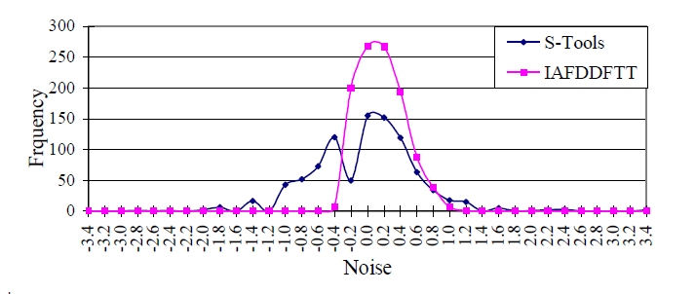
橫軸為Noise值，縱軸為出現次數

Slide 13
Conclusions
Author：
As a result the scheme may be more robust against brute force attack.
In IAFDDFTT distortion of image and change of fidelity (like sharpness, brightness etc) is negligible.
我的結論：
作者只用了兩張圖做測試，樣本太少。
S-tool所用的steganography是LSB，比較的結果差異當然明顯。
Noise Analysis這種方式我沒看過，以後分析時多了一項工具。
在frequency domain下做bit更動是否有問題。
公式都有問題。

Slide 14
Reference
Stool and steganographic tools
Stool download
Introduction using S-tool
MD5

