Slide 1
Monitors
Onvif IPCam

Slide 2
Company
Imoncloud
GKB
Verifeye

Slide 3
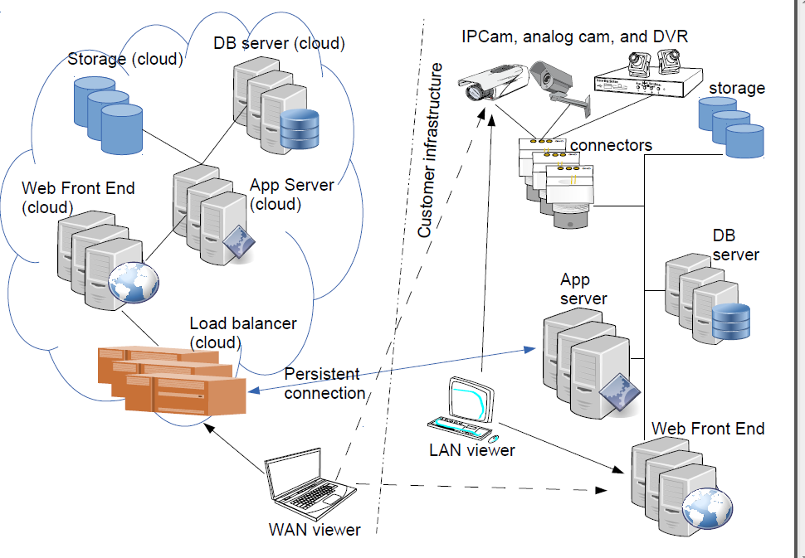

Slide 4
IPCam
Onvif (open newok video interface forum)
WSDl (web service description language)
SOAP(simple object access protocol)
XML

Slide 5
WSDL
GetHostname
Description:
This operation is used by an endpoint to get the hostname from a device.
The device shall return its hostname configurations through the GetHostname command.
SOAP action:
http://www.onvif.org/ver10/device/wsdl/GetHostname
Input:
[GetHostname]
Output:
[GetHostnameResponse]
HostnameInformation [HostnameInformation]
Contains the hostname information.
FromDHCP [boolean]
Indicates whether the hostname is obtained from DHCP or not.
Name - optional; [token]
Indicates the hostname.
Extension - optional; [HostnameInformationExtension]

Slide 6
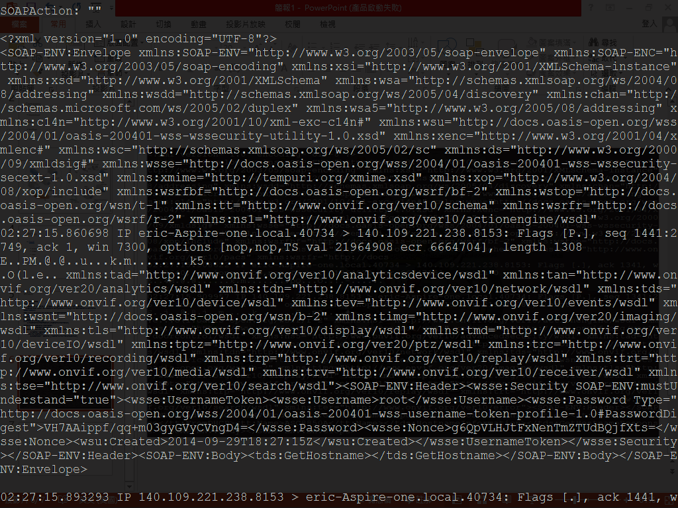

Slide 7
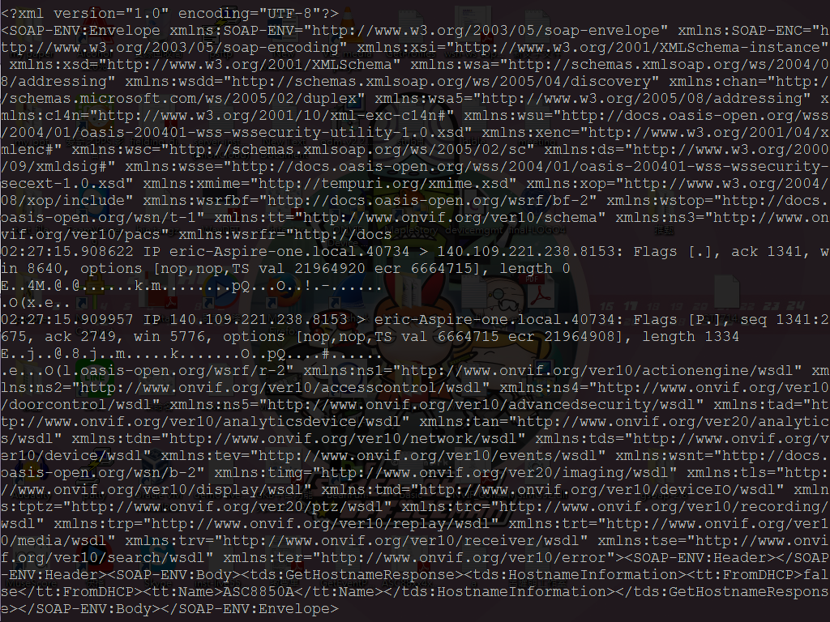

Slide 8
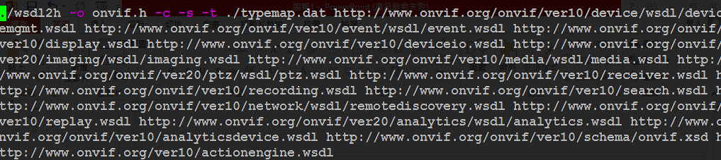
Gsoap

Slide 9
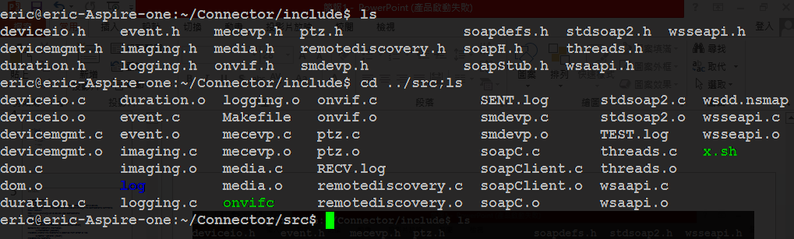

Slide 10
