Slide 1
Secure blind image steganographic technique using discrete fourier transformation
Faisal Alturki, Department of Electronic Engineering College of Technological Studies Shuwaikh, Kuwait
Russell Mersereau, Center for Signal and Image Processing Electrical and Computer Engineering Georgia Institute of Technology Atlanta, GA
Proceedings 2001 International Conference On Image Processing, IEEE

Slide 2
outline
Method
Discrete Fourier Transform(DFT) quantization
Symmetry
Conclusion
Reference

Slide 3
method
The technique embeds the hidden information in the DFT domain after permuting the image pixels in the spatial domain using a key.
The hidden information is embedded using quantization technique.

Slide 4
DFT quantization
To embed the data, we quantize the magnitude of both the real and the imaginary parts of the DFT coefficients to the nearest integer multiple of ∆, where ∆ is some quantization step size.
∆ should be small to maintain good perceptual quality and low perceptual distortion, but large enough to resolve the value of the binary embedded bit unambiguously.
A coefficient can be rounded to an even integer multiple of ∆ to embed binary “1“, and to an odd multiple of ∆ to embed binary “0”

Slide 5
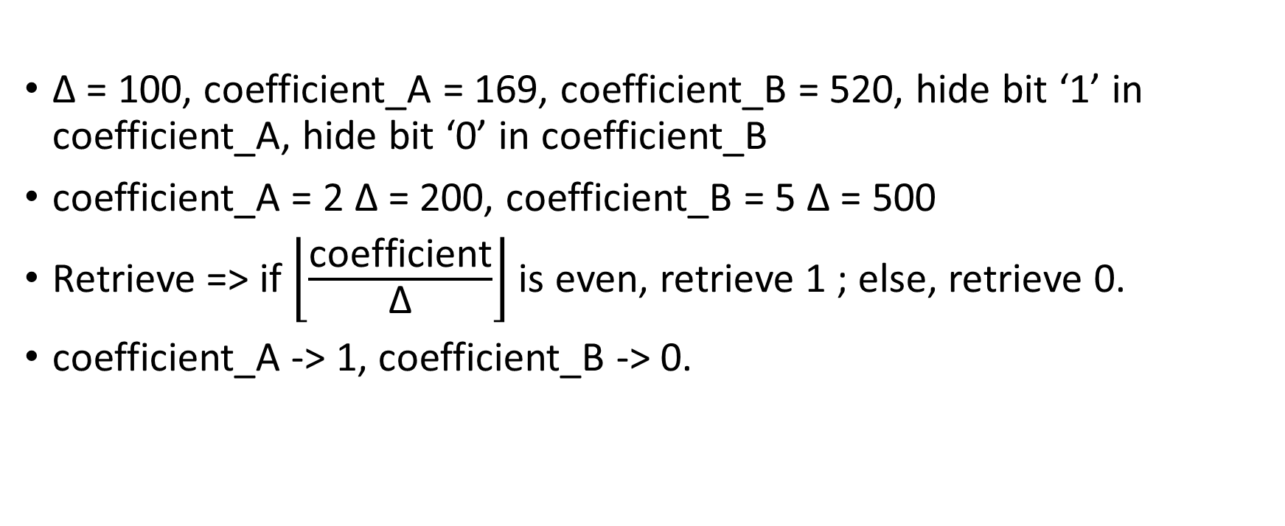
example
∆ = 100, coefficient_A = 169, coefficient_B = 520, hide bit ‘1’ in coefficient_A, hide bit ‘0’ in coefficient_B
coefficient_A = 2 ∆ = 200, coefficient_B = 5 ∆ = 500
Retrieve => if $\left\lfloor \frac{\text{coefficient}}{\text{∆}}\right\rfloor$ is even, retrieve 1 ; else, retrieve 0.
coefficient_A -> 1, coefficient_B -> 0.

Slide 6
Symmetry
The Discrete Fourier Transform (DFT) is commonly described as a transformation of a sequence x_{k} of finite length n into another sequence X_{k} .
If x₀, … , x_{n-1} are real numbers, as they often are in practical applications, then the DFT obeys the symmetry: X_{n-k} = X_{-k} = X_{k}*, where X*, denotes complex conjugation.

Slide 7
conclusion
這篇文張著重於將時域的pixel重新排列，再轉頻域隱藏達倒不易被偵測的目的。而我讀這篇主要目的是看他的DFT如何處理，主要以下兩點：
data經由DFT與IDFT後，所得到的值會與原本不同，這篇文章透過quantization解決了此問題
透過symmetry來解決IDFT時會出現虛部系數的問題

Slide 8
Reference
Symmetry properties
Secure blind image steganographic technique using discrete Fourier transformation

