Slide 1
Steganography using the Fourier Transform and Zero-Padding Aliasing Properties
Published in : Electro/information Technology, 2006 IEEE
Author :McKeon, R.T.

Slide 2
outline
Nyquist rate
Padding
Result
Conclusion
Reference

Slide 3
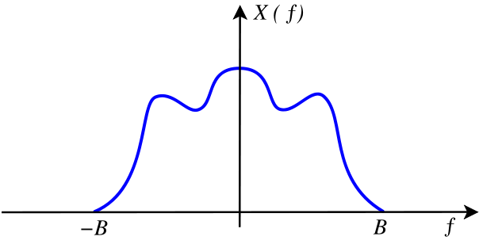
Nyquist rate
f_{s} > 2B

Slide 4
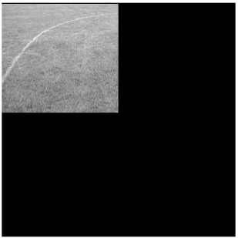
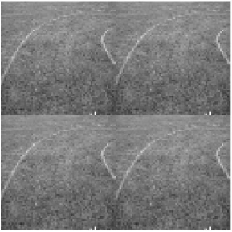
Padding

Slide 5
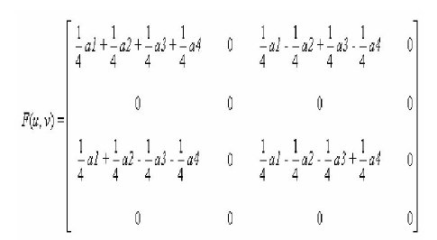
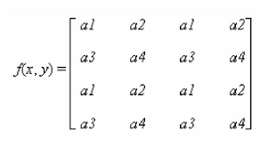
DFT
75% is zero

Slide 6
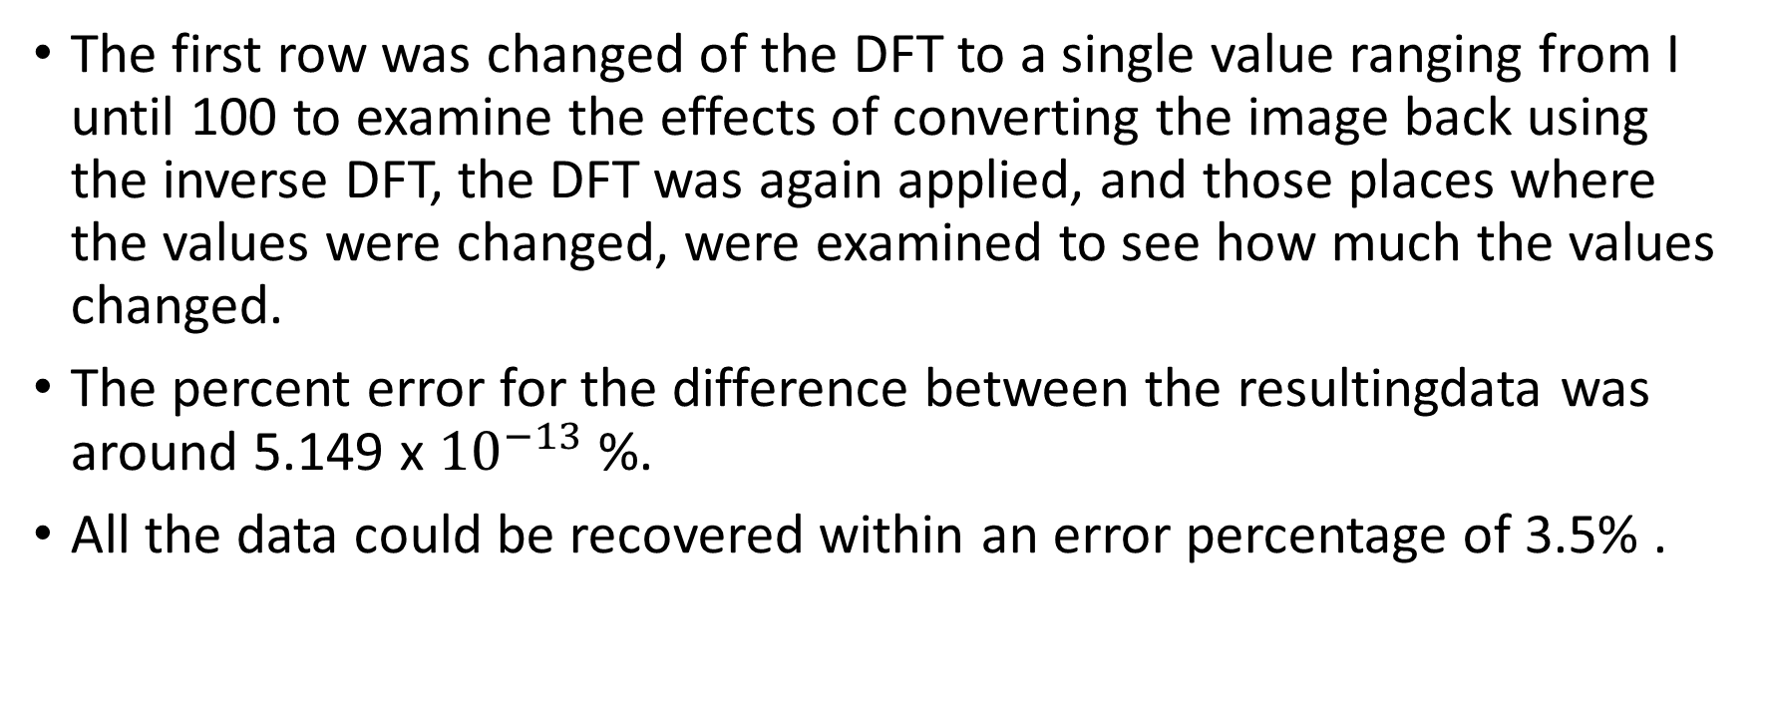
Result
The first row was changed of the DFT to a single value ranging from I until 100 to examine the effects of converting the image back using the inverse DFT, the DFT was again applied, and those places where the values were changed, were examined to see how much the values changed.
The percent error for the difference between the resultingdata was around 5.149 x ${10}^{−13}$ %.
All the data could be recovered within an error percentage of 3.5% .

Slide 7
conclusion
結果只給百分比沒有給樣本數
DFT後 75%為0，但沒有實際講藏密量
用此方法解決問題，執行PVD藏密量降低

Slide 8
reference
HC N 1st, ‘Certain topics in telegraphtans smission theory," Trans. AIEE, Vol. 47, pp. 617-644, Apr. 1928.
Gonzalez, Rafael C. and Woods, Richard E. Digital Image Processing, Second Edition. (C 2002, Prentice Hall Upper Sadde River, New Jersey. Pages 199-205.

