Slide 1
Rich Ross
Dave Wentzel
Technical Evangelist – Data&AI
linkedin.com/in/dwentzel
https://github.com/davew-msft/2019AzureMigrateYourApps

Slide 2
WiFi SSID: MSFTGUEST
Login Event ID (press blue button): msevent298wg
Lab Repo: https://github.com/davew-msft/2019AzureMigrateYourApps
Signup for your Azure Lab Subscription:
http://bit.ly/34jUzSW
* Sign up with an email you can access! Don’t for get that your company VPN may block access so use a personal email if needed.
Activation Code: ACTIVATE4084

Slide 3
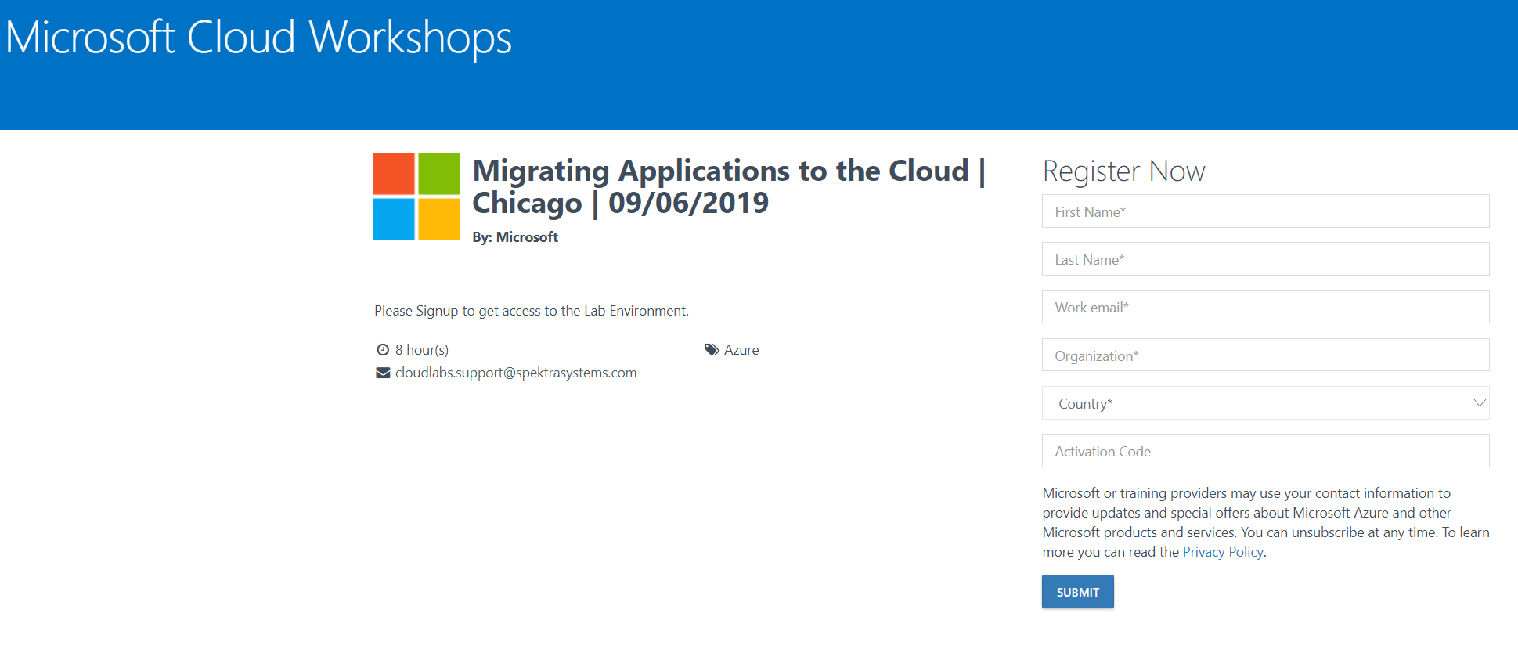
Azure Lab Sign Up Page
* Sign up with an email you can access! Don’t for get that your company VPN may block access so use a personal email if needed.

Slide 4
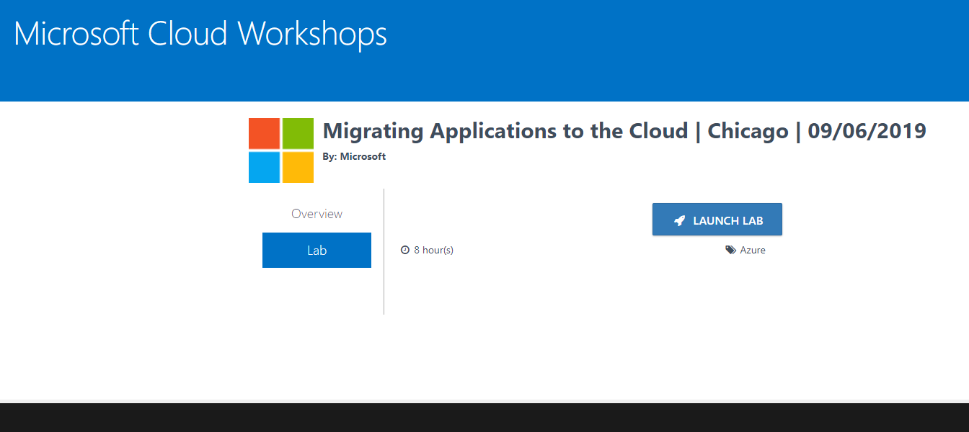

Slide 5
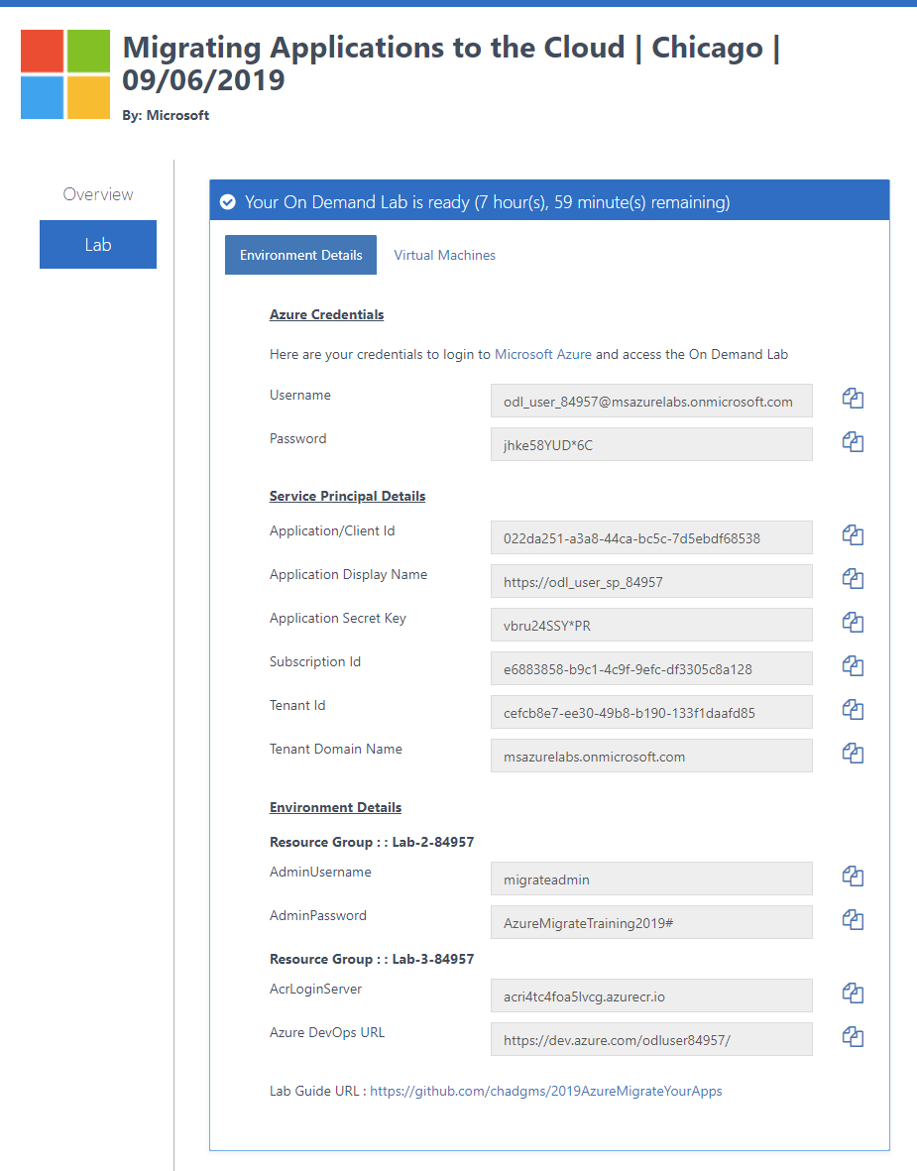
Lab Info Page
You will get a page like this after you press the ‘launch lab’ button
* This information was also sent to your email
Azure Portal Login
SPN Needed for Lab 3
Backup SQL Server for Lab 2
ARC Server and DevOps URL for Lab 3

