Slide 1
WiFi SSID: MSGUEST
Login Event ID (press blue button): <event ID for MTC>
Signup for your Azure Lab Subscription:
http://bit.ly/<lab code>
* Sign up with an email you can access! Don’t for get that your company VPN may block access so use a personal email if needed.
Activation Code: <Lab Activation Code>

Slide 2
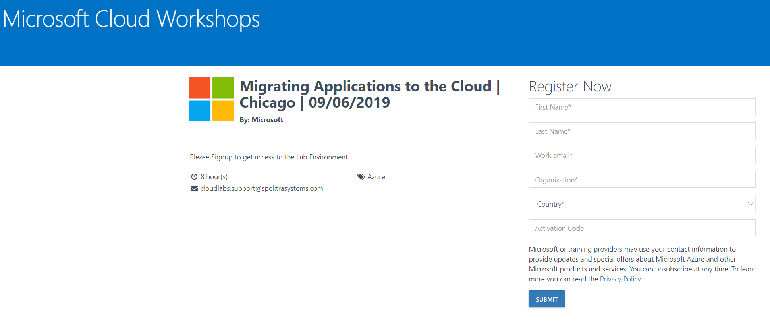
Azure Lab Sign Up Page
* Sign up with an email you can access! Don’t for get that your company VPN may block access so use a personal email if needed.

Slide 3
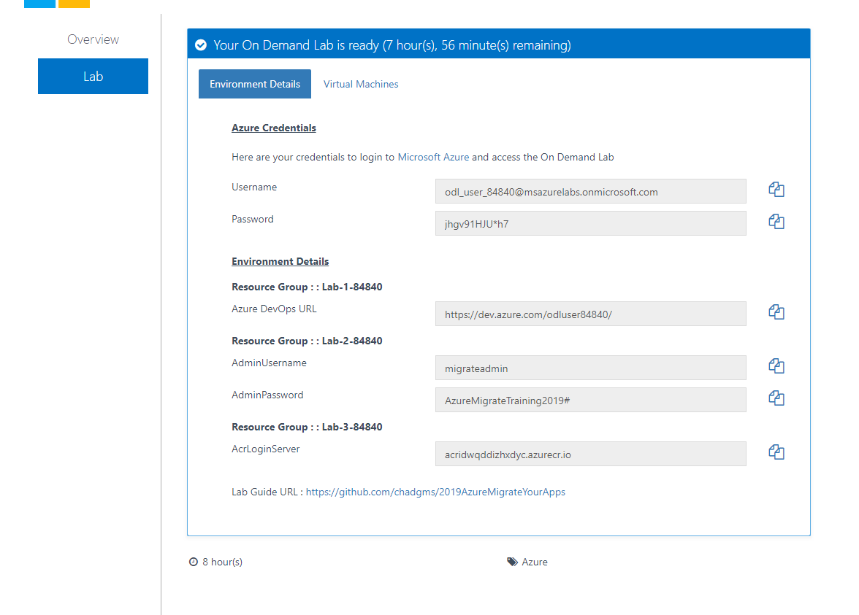
Press -> Enter Lab for Login Information
* This information was also sent to your email
Azure Portal Login
Lab 3 DevOps URL
Lab 3 ACR Login

