Slide 1
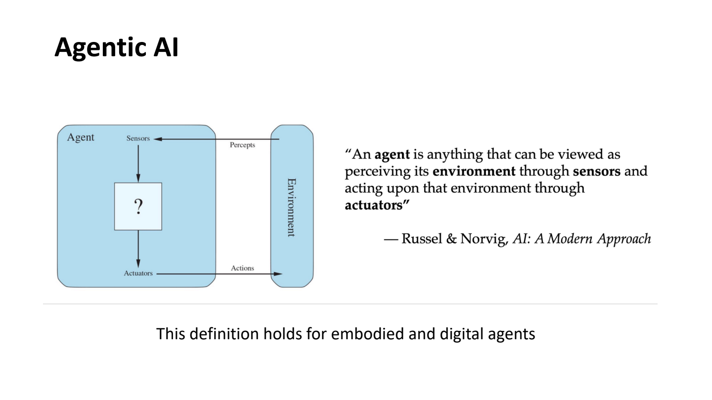
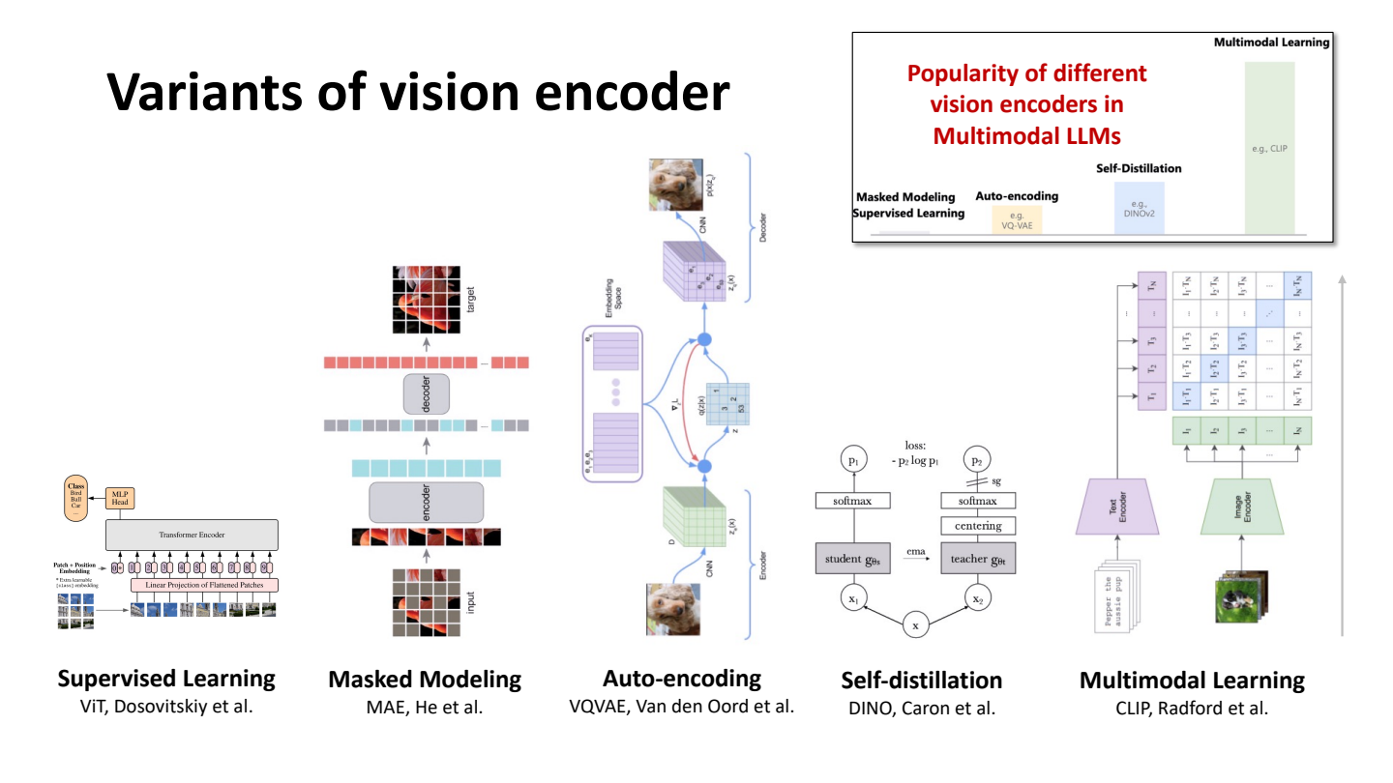
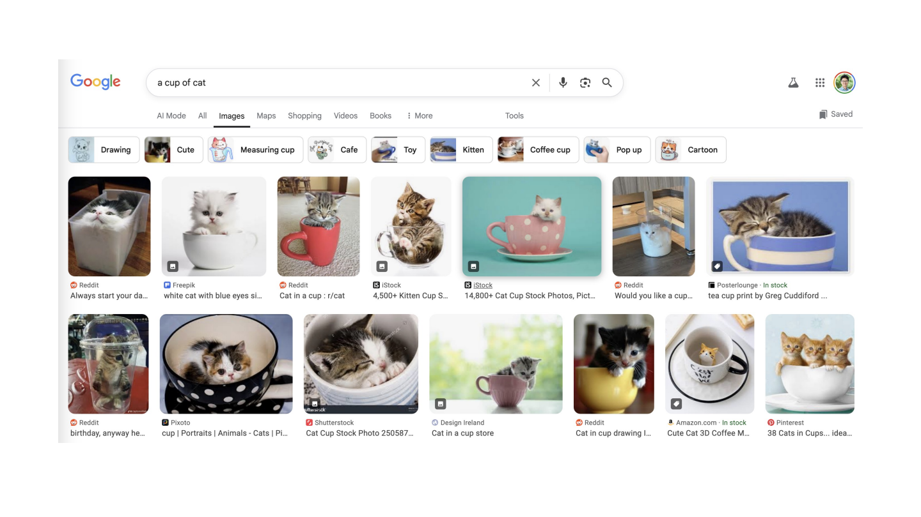
Slide Deck to
Study Guide Agent
A multimodal ENGR 689 project that turns visual lecture decks into cited review, quiz practice, and retake memory.
ENGR 689 · Fall 2026
image path vs text baseline
Notes:
Open with the central claim: lecture slides are visual artifacts, so a study agent should read rendered pages, not only extracted text.
[Sources]
- README.md
- CONTEXT.md
- data/course/slides/Day3 Principle.pdf

Slide 2
Project promise
The application produces learning artifacts that stay traceable to the original slide numbers.
286
138
4
course slides across five lecture decks
embedded images in the Day 3 eval deck
hand-labeled figure-only facts
Student output
Prepared by: [Your Name]
Mini-project presentation
1. Lesson review with slide-number citations
2. Ten-question knowledge check with explanations
3. Retake generation from topic history
Notes:
Replace [Your Name] with the presenter name. The numbers come from the course data README and eval label file.
[Sources]
- data/course/README.md
- README.md
- eval/figure-only-facts.json

Slide 3
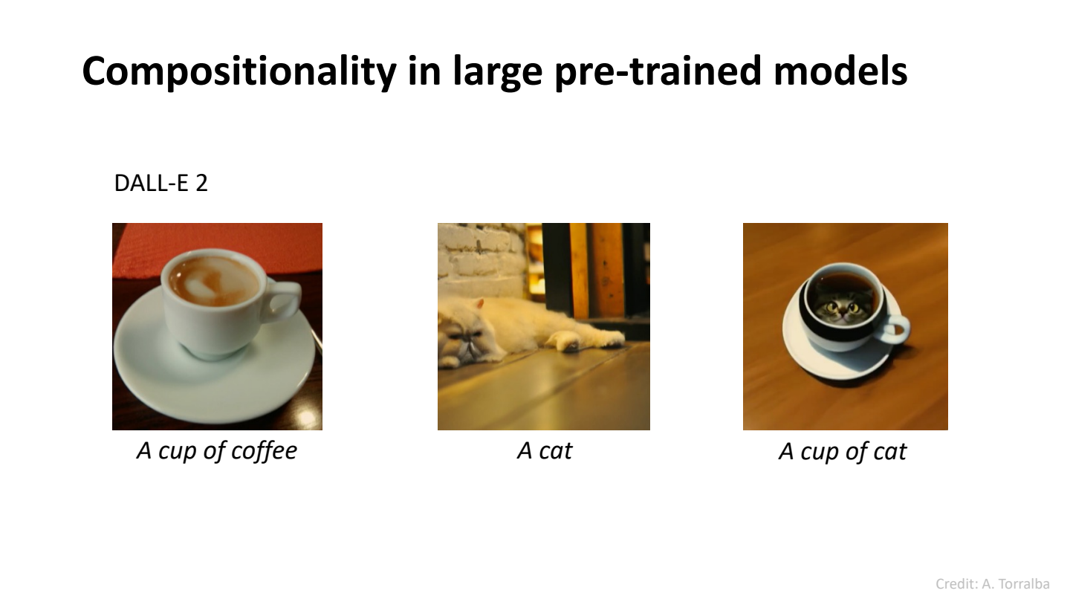
Project description and goal
Goal: transform a lecture PDF into learning artifacts a student can trust, inspect, and revisit.
SlideNote
1
cited review
->
reading
visuals[].assertion
concepts
verbatim_spans
reader_note
->
2
quiz + answer key
Lecture PDF page
3
topic retake
Design principle: every important claim must either cite a slide, cite research, or admit uncertainty.
Notes:
The SlideNote schema is the load-bearing interface. It separates page reading from visual assertions, concepts, and failure notes.
[Sources]
- README.md
- CONTEXT.md
- docs/adr/0002-per-slide-note-schema.md
- src/study_agent/schemas.py

Slide 4
Why this project matters: slides hide meaning in visuals
The text layer is real, but it often omits the reason a slide was shown.
Figure definition
Chart ranking
Retrieval comparison
sensors + actuators vanish from extracted text
the CLIP dominance lives in bar height
slide 56 extracts to zero characters
The evaluation is deliberately small but sharp: three strong figure-only facts plus one known weak case.
Notes:
The deck uses the strongest figure-only examples on the slide itself and notes that slide 10 is reported separately as the weak case.
[Sources]
- data/course/README.md
- eval/figure-only-facts.json
- data/course/slides/Day3 Principle.pdf

Slide 5
How we build it: one run, two paths, written artifacts
The image path is the system. The text path is a baseline that shares the same model, prompt, and schema.
render
page
reader
outline
research
review
quiz
memory
IMAGE PATH
TEXT BASELINE
Produces review-image.md, quiz.json, and the deck contribution to memory.
Stops after review-text.md, so the comparison isolates input modality without double-counting exposure.
implemented now: schemas · render/preflight · paths · config · tests
Notes:
Mention current status clearly: the pipeline is specified, and the landed code covers strict schemas, render/preflight, path helpers, config, and tests.
[Sources]
- docs/spec.md
- CONTEXT.md
- src/study_agent/schemas.py
- src/study_agent/render.py
- src/study_agent/paths.py
- src/study_agent/config.py
- tests/test_schemas.py

Slide 6
Demo and evaluation: prove the modality claim
The demo can replay saved artifacts; the evaluation checks whether visual facts survive into notes and citations.
Filmable
Demo Flow
Evaluation scoreboard
/3
/5
/10
1
Subject + PDF upload
2
7 status boxes
headline figure-only fact recovery
repeatability per labeled slide
quiz citation support by hand
3
cited review inspector
4
image/text comparison
5
quiz, grade, retake
bridged fact
Notes:
The scoreboard is intentionally shown as denominators because the repo has the protocol and labels, while results are still to be filled after the golden run.
[Sources]
- docs/spec.md
- eval/results.md
- eval/figure-only-facts.json
- docs/adr/0006-eval-protocol-and-results-table.md

Slide 7
Conclusion: the value is faithful learning artifacts
The project turns a slide deck into an auditable chain: visual facts -> structured notes -> cited review -> quiz -> topic memory.
What we learned
What remains
What to discuss
Schemas are the contract.
Visual assertions need their own field.
Failure notes must stay inspectable.
Finish page reader through memory.
Commit the golden Day 3 run.
Build Streamlit replay and retake UI.
How many labeled facts are enough?
Where should topic matching become human-reviewed?
What is a fair text baseline?
next milestone: end-to-end Day 3 run with image/text comparison ready to replay
Notes:
Close by positioning the project as both a useful study tool and a controlled modality experiment for the course.
[Sources]
- README.md
- CONTEXT.md
- docs/spec.md
- docs/adr/0001-model-provider-and-vision-model.md
- docs/adr/0003-cross-deck-topic-taxonomy.md
- docs/adr/0005-quiz-answer-key-and-retake-schema.md

