Slide 1
Slide Deck to Study Guide Agent
ENGR 689 Multimodal LLM Agents
Mini-Project Presentation
Notes:
Opening: this project turns lecture slide PDFs into cited study material and adaptive quiz practice.
[Sources]
- README.md
- CONTEXT.md

Slide 2
Slide Deck to Study Guide Agent
Prepared by: [Your Name]
For ENGR 689 mini-project presentation
Notes:
Replace [Your Name] with the presenter or team name before presenting.
[Sources]
- docs/Mini-Project Presentation (ENGR 689 F26).pptx
- README.md

Slide 3
Project description and goal
Goal: turn one lecture deck into a cited lesson review plus a quiz the student can retake.
Lecture PDF
Slide notes
Lesson review
Knowledge check
render each page
->
read prose and visuals
->
explain with slide citations
->
quiz, grade, and retake
The important constraint: the image path must see the slide as a page image, not just extracted text.
Notes:
Describe the user story: a student uploads a lecture PDF and gets review material, quiz practice, grading, and later retakes.
[Sources]
- README.md
- CONTEXT.md
- docs/spec.md

Slide 4
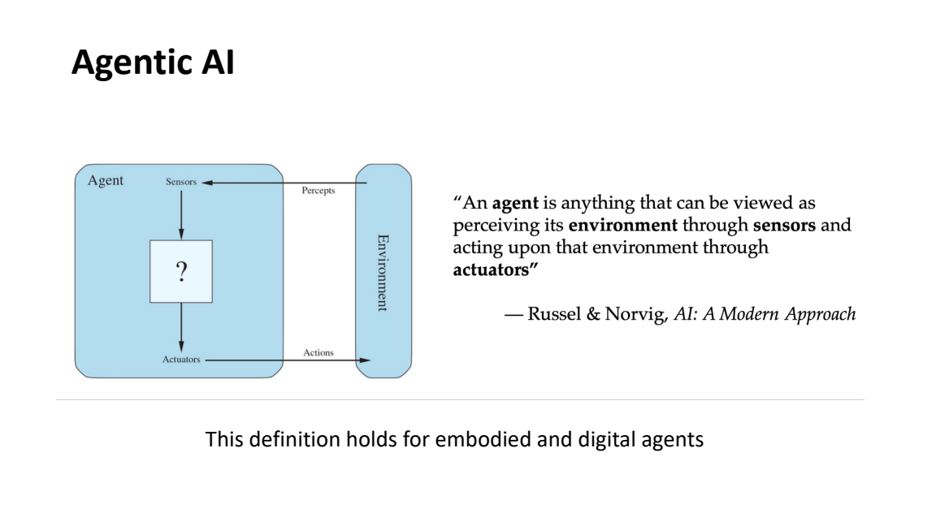
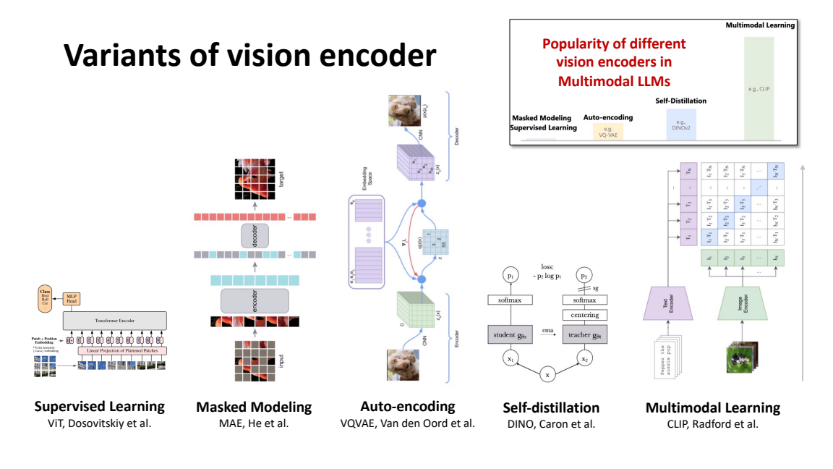
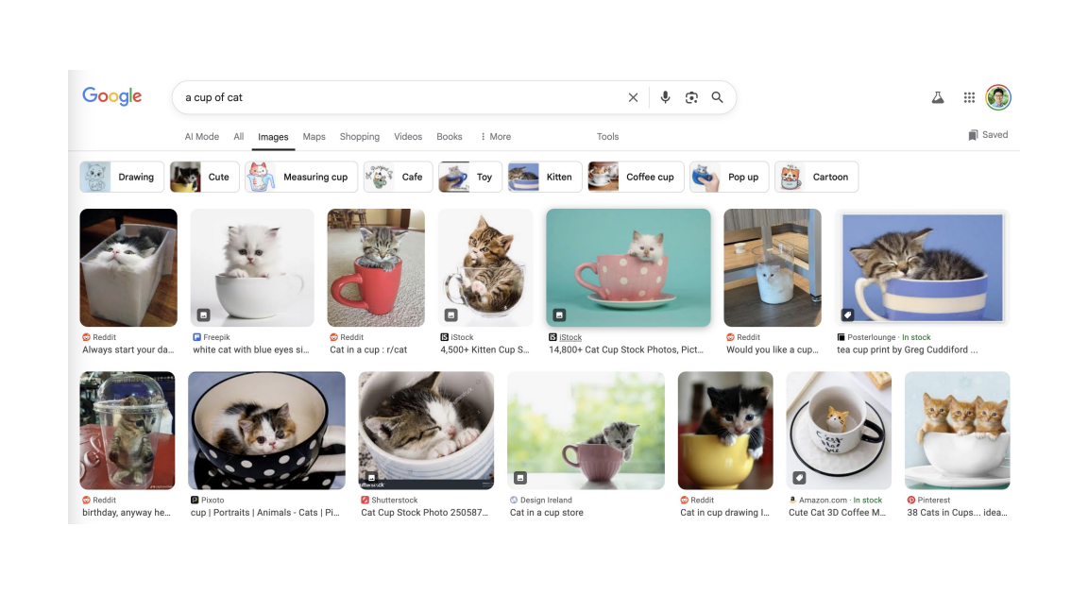
Why this project matters: slides hide meaning in visuals
The project compares an image path against a text-only baseline because extraction misses figure content.
figure definition
bar heights
image comparison
These are not decorative examples; each one carries a fact that ordinary PDF text extraction can lose.
Notes:
Explain the labeled figure-only facts: sensors/actuators, CLIP encoder dominance, and generation versus retrieval.
[Sources]
- README.md
- eval/figure-only-facts.json
- data/course/slides/Day3 Principle.pdf

Slide 5
How do we build this application
Implementation is staged so each boundary writes auditable artifacts before the next model call reads them.
Render
->
Read pages
->
Outline
->
Research
->
Review
->
Quiz
->
Memory
Currently implemented
Next implementation stages
- Strict Pydantic data schemas
- PDF render and preflight stage
- Run/memory path helpers
- Tests for schemas, paths, render, config
- Vision page reader and text baseline
- Outline, research, review writer
- Quiz, grader, topic memory, replay UI
Notes:
Emphasize that the repo is honest about status: the architecture is specified, and core scaffolding has landed.
[Sources]
- docs/spec.md
- src/study_agent/schemas.py
- src/study_agent/render.py
- src/study_agent/paths.py
- src/study_agent/config.py
- tests/

Slide 6
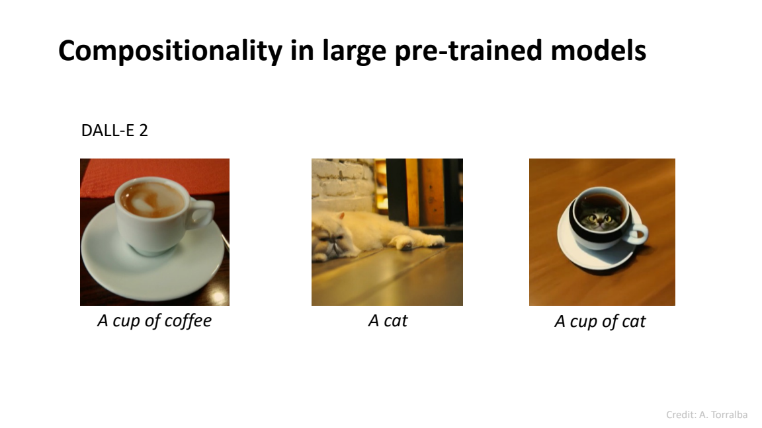
Demo and evaluation
The demo can replay a saved run; the evaluation asks whether visual facts survive into the agent's notes and quiz citations.
Demo flow
Evaluation plan
1. Upload Day 3 lecture deck
2. Watch seven stage boxes complete
3. Compare image and text reviews
4. Take quiz and see topic rollup
- Figure-only fact recovery: image vs. text
- Repeatability: 5 image re-reads per label
- Citation accuracy: quiz cites supported slides
- Known weak case reported separately
bridged fact ->
Notes:
The most important demo moment is the side-by-side comparison: generation composes concepts while retrieval returns nearest existing images.
[Sources]
- docs/spec.md
- eval/results.md
- eval/figure-only-facts.json
- data/course/slides/Day3 Principle.pdf

Slide 7
Conclusion, lessons learned, and future works
Main takeaway: treating slides as visual pages makes the study agent more faithful to how course material actually teaches.
Lessons learned
Future work
Professor-facing claim
- The schema is the agent's contract
- Visuals need their own evidence field
- Honest degraded states are better than silent failures
- Finish page reader through memory
- Commit one golden run
- Build Streamlit replay for the demo
- Expand labels beyond one course deck
The project is not just a study tool; it is a controlled test of whether multimodal input changes learning artifacts.
Next milestone: an end-to-end Day 3 run with image/text comparison artifacts ready to replay.
Notes:
Close by naming the practical next step: produce the golden Day 3 run, then use the UI to replay it in class.
[Sources]
- README.md
- CONTEXT.md
- docs/spec.md
- docs/adr/

