Slide 1
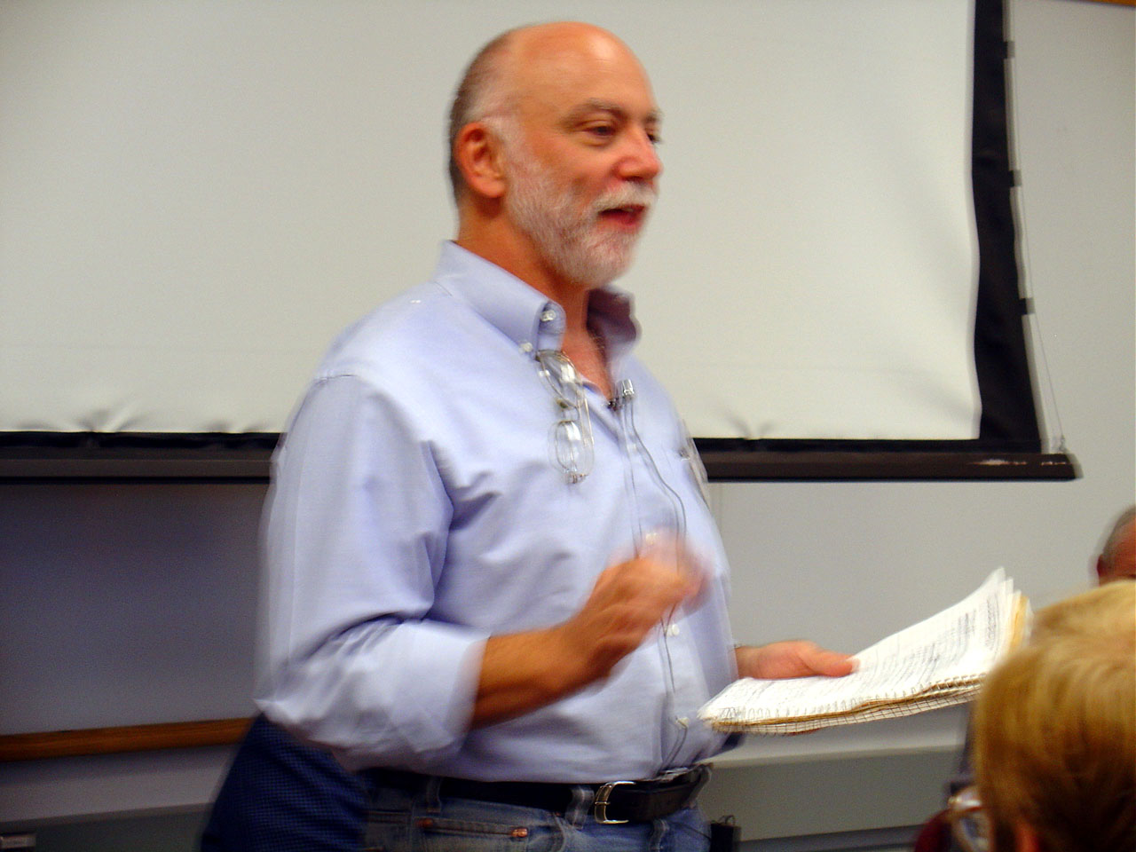
To iterate is human,
To recurse divine
L. Peter Deutsch

Slide 2
Today’s Superpower
No more loops!

Slide 3
But First…
Recursion
What is it?

Slide 4
Recursion
Informally:
Something defined in terms of itself
Thing where parts are instances of the thing
Applies to:
Code
Data
Both at the same time

Slide 5
Recursion
A
B
There’s a wire from A to B, or
There’s a wire from A to x, and x is connected to B
A is connected to B if:
W
A
X
Y
Z
B

Slide 6
Recursion
A is connected to B if:
There’s a wire from A to B, or
There’s a wire from A to x, and x is connected to B

Slide 7
function isConnected(a, b) {
if (wireBetween(a, b))
return true
for (x in outgoingConnections) {
if (isConnected(x, b))
return true
}
return false
}
A is connected to B if:
There’s a wire from A to B, or
There’s a wire from A to x, and x is connected to B

Slide 8
function isConnected(a, b) {
if (wireBetween(a, b))
return true
for (x in outgoingConnections) {
if (isConnected(x, b))
return true
}
return false
}
A
B
isConnected(A, B)
if (wireBetween(a, b))
return true
TRUE!

Slide 9
W
A
X
Y
function isConnected(a, b) {
if (wireBetween(a, b))
return true
for (x in outgoingConnections) {
if (isConnected(x, b))
return true
}
return false
}
Z
isConnected(A, B)
B
FALSE!
wireBetween(A, B)

Slide 10
W
A
X
Y
function isConnected(a, b) {
if (wireBetween(a, b))
return true
for (x in outgoingConnections) {
if (isConnected(x, b))
return true
}
return false
}
Z
isConnected(A, B)
B
wireBetween(A, B)
x = W
isConnected(W, B)
FALSE!
wireBetween(W, B)

Slide 11
W
A
X
Y
function isConnected(a, b) {
if (wireBetween(a, b))
return true
for (x in outgoingConnections) {
if (isConnected(x, b))
return true
}
return false
}
Z
isConnected(A, B)
B
wireBetween(A, B)
x = W
isConnected(W, B)
wireBetween(W, B)
x = no outgoing connections
return false
FALSE!

Slide 12
W
A
X
Y
function isConnected(a, b) {
if (wireBetween(a, b))
return true
for (x in outgoingConnections) {
if (isConnected(x, b))
return true
}
return false
}
Z
isConnected(A, B)
B
wireBetween(A, B)
x = W
isConnected(W, B)
wireBetween(W, B)
x = no outgoing connections
return false
x = X
isConnected(X, B)
FALSE!
wireBetween(X, B)

Slide 13
W
A
X
Y
function isConnected(a, b) {
if (wireBetween(a, b))
return true
for (x in outgoingConnections) {
if (isConnected(x, b))
return true
}
return false
}
Z
isConnected(A, B)
B
wireBetween(A, B)
x = W
isConnected(W, B)
wireBetween(W, B)
x = no outgoing connections
return false
x = X
isConnected(X, B)
wireBetween(X, B)
x = Z
isConnected(Z, B)
wireBetween(Z, B)
TRUE!
return true

Slide 14
W
A
X
Y
function isConnected(a, b) {
if (wireBetween(a, b))
return true
for (x in outgoingConnections) {
if (isConnected(x, b))
return true
}
return false
}
Z
isConnected(A, B)
B
wireBetween(A, B)
x = W
isConnected(W, B)
wireBetween(W, B)
x = no outgoing connections
return false
x = X
isConnected(X, B)
wireBetween(X, B)
x = Z
TRUE!

Slide 15
W
A
X
Y
function isConnected(a, b) {
if (wireBetween(a, b))
return true
for (x in outgoingConnections) {
if (isConnected(x, b))
return true
}
return false
}
Z
isConnected(A, B)
B
TRUE!

Slide 16
Recursion
Slightly more formally, recursion has:
A base case which requires no more recursion
A recursive step
A is connected to B if:
There’s a wire from A to B, or
There’s a wire from A to x, and x is connected to B
For recursion to terminate, the recursive step must take you closer to the base case.

Slide 17
Recursion
Slightly more formally, recursion has:
A base case which requires no more recursion
A recursive step
A is connected to B if:
There’s a wire from A to B, or
There’s a wire from A to x, and x is connected to B and we have not already visited x.
For recursion to terminate, the recursive step must take you closer to the base case.

Slide 18
Recursion
Is everywhere:
A base case, which requires no more recursion
A recursive step
Natural numbers (ℕ):
Base: | 0 is in ℕ
Recursive: | if x is in ℕ, then x+1 is in ℕ

Slide 19
Recursion
Is everywhere:
A base case, which requires no more recursion
A recursive step
Sum of numbers up to n:
Base: | sumUpTo(0) is 0
Recursive: | sumUpTo(n) is n + sumUpTo(n-1)

Slide 20
Recursion
Is everywhere:
A base case, which requires no more recursion
A recursive step
Definition of a list:
Base: | The constant [ ] is an (empty) list
Recursive: | A value concatenated to a list is a list

Slide 21
Recursion
Is everywhere:
A base case, which requires no more recursion
A recursive step
Length of a list:
Base: | The length of [ ] is 0
Recursive: | The length of a list with a first value and a trailing list is 1 + the length of the trailing list

Slide 22
Haskell
Sum of numbers up to n:
Base: | sumUpTo(0) is 0
Recursive: | sumUpTo(n) is n + sumUpTo(n-1)
sumUpTo 0 = 0
sumUpTo n = n + sumUpTo (n-1)

Slide 23
Haskell
Length of a list:
Base: | The length of [ ] is 0
Recursive: | The length of a list with a first value and a trailing list is 1 + the length of the trailing list
len [] = 0
len (hd : rest) = 1 + len rest

Slide 24
Quick lab...

Slide 25
Haskell
Sum of a list:
Base: | ???
Recursive: | ???

Slide 26
Haskell
Sum of a list:
Base: | The sum of [ ] is 0
Recursive: | The sum of a list with a first value n and a trailing list is n + the sum of the trailing list
This is what “length of a list” looked like
len [] = 0
len (hd : rest) = 1 + len rest

Slide 27
Haskell
Sum of a list:
Base: | The sum of [ ] is 0
Recursive: | The sum of a list with a first value n and a trailing list is n + the sum of the trailing list
sum [] = 0
sum (hd : rest) = hd + sum rest

Slide 28
Haskell Lists

Slide 29
We’ve seen this style:
Prelude> [ 1, 2, 3, 4 ]
[1,2,3,4]
It’s a shortcut for this:
Prelude> 1 : 2 : 3 : 4 : []
[1,2,3,4]

Slide 30
Prelude> 1 : 2 : 3 : 4 : []
[1,2,3,4]
Joins an element to the start of a list
:
Prelude> a = [] -- empty list
Prelude> b = 4 : a -- [ 4 ]
Prelude> c = 3 : b -- [ 3, 4 ]
Prelude> d = 2 : c -- [ 2, 3, 4 ]
Prelude> e = 1 : d -- [ 1, 2, 3, 4 ]
Prelude> e
[1,2,3,4]

Slide 31
Pattern Matching
Prelude> [ 1, 2, 3 ]
Prelude> len [ 1, 2, 3 ]
Is the same as
Prelude> len 1 : 2 : 3 : []
so
len 1 : 2 : 3 : []
len (x : xs) = 1 + len xs
Is the same as
Prelude> 1 : 2 : 3 : []
len [] = 0
len (x:xs) = 1 + len xs

Slide 32
sumList [] = 0
sumList (x:xs) = x + sumList xs
Prelude> sumList [ 1, 2, 3 ]
sumList [ 1, 2, 3 ]
sumList 1 : 2 : 3 : []
1 + sumList 2 : 3 : []
It’s as if the function is crawling down the list, leaving a result in its wake… Remember this for next week.
1 + 2 + sumList 3 : []
1 + 2 + 3 + sumList []
1 + 2 + 3 + 0
6

Slide 33
double [] = []
double (x:xs) = 2*x : double fn xs
Prelude> double [ 1, 2, 3 ]
double [ 1, 2, 3 ]
double 1 : 2 : 3 : []
It’s as if the function is applying (*2) to each element to create a new list.
2 : double (2 : 3 : [])
2 : 4 : double (3 : [])
2 : 4 : 6 : double []
[ 1, 2, 3 ]
↓ ↓ ↓
(*2) (*2) (*2)
↓ ↓ ↓
[ 2, 4, 6 ]
2 : 4 : 6 : []
[ 2, 4, 6 ]

Slide 34
Ligatures
f f
ff
diﬃcult to ﬁnd ﬂuid
f ​i
fi
f​ l
fl
...

Slide 35
You can pattern match on multiple elements at the start of a list
convertToLigatures:: String -> String
convertToLigatures [] = []
convertToLigatures ('f' : 'f' : 'i' : rest) = 'ﬃ' : convertToLigatures rest
convertToLigatures ('f' : 'f' : 'l' : rest) = 'ﬄ' : convertToLigatures rest
convertToLigatures ('f' : 'f' : rest) = 'ﬀ' : convertToLigatures rest
convertToLigatures ('f' : 'i' : rest) = 'ﬁ' : convertToLigatures rest
convertToLigatures ('f' : 'l' : rest) = 'ﬂ' : convertToLigatures rest
convertToLigatures ('i' : 'i' : rest) = 'ĳ' : convertToLigatures rest
convertToLigatures (other : rest) = other : convertToLigatures rest
main = do
putStr $ convertToLigatures "difficult to find fluid wiffle"
diﬃcult to ﬁnd ﬂuid wiﬄe

Slide 36
To Recurse is Divine
A lot of data can be recursively defined
Recursive code makes to easy to handle this data
It also eliminates many of the problems with loops for other tasks
But...
But there’s a lot of boilerplate code.
Next week: factor that out; even more functional.

Slide 37
Homework...

Slide 38
Due Tuesday, May 4
Due Tuesday, May 4
Fork and clone the repo https://github.com/Eastside-FP/dayfour You’ll be working on code the the assignment/ directory, and submitting using a pull request.
Fork and clone the repo https://github.com/Eastside-FP/dayfour. You’ll be working on code the the assignment/ directory, and submitting using a pull request.
In that directory, you’ll find the file assignment.hs.
It contains placeholders for code that you’ll write, along with a set of tests.
Update the placeholders to make them do what the description says, and so that the tests pass.
Questions? pragdave@gmail.com

