Slide 1
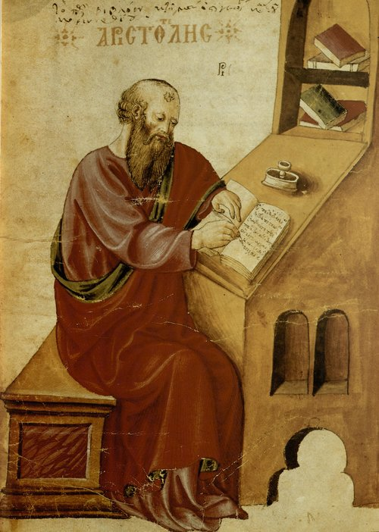
but the whole is something beside the parts…
Aristotle, talking about emergent properties

Slide 2
Today’s Superpower
Do a lot with a little by combining functions

Slide 3
But First…
Cabal
The Haskell build tool

Slide 4
≻ mkdir MyProject
≻ cd MyProject/
≻

Slide 5
≻ mkdir MyProject
≻ cd MyProject/
≻ cabal init -n --is-executable
Make this directory a Cabal project
Don’t prompt for project info
We’re building a running program

Slide 6
≻ mkdir MyProject
≻ cd MyProject/
≻ cabal init -n --is-executable
Guessing dependencies...
Generating LICENSE...
Warning: unknown license type, you must put a copy in LICENSE yourself.
Generating Setup.hs...
Generating CHANGELOG.md...
Generating Main.hs...
Generating MyProject.cabal...
Warning: no synopsis given. You should edit the .cabal file and add one.
You may want to edit the .cabal file and add a Description field.
≻

Slide 7
≻ ls
CHANGELOG.md Main.hs MyProject.cabal Setup.hs

Slide 8
≻ ls
CHANGELOG.md Main.hs MyProject.cabal Setup.hs
module Main where
main :: IO ()
main = putStrLn "Hello, Haskell!”
name: MyProject
version: 0.1.0.0
license-file: LICENSE
author: pragdave
maintainer: dave@pragdave.me
build-type: Simple
extra-source-files: CHANGELOG.md
cabal-version: >=1.10
executable MyProject
main-is: Main.hs
-- other-modules:
-- other-extensions:
build-depends: base >=4.12 && <4.13
-- hs-source-dirs:
default-language: Haskell2010

Slide 9
≻ ls
CHANGELOG.md Main.hs MyProject.cabal Setup.hs
≻ cabal v2-run
Resolving dependencies...
Build profile: -w ghc-8.6.5 -O1
In order, the following will be built (use -v for more details):
- MyProject-0.1.0.0 (exe:MyProject) (first run)
Configuring executable 'MyProject' for MyProject-0.1.0.0..
Warning: The 'license-file' field refers to the file 'LICENSE' which does not
exist.
Preprocessing executable 'MyProject' for MyProject-0.1.0.0..
Building executable 'MyProject' for MyProject-0.1.0.0..
[1 of 1] Compiling Main ( Main.hs, /home/dave/Me/EastSide2021/daythree/code/MyProject/dist-newstyle/build/x86_64-linux/ghc-8.6.5/MyProject-0.1.0.0/x/MyProject/build/MyProject/MyProject-tmp/Main.o )
Linking /home/dave/Me/EastSide2021/daythree/code/MyProject/dist-newstyle/build/x86_64-linux/ghc-8.6.5/MyProject-0.1.0.0/x/MyProject/build/MyProject/MyProject ...
Hello, Haskell!

Slide 10
≻ cabal v2-run
Resolving dependencies...
Build profile: -w ghc-8.6.5 -O1
In order, the following will be built (use -v for more details):
- MyProject-0.1.0.0 (exe:MyProject) (first run)
Configuring executable 'MyProject' for MyProject-0.1.0.0..
Warning: The 'license-file' field refers to the file 'LICENSE' which does not
exist.
Preprocessing executable 'MyProject' for MyProject-0.1.0.0..
Building executable 'MyProject' for MyProject-0.1.0.0..
[1 of 1] Compiling Main ( Main.hs, /home/dave/Me/EastSide2021/daythree/code/MyProject/dist-newstyle/build/x86_64-linux/ghc-8.6.5/MyProject-0.1.0.0/x/MyProject/build/MyProject/MyProject-tmp/Main.o )
Linking /home/dave/Me/EastSide2021/daythree/code/MyProject/dist-newstyle/build/x86_64-linux/ghc-8.6.5/MyProject-0.1.0.0/x/MyProject/build/MyProject/MyProject ...
Hello, Haskell!
≻ cabal v2-run
Up to date..
Hello, Haskell!

Slide 11
Using External Libraries
Two-step process:
Getting them onto your machine
Adding them to your project

Slide 12
Using External Libraries
≻ cabal v2-install gloss
Resolving dependencies...
Up to date
Two-step process:
Getting them onto your machine
Adding them to your project

Slide 13
Using External Libraries
MyProject.cabal
name: MyProject
version: 0.1.0.0
license-file: LICENSE
author: pragdave
maintainer: dave@pragdave.me
build-type: Simple
cabal-version: >=1.10
executable MyProject
main-is: Main.hs
build-depends: base >=4.12 && <4.13
Two-step process:
Getting them onto your machine
Adding them to your project

Slide 14
Using External Libraries
MyProject.cabal
name: MyProject
version: 0.1.0.0
license-file: LICENSE
author: pragdave
maintainer: dave@pragdave.me
build-type: Simple
cabal-version: >=1.10
executable MyProject
main-is: Main.hs
build-depends: base >=4.12 && <4.13, gloss
name: MyProject
version: 0.1.0.0
license-file: LICENSE
author: pragdave
maintainer: dave@pragdave.me
build-type: Simple
cabal-version: >=1.10
executable MyProject
main-is: Main.hs
build-depends: base >=4.12 && <4.13, gloss
Two-step process:
Getting them onto your machine
Adding them to your project
build-depends: base >=4.12 && <4.13, gloss

Slide 15
Gloss
Simple Haskell Graphics Library

Slide 16
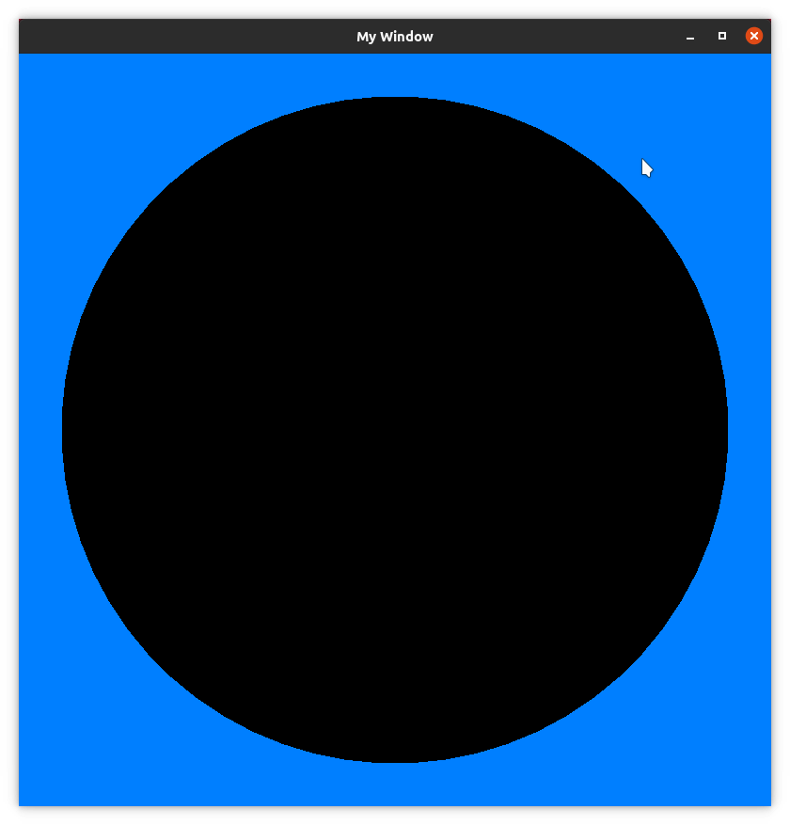
Main.hs
module Main where
import Graphics.Gloss
main = display windowed azure (circleSolid 350)
where
windowed = (InWindow "My Window" (800, 800) (10, 10))

Slide 17
Main.hs
module Main where
import Graphics.Gloss
main = display windowed azure (circleSolid 350)
where
windowed = (InWindow "My Window" (800, 800) (10, 10))

Slide 18
Main.hs
Hey, Gloss: display the following…
And here’s what to draw
module Main where
import Graphics.Gloss
main = display windowed azure (circleSolid 350)
where
windowed = (InWindow "My Window" (800, 800) (10, 10))
Here’s where you display it
Use this background

Slide 19
Main.hs
module Main where
import Graphics.Gloss
main = display windowed azure (circleSolid 350)
where
windowed = (InWindow "My Window" (800, 800) (10, 10))
In a window (not full screen)
size
coord of top-left
Window title

Slide 20
Main.hs
module Main where
import Graphics.Gloss
main =
display windowed azure drawing
where
windowed = InWindow . . .
drawing = circleSolid 350

Slide 21
Main.hs
module Main where
import Graphics.Gloss
face =
circleSolid 350
main =
display windowed azure drawing
where
windowed = InWindow "My Window" (800, 800) (10, 10)
drawing = face

Slide 22
Main.hs
module Main where
import Graphics.Gloss
face =
circleSolid 350
hub =
color orange $ circleSolid 40
main =
display windowed azure drawing
where
windowed = InWindow "My Window" (800, 800) (10, 10)
drawing = pictures [
face,
hub
]

Slide 23
What’s Going On?
The 3rd parameter to display is the picture to display. It is a value of type Picture.
circleSolid is a function that takes a number (the radius) and returns a Picture
circleSolid :: Float -> Picture
color is a function that takes a Color and a Picture, and returns a new Picture drawn in that color
color :: Color -> Picture -> Picture

Slide 24
What’s Going On?
circleSolid :: Float -> Picture
color :: Color -> Picture -> Picture
color orange $ circleSolid 40
Picture
Picture

Slide 25
Seems backwards!
circleSolid :: Float -> Picture
color :: Color -> Picture -> Picture
color orange $ circleSolid 40
Picture
Picture

Slide 26
Not part of Haskell
I want to write
So let’s add it
circleSolid 40 |> color orange
|> is an operator that takes what’s on the left and adds it as a parameter to what’s on the right
Sounds pretty complex...
(|>) x f = f x
color orange (circleSolid 40)

Slide 27
Main.hs
module Main where
import Graphics.Gloss
(|>) x f = f x -- forward pipeline
face =
circleSolid 350
hub =
circleSolid 40
|> color orange
main =
display windowed azure drawing
where
windowed = InWindow "My Window" (800, 800) (10, 10)
drawing = pictures [
face,
hub
]

Slide 28
Main.hs
face =
circleSolid 350
hand =
rectangleSolid 5 340
|> color yellow
|> translate (-2.5) 170
hub =
circleSolid 40
|> color orange
main =
display windowed azure drawing
where
windowed = InWindow "My Window" (800, 800) (10, 10)
drawing = pictures [
face,
hand,
hub
]

Slide 29
Boring!
Let’s animate it
(Remember I said early on: ease of change is the driver of good design…)

Slide 30
Main.hs
face =
circleSolid 350
hand seconds =
rectangleSolid 5 340
|> color yellow
|> translate (-2.5) 170
|> rotate (seconds * 6)
hub =
circleSolid 40
|> color orange
main =
animate windowed azure renderer
where
windowed = InWindow "My Window" (800, 800) (10, 10)
renderer seconds =
pictures [
face,
hand seconds,
hub
]
Use animate instead of display. (this calls the 3rd parameter at intervals, passing in the elapsed number of seconds)
3
Pass the number of seconds to the hand drawing code.
4
Accept the parameter
Use it to rotate the hand.
1
2

Slide 31
Main.hs
face =
circleSolid 350
hand seconds =
rectangleSolid 5 340
|> color yellow
|> translate (-2.5) 170
|> rotate (seconds * 6)
hub =
circleSolid 40
|> color orange
main =
animate windowed azure renderer
where
windowed = InWindow "My Window" (800, 800) (10, 10)
renderer seconds =
pictures [
face,
hand seconds,
hub
]
Data flows through transformations
Forward pipelines ( |> ) make flow explicit
Type checking ensures interfaces between transformations are correct

Slide 32
Homework...

Slide 33
Due Tuesday, April 27
Fork and clone the repo https://github.com/Eastside-FP/daythree You’ll be working on code the the assignment/ directory, and submitting using a pull request.
Fork and clone the repo https://github.com/Eastside-FP/daythree. You’ll be working on code the the assignment/ directory, and submitting using a pull request.
In that directory, you’ll find a version of the code we developed in class. Before you change anything, use cabal v2-run to make sure it runs for you.
The four parts of the assignment are on the next slide. Before you tackle them, take a moment to think about the ideas of pipelines and transformations. Each of the parts can be solved in many ways, and different parts have different styles of solution. But see if you can identify and express some of those solutions as transformations.
Questions? pragdave@gmail.com

Slide 34
Due Tuesday, April 27
The hand currently takes 60s to complete a revolution, because it treats the animation time (seconds) as the time to display. Change the code so that our internal time is 30 times faster than animation time. Think about how this change can be expressed in a functional way (as a transformation).
Add another hand that rotates 60 times slower than the first. Try to reuse existing code as much as possible, rather than just copying the hand function.
Add a time display that shows the value of our internal time as mm:ss. The seconds field should display 0 to 59 as the second hand sweeps, and the minute field will increase by one for each of the second hand’s revolutions. (You’ll need to search https://hackage.haskell.org/ for useful functions)
Split the time display, and show the seconds by the end of the second hand, and the minutes by the minutes hand. You choose whether the numbers are shown horizontally or parallel to the hand.
Questions? pragdave@gmail.com

