Slide 1
QUIZ APPLICATION
Group Members:
Amar Singh– TEITB 35
Parth Singh – TEITB 37
Shubham Singh – TEITB 39

Slide 2
Introduction
Learning through games is fun thing to do. Keeping that in mind we have developed a quiz application using latest technologies.
This game consist of questions which challenge students to learn about mongoDB database.
Questions are developed keeping concepts in mind.

Slide 3
Project Description
The Project can be described via the following functionalities:
a. Quiz Card : Displaying Questions
b. Answer Verification : Verifying Answers
c. Score Component : Maintaining score of the user.
d. Percentage : For result declaration.

Slide 4
Technology Stack
HTML : For the basic layout of the Web Page
CSS : To style the HTML elements
React.js : Powerful Front end Library to design the components and make the page attractive
Node JS: Powerful JavaScript runtime environment.
JavaScript: For Validation purpose.

Slide 5
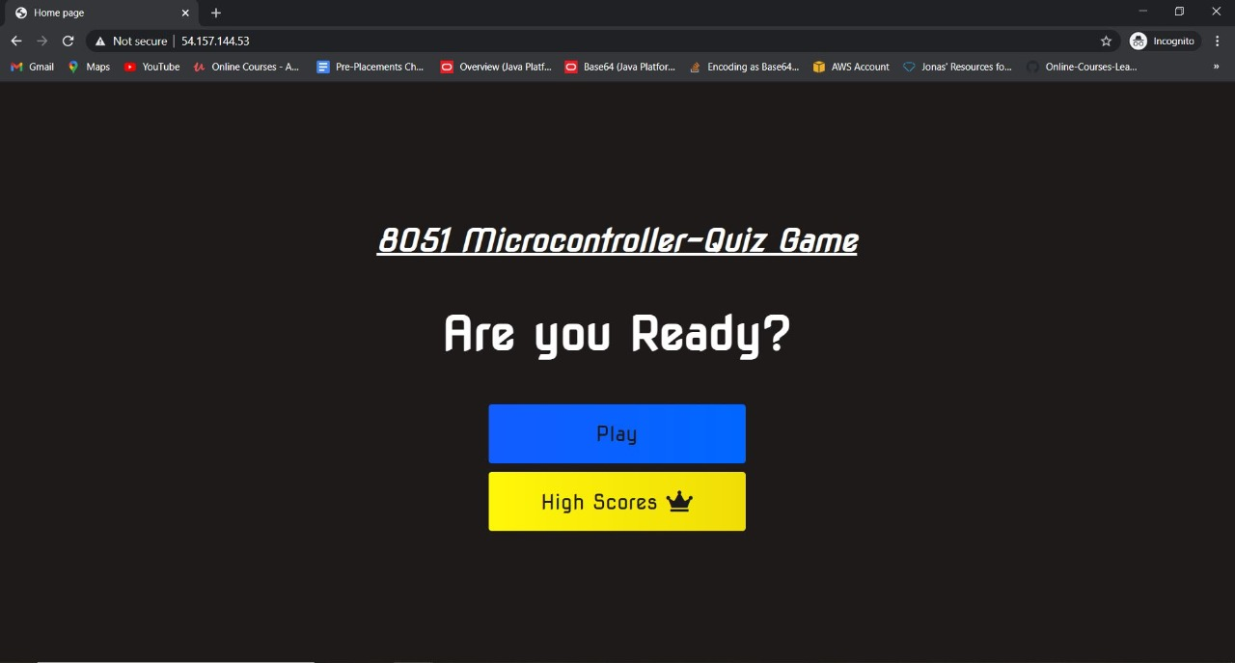
Our Project

Slide 6
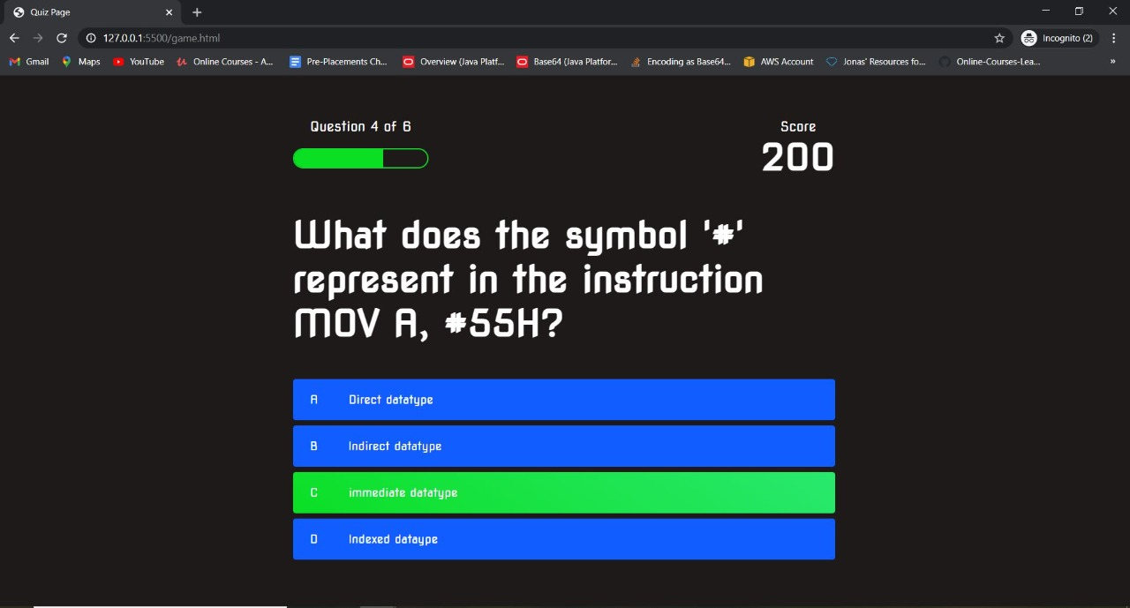
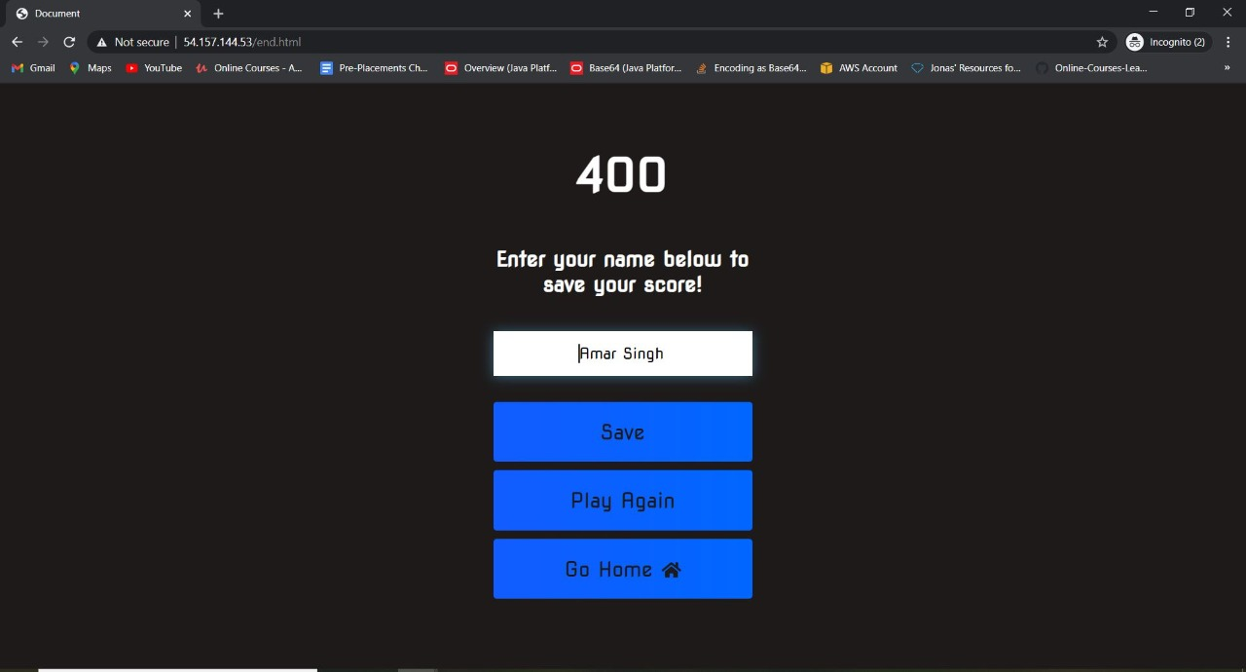

Slide 7
Conclusion
LET US SHOW THE GAME FOR THE CONCLUSION

Slide 8
THANK YOU

